Slide 2
Demonstration Kit

Slide 3
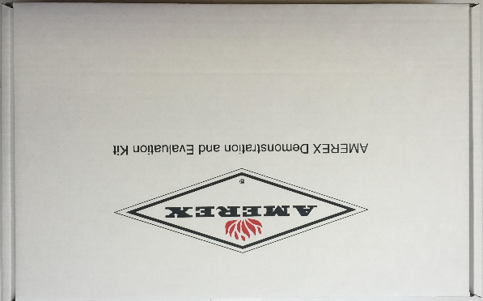
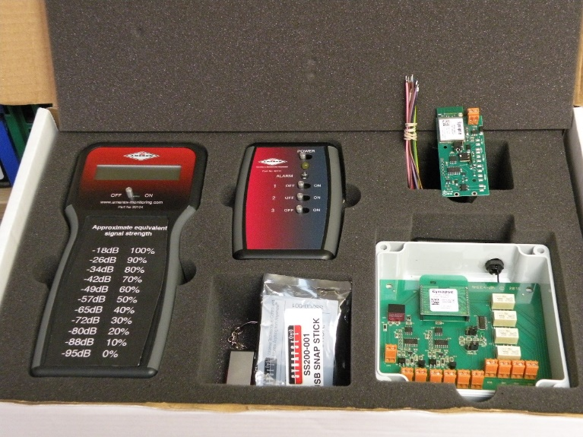
The Kit
The kit is made up of;
Signal Strength Meter
Test Box
Single analogue board
Dual analogue board
Snap Stick
Memory stick
Battery pack

Slide 4

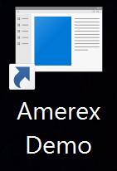
Memory Stick
Insert Red memory stick it in one of the USB ports on your laptop.
Open the memory stick and copy all the files into a folder on your desktop.
Open the folder ‘DemoSetupV1_5’ , click on this folder and double click the ‘DemoSetup’ file. This will download the AMEREX Integrated demo. It will also add a icon which is the shortcut to run this application
Do the same with the Portal-setup-2.5.0 on the memory stick. Again it will add and icon to your desktop

Slide 5
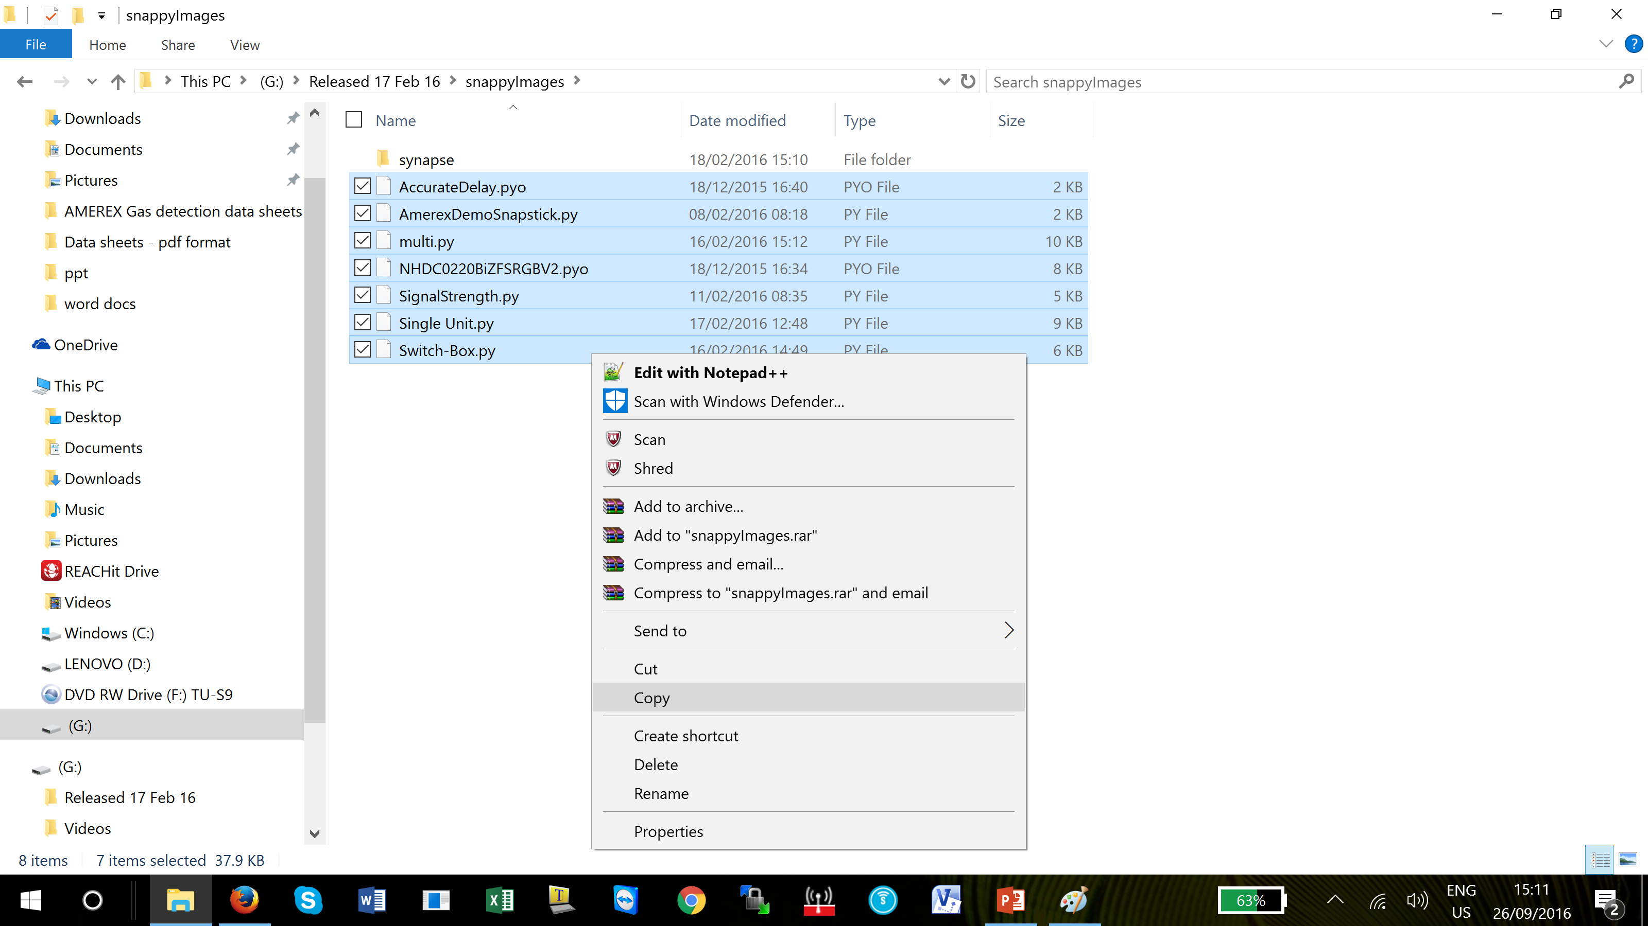
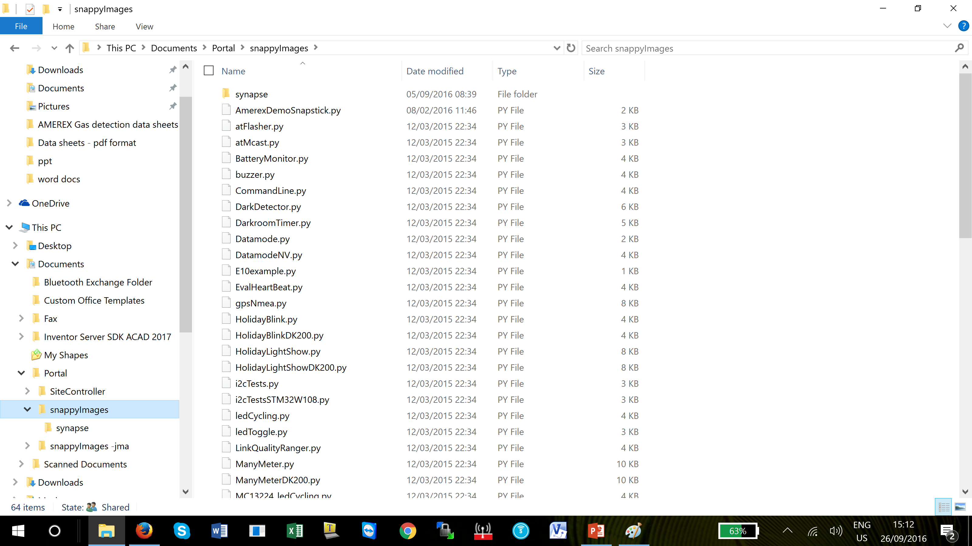
SnappyImage Files
In the memory stick open the folder called ‘snappyImages’ and copy all the files in this folder.
Now open ‘Documents’ folder and the ‘My Documents’ You will see the Portal folder open this and copy all the snappyImage files into the snappyImage folder. It will overwrite the other files and this is ok.
Notes:
Your PC/Laptop may look different to mine

Slide 6
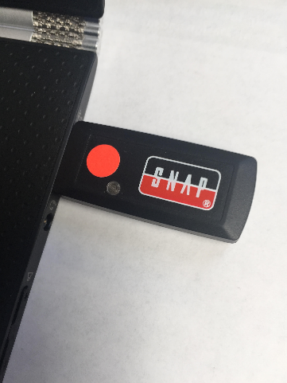
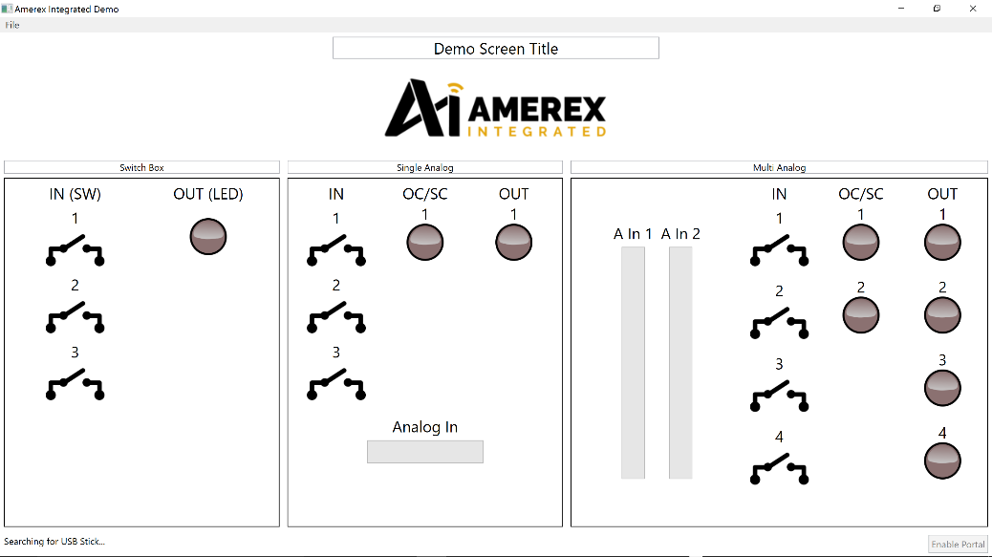
Snap Stick
The AMEREX Integrated Snap Stick is used to connect the modules/nodes to the demonstration control Panel.
Insert the Snap Stick with the red dot into a USB port.
Click the Amerex Demo icon.
The LED will flash Green indicating the stick is connected to a mesh node.
By activating the switches and analogue inputs you will see the virtual switches in the different sections of the demo window change state.
Notes:
The AMEREX Integrated Snap Stick is used to connect the modules/nodes to the demonstration control Panel.
Insert the Snap Stick with the red dot into a USB port. Click the Amerex Demo icon. The LED will flash Green indicating the stick is connected to a mesh node.
By activating the switches on the test box you will see the virtual switches in the switch box section change state.

Slide 7
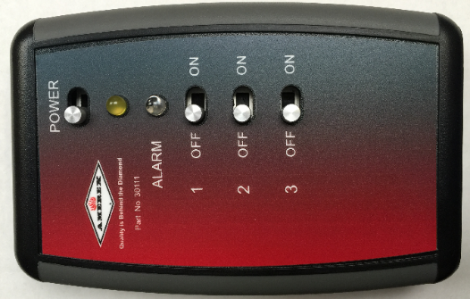
Test Box
Switch the power switch to the right and the Yellow LED will flash.
The test box is now ready to connect to the Control panel screen.
Each switch controls a switch icon on the GUI and the Alarm LED is activated when the monitored input of the dual unit is set.
Notes:
The next slides describe the different types of equipment contained in the Demo box. The test box/switch box is a three digital input unit only and is used in conjunction with the signal strength meter to plan networks.

Slide 8
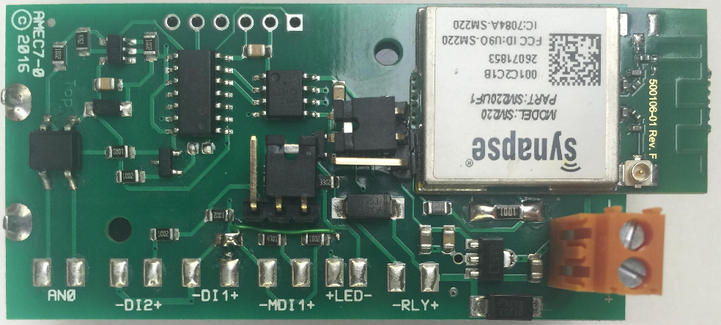
Analogue input boards
30110
Board designation AMEC7
Single analogue and 3 digital inputs
Single monitored digital input (this input can be selected as switch inputs without monitoring). Red circle
Jumpers for monitoring or switch inputs. Yellow circle
Dual digital inputs – no monitoring DI1 and DI2
30110 – Single analogue and dual digital inputs
Notes:
The 30109 unit only has the capacity for 24v d.c. The 30110 does have a facility to run on batteries (two AA batteries) but we do not recommend this for any long periods of time – for testing and trouble shooting only.

Slide 9
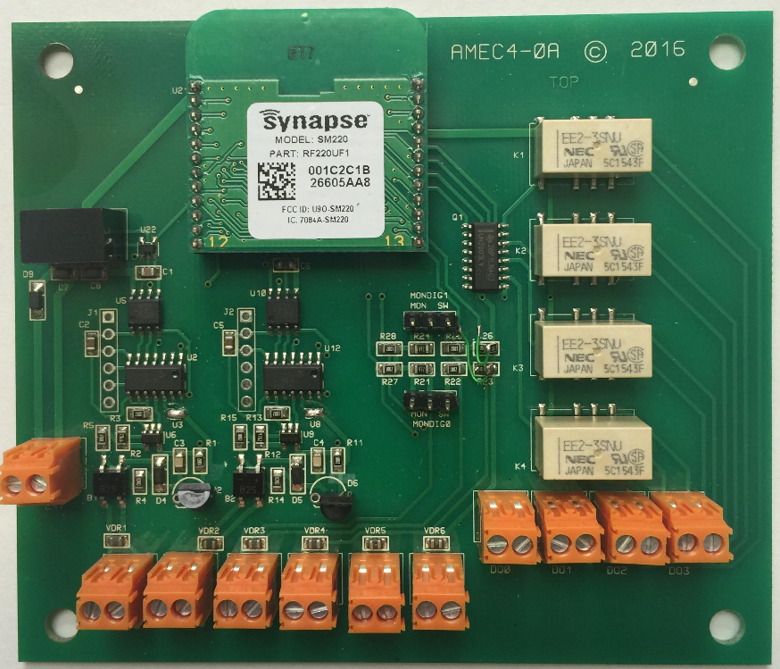
Analogue input boards
30109
Board designation AMEC4
Dual analogue and 4 digital inputs
Dual monitored digital inputs (these inputs can be selected as switch inputs without monitoring). Red circle
Jumpers for monitoring or switch inputs. Yellow circle
Dual digital inputs – no monitoring
24v d.c input
Relay Outputs
Analogue and Digital Inputs
Notes:
The 30109 unit only has the capacity for 24v d.c. The 30110 does have a facility to run on batteries (two AA batteries) but we do not recommend this for any long periods of time – for testing and trouble shooting only.

Slide 10
Jumper Settings
The single analogue input board has 24v. d.c /Batt (yellow circle) and one monitored or digital jumper (Orange circle). The red circle is the monitored digital inputs.
24v d.c input
Relay Outputs
Analogue and Digital Inputs
The yellow circle on the dual analogue input board has only monitored or digital jumper settings. The red circle are the monitored digital inputs

Slide 11
Monitored Inputs
This board has two resistors mounted on the PCB, they are to simulate (if required) the OC/SC on the AMEREX Integrated Demonstration screen.
To use this function, ensure the jumper above MDI1 is set to ‘MON’. Connect the PCB as shown.

Slide 12
Monitored Inputs
When the MDI1 line is shorted (SC) the LED in the middle window (Single Unit) will illuminate. If one of the lines to the PCB is disconnected (OC) the LED again will illuminate.
The same action is used for the Dual unit whereby the jumpers must be set to ‘MON’ and the EOL PCB is connected to the MDI1 and or MDI2 connectors.

Slide 13
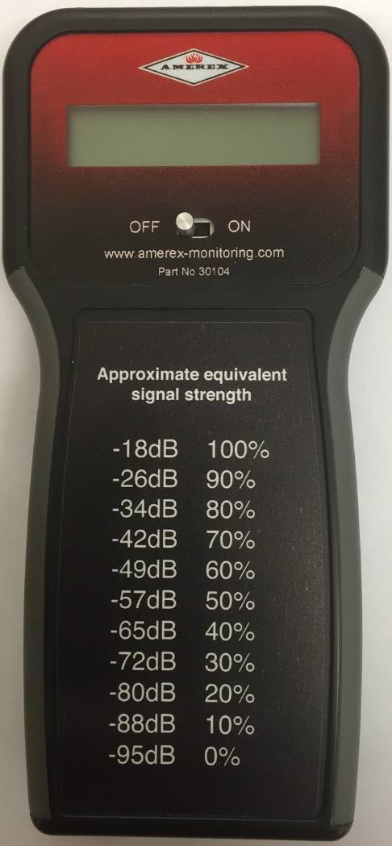
Signal Strength Meter
The signal strength meter is a tool to monitor and measure the signal strength (Line Quality %) of the connection between
Received signal strength from the receiving node in percentage terms (%).
For example;
‘Tx Sig Strength 58%’
‘Rx Sig Strength 65%’
The colour of the display will change depending on the signal strength of the signal strength. The colours are Red and Green
Notes:
The SSM is a useful tool when planning the network.

Slide 14
The GUI can be edited by clicking on the areas marked by the
Yellow circles and can saved by using the ‘File’ tab shown in Red
Notes:
You can edit in the yellows areas

Slide 16
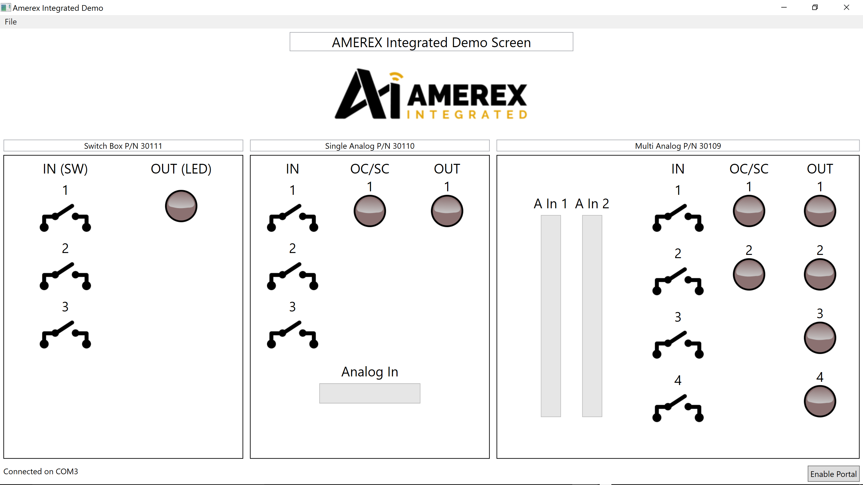
The Snap Stick has been seen by the AMEREX software and is ready to use.
Notes:
As you can see the Snap Stick has been seen by the AMEREX software and is ready to use.

Slide 17
From the AMEREX demo screen you can also access ‘Portal’ which is the setting up and commissioning software for our network.
Click on the ‘Enable Portal’ tab and you will asked if you wish to go to Portal – click OK
You can now open Portal
Snap Stick
Notes:
Portal will be covered by another slide show

Slide 18
K
E
C
J
H
A
E
J
B
F
K
K
H
C
G
L
L
D
M
M
H
I
Notes:
This slide shows the switches with letters – the key for the following matrix

Slide 19
Demonstration Matrix
The matrix shows the switching program for the demo kit.
Notes:
Matrix showing different combinations of switches and analogue inputs and outputs

Slide 20
Applications
Notes:
Open floor – students to think of applications

Slide 21
Return

