Slide 2
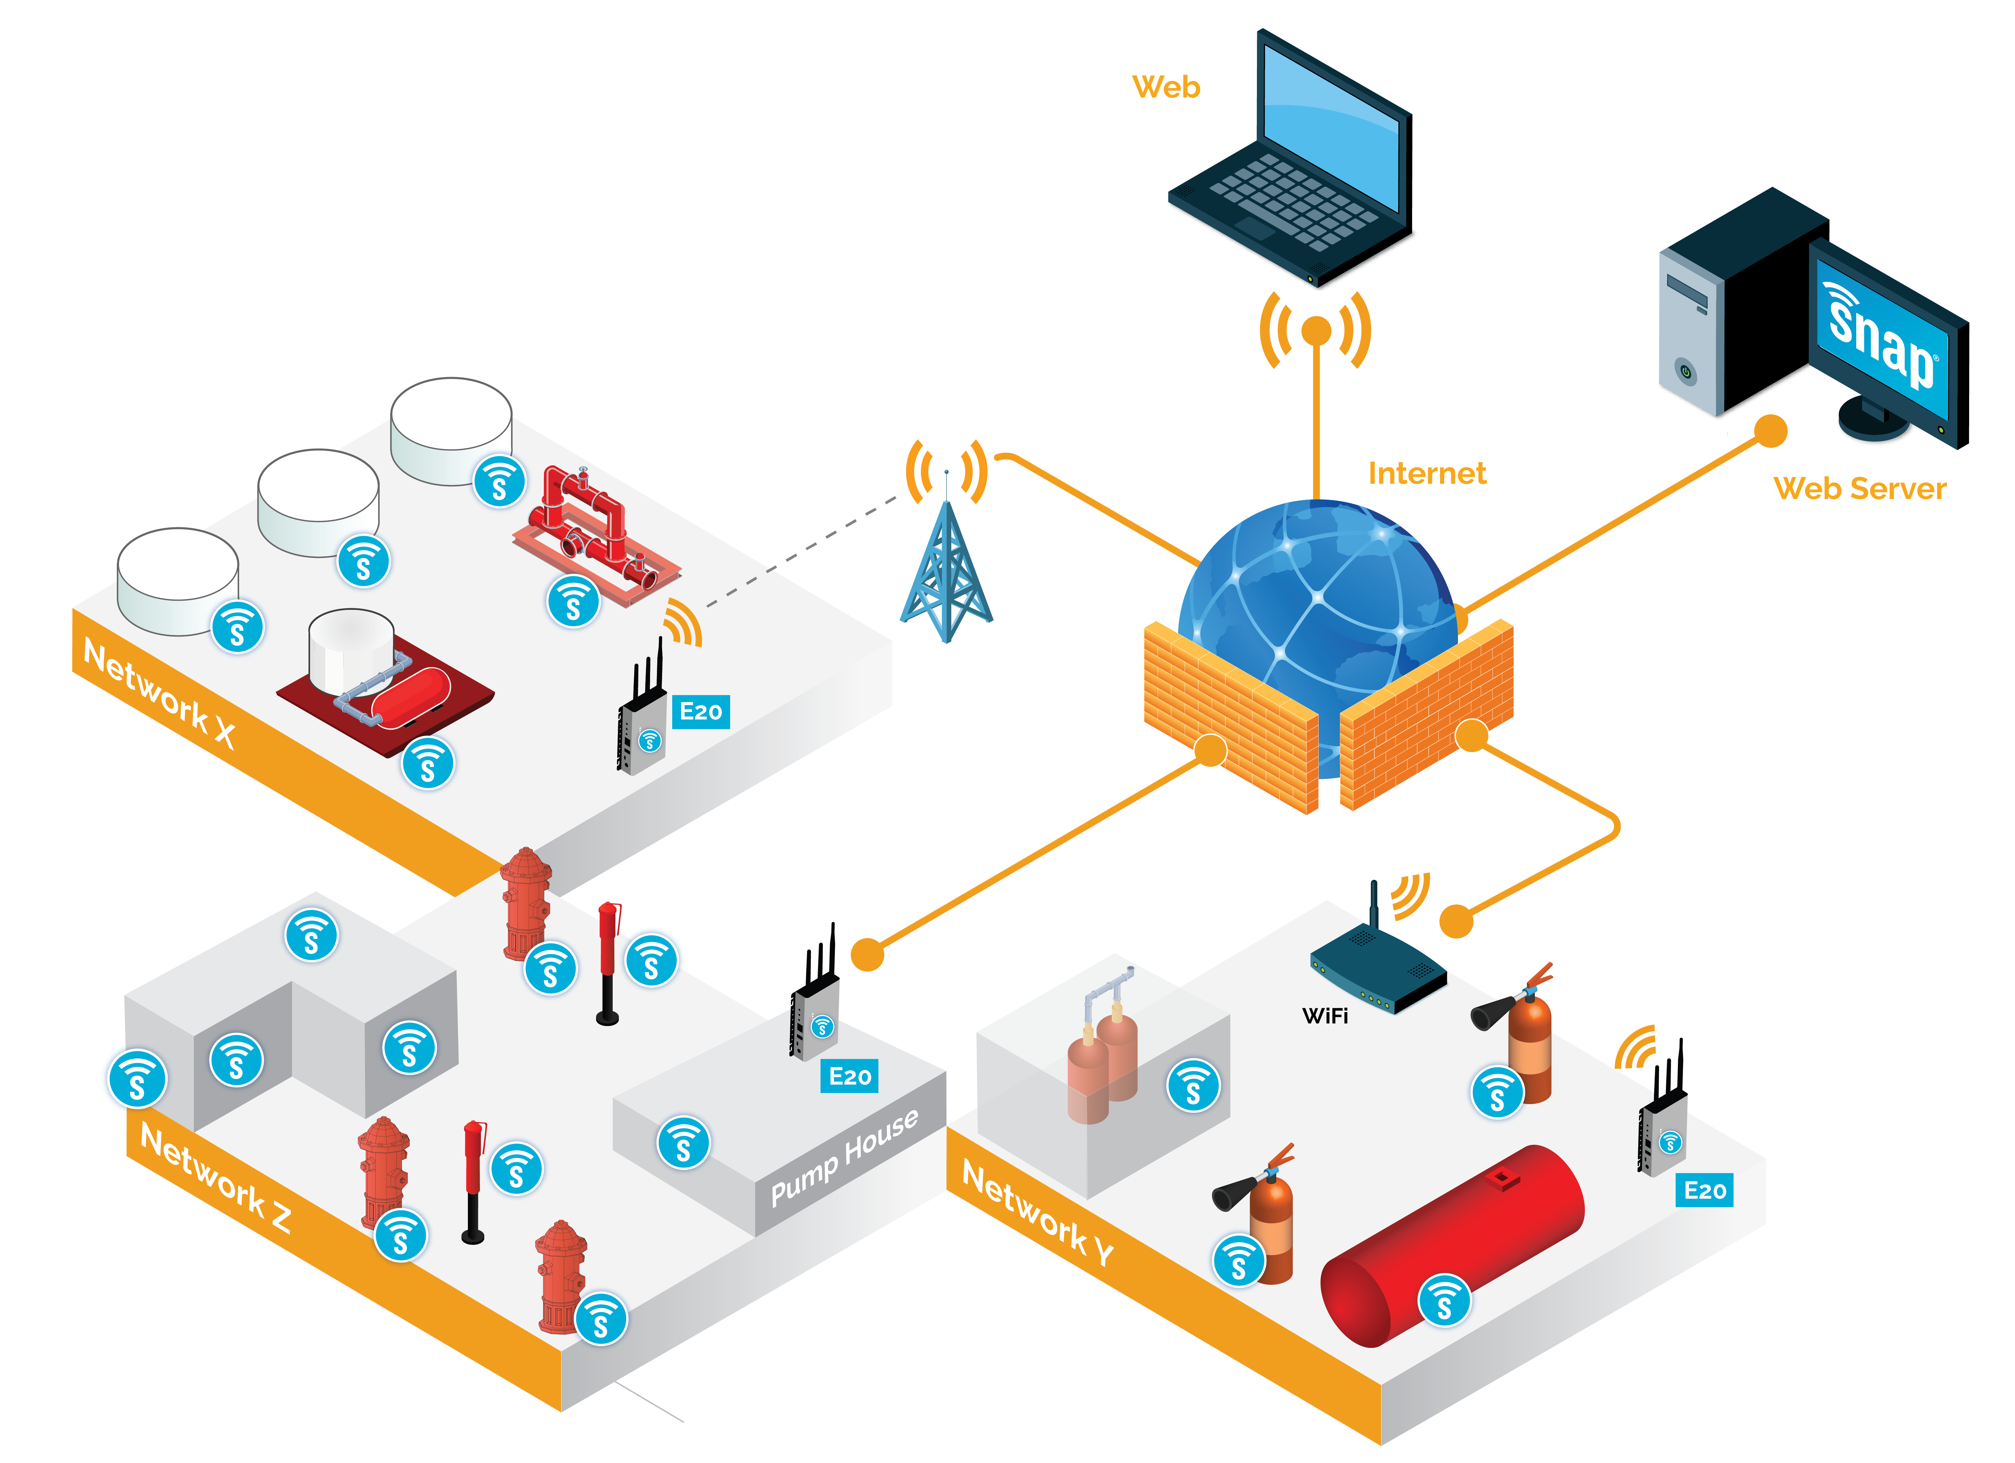
The AMEREX Integrated Mesh network training

Slide 3
Schedule
Day 1
Introductions
Enrolment
Documentation
Day 3
Recap on day 2
Portal
Setting up nodes
Setting up the site controller
Applications/Installations
Day 2
Demonstration kit
AMEREX Integrated demo GUI
Portal
Applications
Day 4
Recap on day 3
AIMs
Examination

