Slide 2
Portal Software
Setting up, Testing
and Commissioning

Slide 3
Portal
The Portal Environment
Portal is the desktop environment used to conﬁgure and deploy a SNAP network.
It provides a user customizable interface to aid in developing your SNAPpy scripts.
All Portal’s windows can be resized, relocated, and enabled/disabled to conﬁgure the environment as needed.

Slide 4
Portal
The Portal Environment
Initializing Portal for the ﬁrst time, opens in a default window conﬁguration as shown below.
Portal has been recognized with the standard address 00.00.01. This is Portal’s network address.
All devices have a network address
The network address is the last 6 digits of the
Mac Address.

Slide 5
Portal
The Portal Environment
Initializing Portal for the ﬁrst time, opens in a default window conﬁguration as shown below. You can see Portal has been recognized with the standard address 00.00.01.
This is Portal’s network address. All devices have a network address and once a device is connected to the network the network address will appear in the ‘Network Address’ column. The network address is the last 6 digits of the Mac Address.

Slide 6
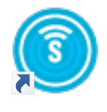
Connecting to Portal
We are assuming Portal and the AMEREX Demo software has been loaded on the PC/laptop, the AMEREX Snapstick is inserted in a USB port and the snappyimages have been copied into …My Documents/Portal/snappyImages.
If not go back to the Demo kit slides and install this software.
To open Portal click on the icon and
Portal shall appear in the default state.
If the window appears which is not the one shown don’t worry, the windows can be moved, changed etc. to suit your particular requirements.

Slide 7
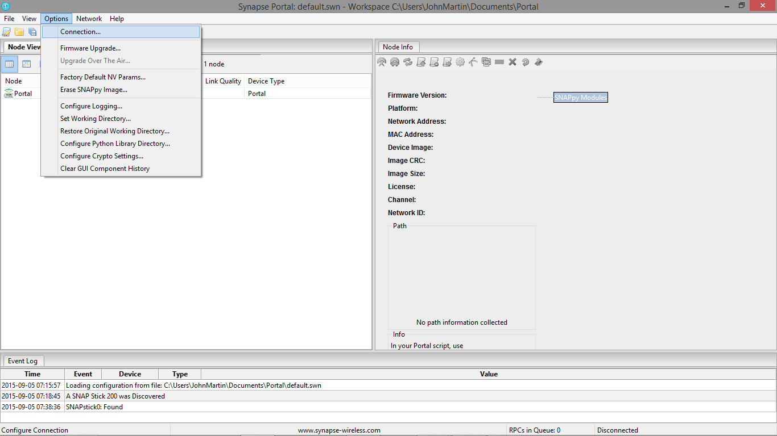
Connecting to the Snapstick
Select from the ‘Options’ drop down menu – ‘Connection’…..

Slide 8
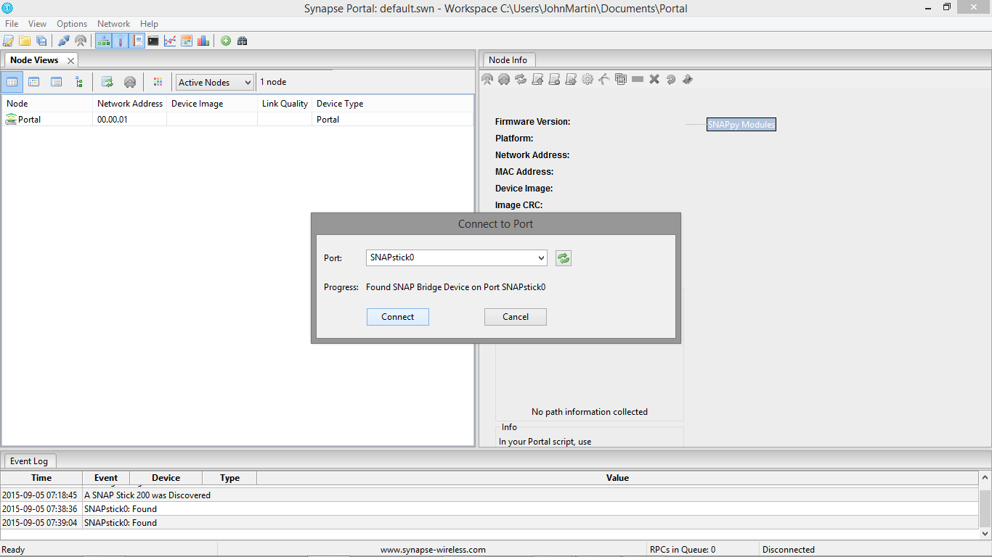

Connecting to the Snapstick
A pop up window will appear asking you to connect to the SnapStick.
Click on ‘Connect’ button.
If no SnapStick appears in the ’Port’ window click on the Refresh logo in the ‘Connect to Port’ window

Slide 9
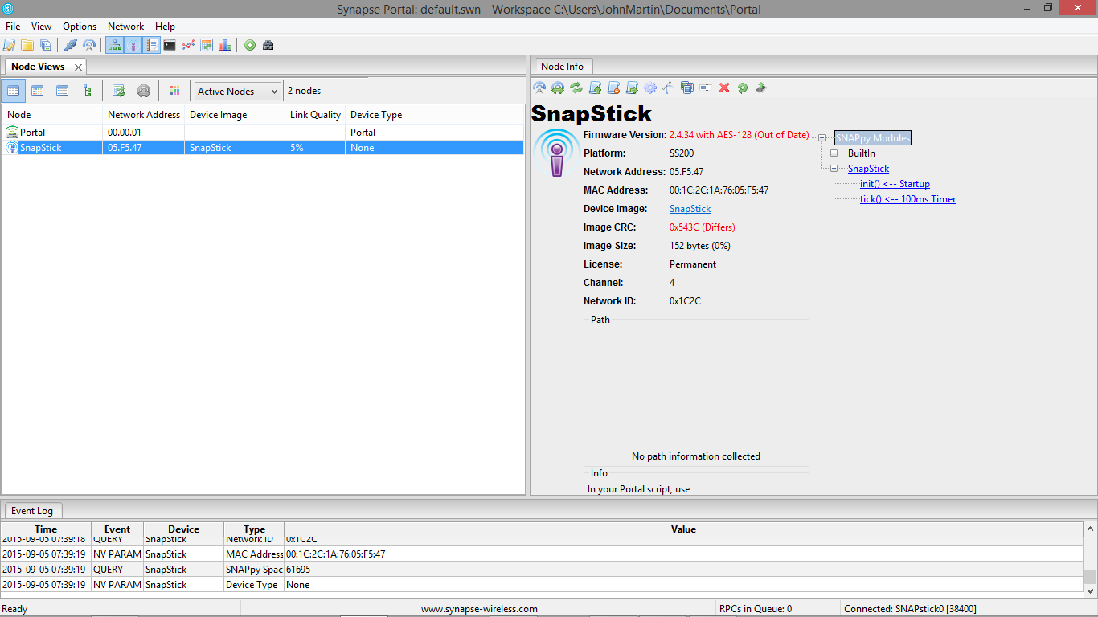
Connecting to the Snapstick
Click on ‘Connect’, the information contained within the node (Snap Stick) will appear in the Node Info window.
As you can see in this case the network address is 05.F5.47
You are now ready to connect Portal to the network nodes.

Slide 10
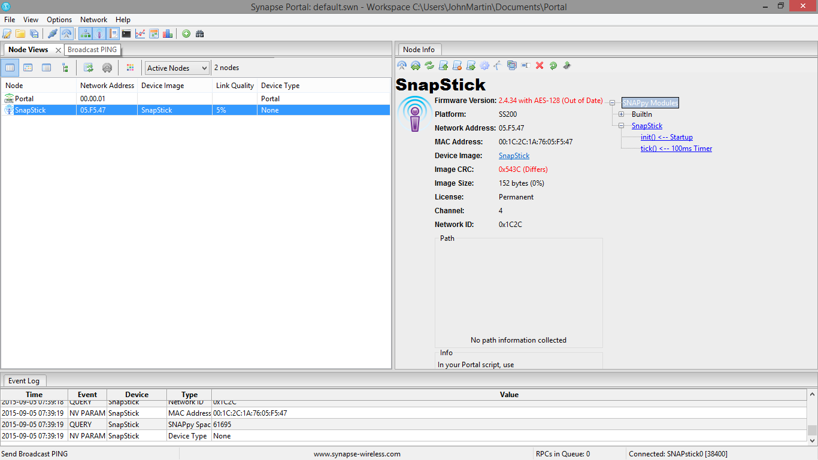
Connecting to the network nodes
Any node(s) connected to the network should automatically appear in the Node View window of Portal.
If they do not, click on the ‘Broadcast PING’ Icon below the Option command bar.

Slide 11
Connecting to the network nodes
Any node(s) connected to the network should automatically appear in the Node View window of Portal.
If they do not, click on the ‘Broadcast PING’ Icon below the Option command bar.

Slide 12
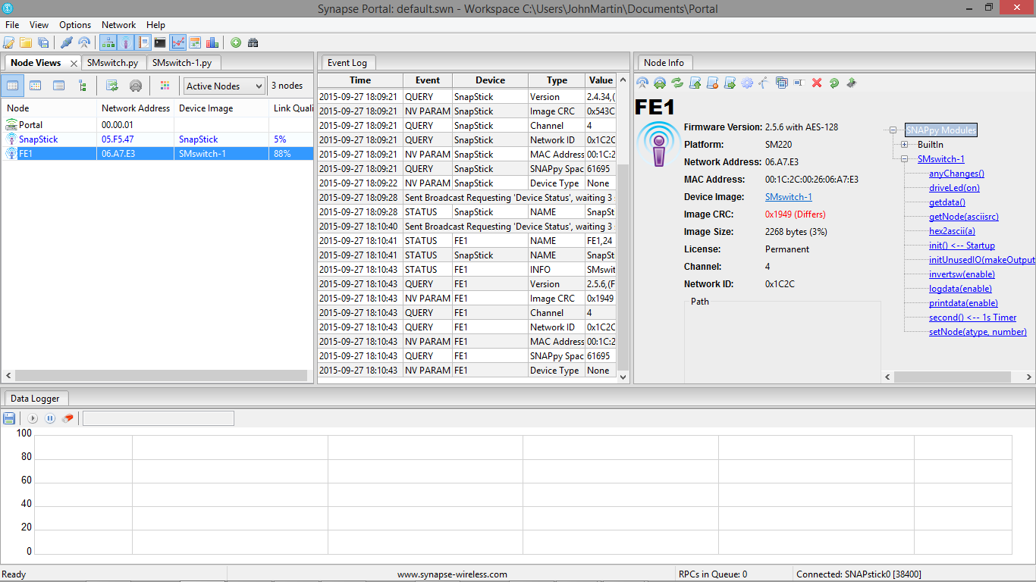
Connecting to the network nodes
By clicking on the individual nodes in ‘Node View’ window, the detailed node information will be shown in the Node Info’ window.
This shows one node (FE1) that is connected to the network.
This is the SnappyImage for this node
Notes:
Note - Your node may have another name such as Node 1.

Slide 13
Connecting to the network nodes
The screen shot shows, ‘Node Views’ panel indicates which nodes are on the network.
‘Event log’ (shows what has happened on the network)
‘Node info’ indicates what information is held on the node which is highlighted the ‘Node View’ window.

Slide 14
Connecting to the network nodes
As you can see we have added Data Logger window.
The windows can be adjusted to suit the individual, and new windows can be added by clicking on the appropriate icon.

Slide 15
Connecting to the network nodes
Grab the window tab (Node View) by right clicking the mouse key and move it around the screen to where you wish to place it.
Release the tab by releasing the right hand mouse key.

Slide 16
Line Quality Value
In the Node Views there is a Line Quality figure – this is equivalent to signal strength so it should be as high as possible.
This screen shot gives LQ of 88%.

Slide 17
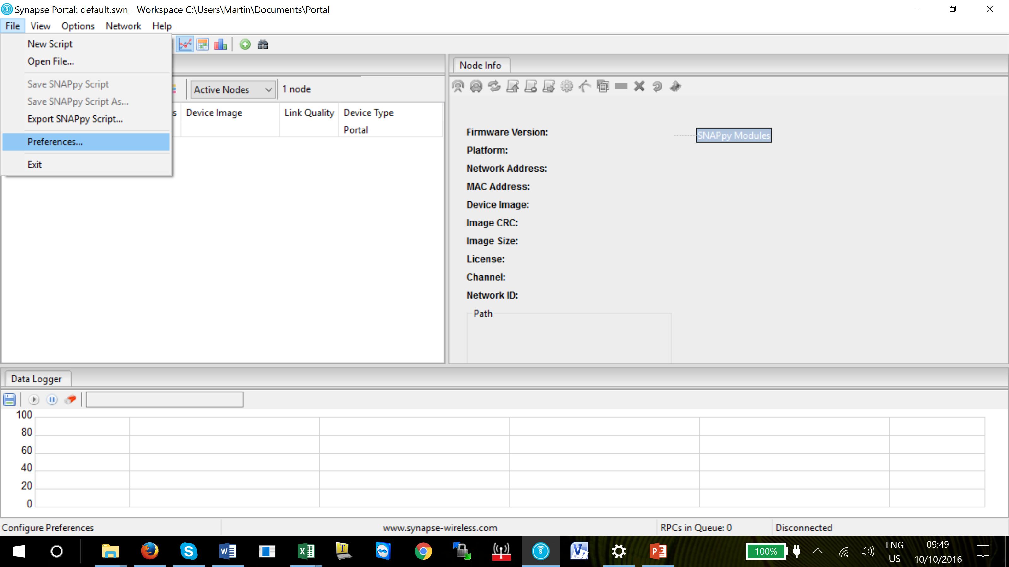
Line Quality Value
The LQ can be changed to a dBm value.
This can be achieved by clicking ‘File’ and then ‘Preferences’
The Line Quality as a percentage figure can be changed to a dBm value if this is preferred.

Slide 18
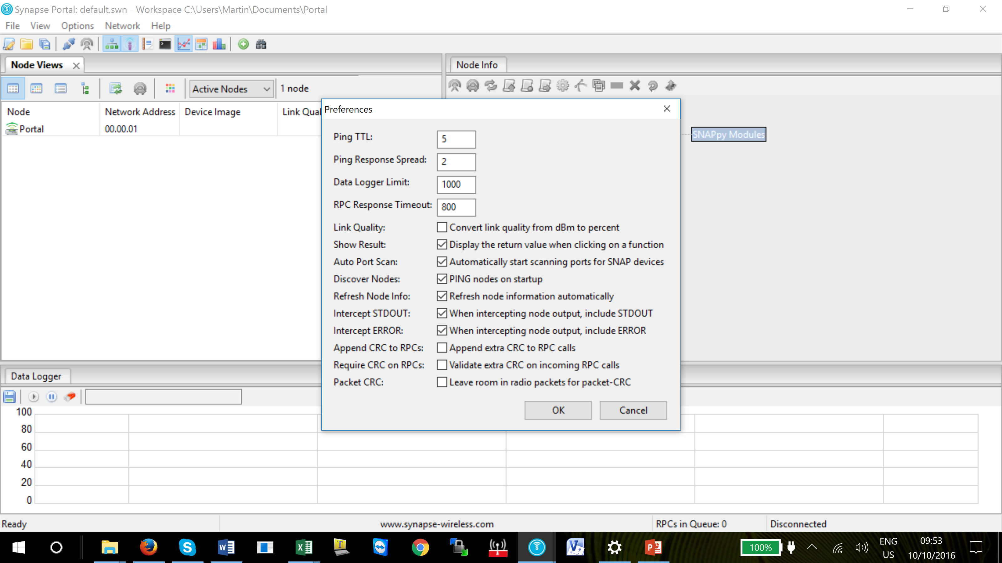
Line Quality Value
Tick the Line quality box and then OK.
The Line Quality figures will now be shown in dBm values

Slide 19
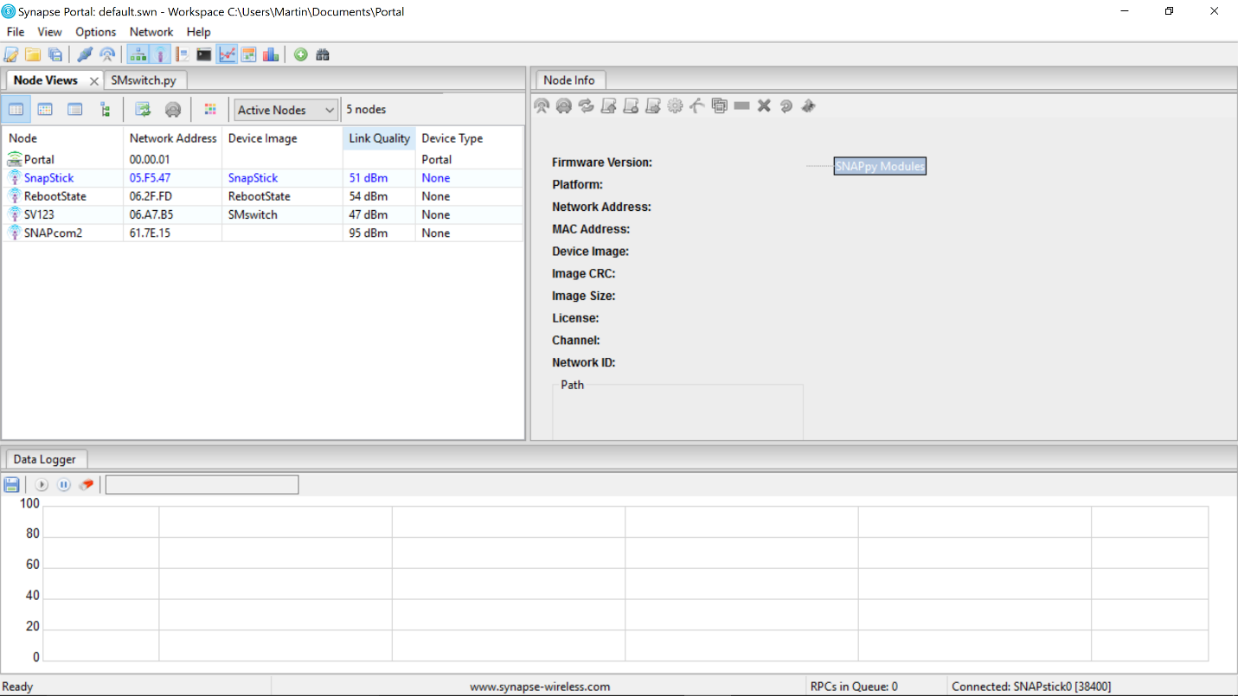
Line Quality Value
Tick the Line quality box and then OK. The Line Quality figures will now be shown in dBm values.
To change the dBm values to % reverse the procedure previously indicated.

Slide 20
Data Logger
To enable the data logger to show active data from the selected connected (highlighted) node, go to the Node Information window and select Logdata(enable) line.
Notes:
The logging feature must be added into the SnappyImage

Slide 21
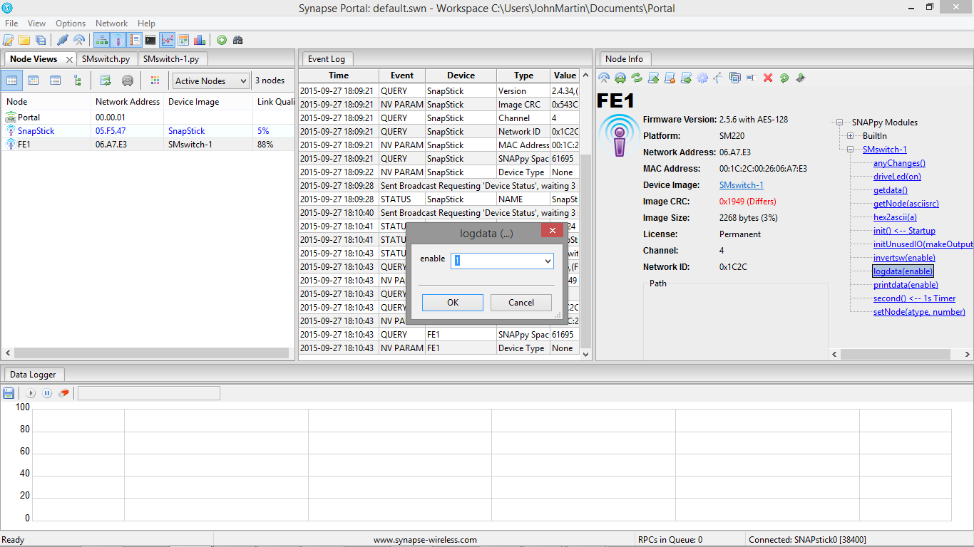
Data Logger
Click Logdata(enable) and a pop up window will appear as indicated in the screen shot below.
Ensure the enable line in the pop up has 1 in the window – this will start the data logger when OK is pressed.
Notes:
If a ‘0’ is entered in the window and ‘OK’ is pressed it will stop the data logging trace.

Slide 22
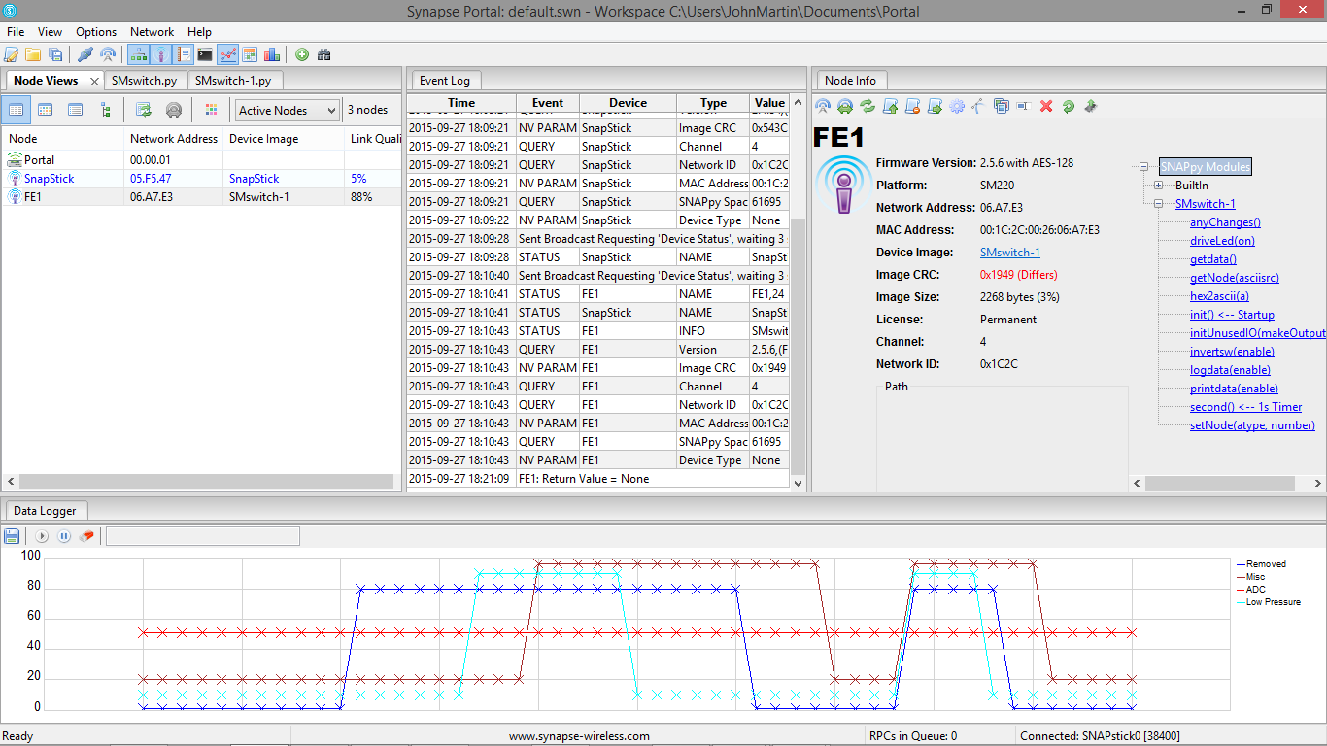
Data Logger
Click the ‘Play’ button below the Data Logger tab to start the trace, if it has not already started.

Slide 23
Data Logger
The coloured traces are the switches.
In this case we are using a 3 digital input unit.
As the switches are activated you will see the switch lines SW1, SW2 and SW3 change state, which in the screen shot below are called ‘Removed’, ‘Misc’ and ‘Low Pressure
Notes:
Note – To change the labels on the switches you will need to edit the SnappyImage coding.

Slide 24
Data Logger
The changes to the labels of the switches is carried out in the python program inside the SnappyImage and we do not recommend any changes to the SnappyImage file unless carried out by a qualified python programmer.

Slide 25
Data Logger
As you can see data logger is shown in the ‘Data Logger’ window and traces any changes to the switch state set by the user. In this case the ADC line is monitoring the battery level.
To turn the ‘Data Logger’ off select Logdata(enable) and select 0 in the pop up window.
If two or more data logging activities are present at the same time the data logger window will show the data lines moving up and down in a rapid fashion. We recommend only one device to be logged at one time.
Notes:
Note - Only have one node data logging at any one time. If the data logger shows rapid movement of lines up and donw the trace area stop the all logging as there will be more than one device being logged.

Slide 26
Data Logger
To erase the current data logging click the ‘Erase’ icon and a new trace will start.
Notes:
Note - Only have one node data logging at any one time. If the data logger shows rapid movement of lines up and donw the trace area stop the all logging as there will be more than one device being logged.

Slide 27
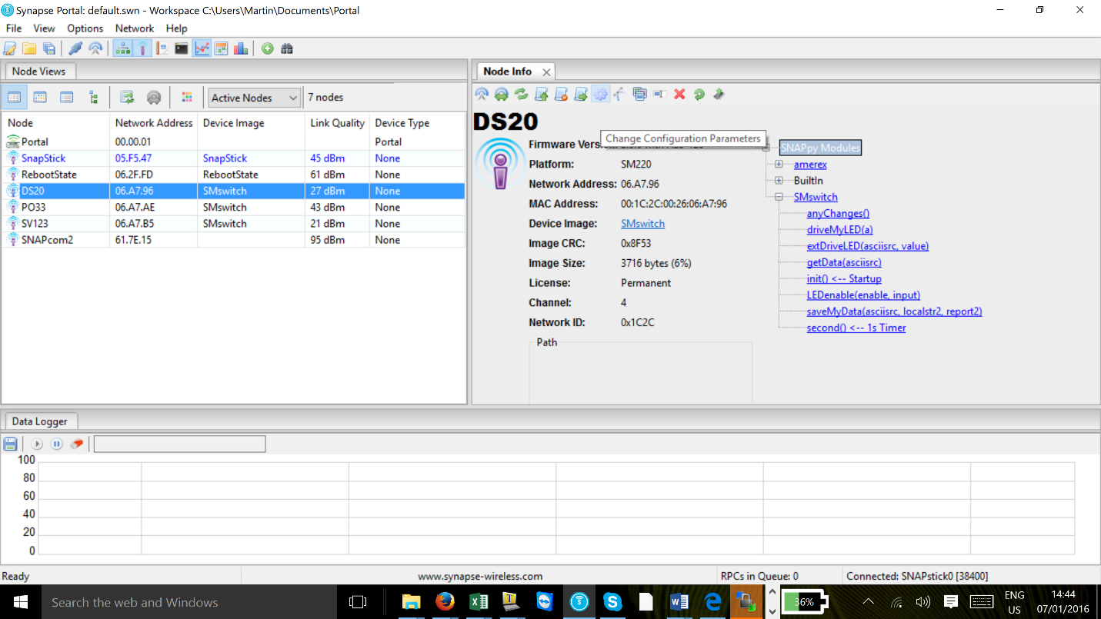
Changing Channel
If more than one network set up is used in proximity to other another network we recommend they should run on different channels.
This can be achieved by the following actions.
Highlight the node that you wish to change, ensure the ‘Node Info’ window is open. Click on the ‘Gear’ icon

Slide 28
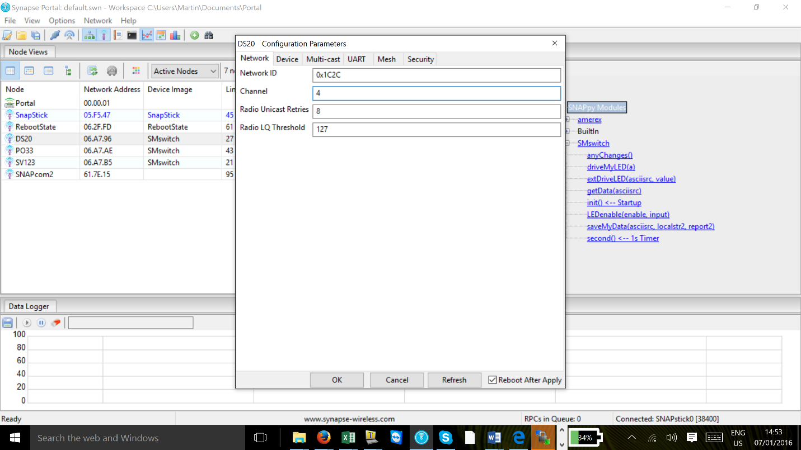
Changing Channel
When the ‘Gear’ icon has been accessed a pop up window (Configuration Parameters) will appear.

Slide 29
Changing Channel
The first line shows the node Network ID, the second line down shows the channel the node is set to - the default channel is Ch.4.
To change the channel number select a channel from 0 to 3 or 5 to15. Channel 15 is reserved for Receive only as per FCC power restrictions.
Notes:
Note – Channel 4 is the default channel all AI devices are supplied in this default state.

Slide 30
Changing Channel
Insert the desired channel number and press OK – the node will reboot. Tick box at the bottom right is ticked.
If you do not wish to reboot the node un-check the tick box at the lower right hand corner of the pop up window.
Notes:
Note – We recommend the ‘Reboot after apply’ box is ticked.

Slide 31
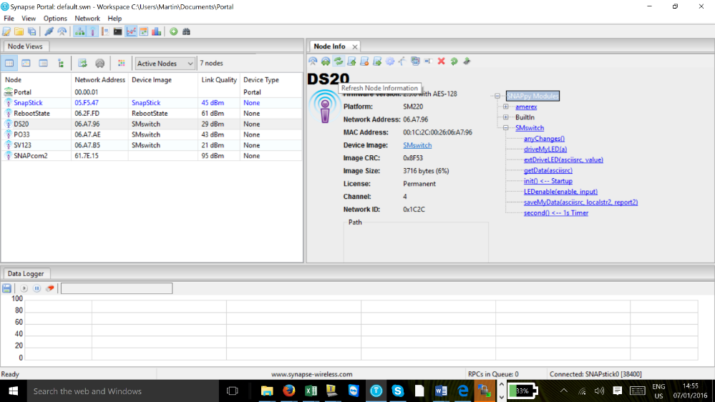
Changing Channel
To refresh the ‘Node’ click the refresh icon.
The channel number will now be changed from 4 (default) to the channel you have chosen.
Notes:
Note –

Slide 32
Changing Channel
Carry out the same procedure for all the nodes you wish to change channel.
Note - the Snap Stick MUST be the last node where the channel is changed. If you do not see a device after the channel has been changed click on the Binocular icon in the command
Notes:
Note –

Slide 33
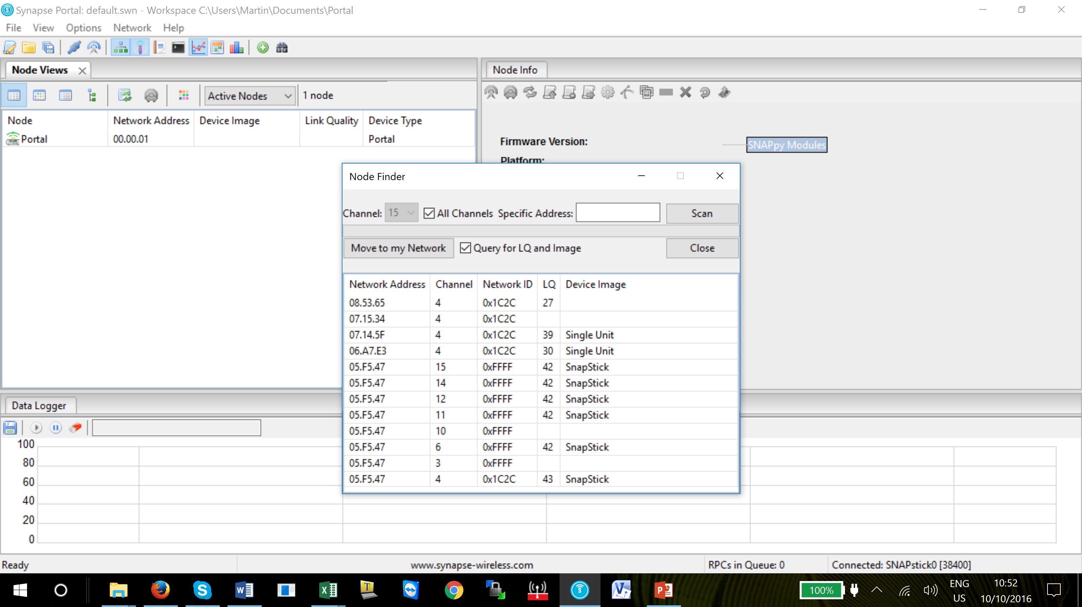
Changing Channel
Tick the box ‘All channels’
Then Click on ‘Scan’.
It will show all the devices on the network
The device may have been assigned a different channel by mistake.
If this is the case, highlight the device you wish to move and click on ‘Move to my network’ tab and the device will automatically move to the current network.
Notes:
Note –

Slide 34
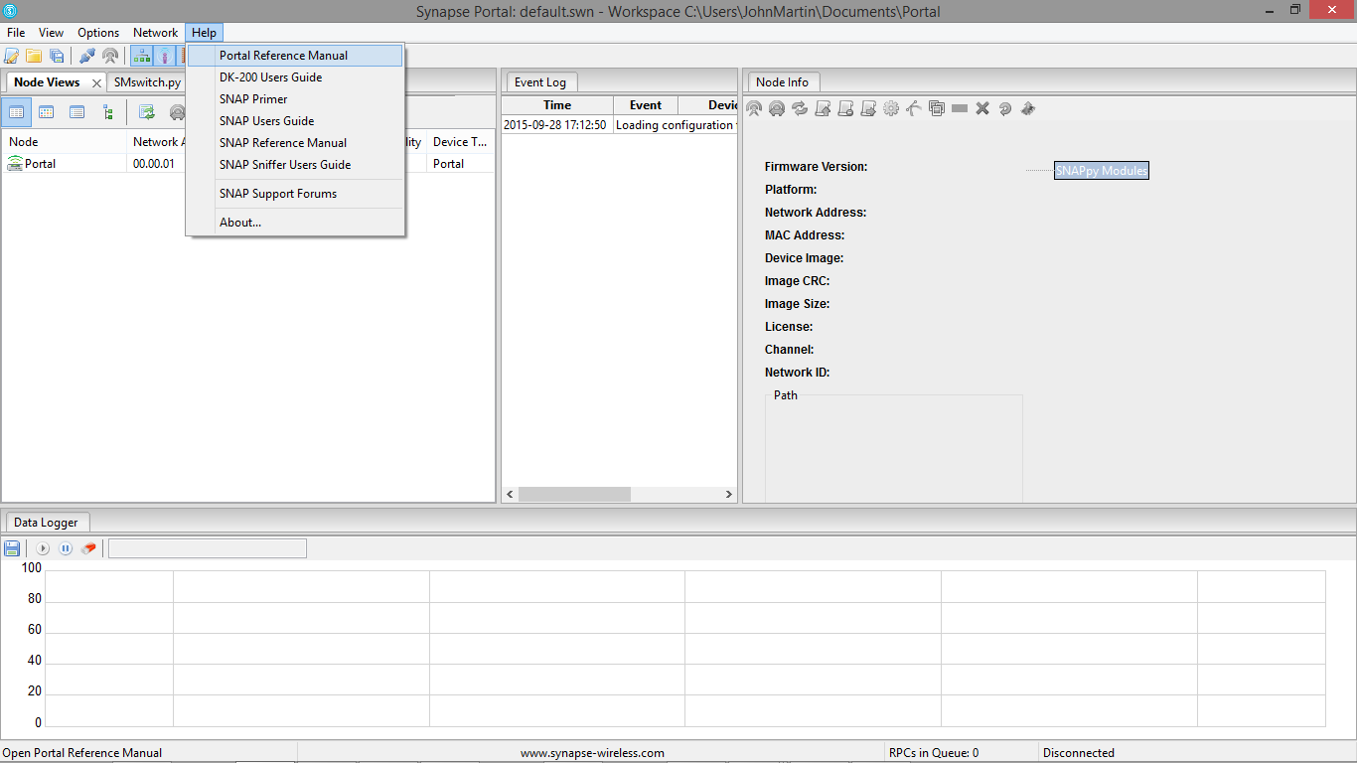
Documentation
Additional documentation covering Portal and other devices can be found in the ‘Help’ drop down menu on Portal command line.
Click on any of the documents to view the manual
Notes:
Note –

Slide 35
Questions?
Notes:
Note –

Slide 36
Return

