Slide 1
SC No.1

Slide 2
Site Controller
Getting Started

Slide 3
Site Controller
Overview of the Site Controller
The Site Controller combines a SM220 RF module and an embedded Linux-based computer to provide connectivity (Ethernet, cellular, Wi-Fi, serial,) and site aggregation capabilities to a diverse array of SNAP IoT networks across industrial temperature ranges.

Slide 4
Site Controller
Overview of the Site Controller
TCP/IP connections can even bridge remote SNAP devices into one common network, an effective method for centralizing data storage, performing web - based analytics, and monitoring remote applications.
Powered by Freescale’s i.MX 6 processor.

Slide 5
Site Controller
Overview of the Site Controller
The Site Controller has ample computing power, reliable connectivity options, and a sturdy design that makes it the ideal networking gateway for large - scale IoT deployments.

Slide 6
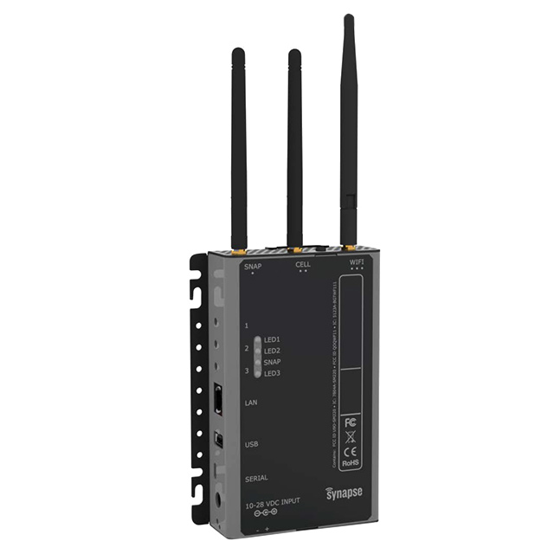
Site Controller
Start up guide
The site controller can be powered by either, a barrel connector via an a.c. adapter power unit or by 24v d.c. power supply.
The barrel connector is located on the side of the site controller.
Connect the power supply you wish to use for the site controller (24v d.c. or the barrel connector from the PSU).
The 24v d.c. supply is connected to green terminal connector rail which is polarity conscious.
10-28VDC

Slide 7
Site Controller
Accessing the site controller
To access the site controller you will require items of software that will allow you to view and edit the programs.
Some of the files are already embedded in the site controller but require activation.
You will also require to download the following;
Tera Term
NotePad++
WinSCP
Notes:
(The above are our suggested software, you can use an alternatives if you wish) You can also find the software on the following sites.

Slide 8
Site Controller
Accessing the site controller
The standard software we recommend is Tera Term, NotePad++ and WinSCP.
Site where you can download the programs
http://download.cnet.com/Tera-Term/3000-20432_4-75766675.html
https://notepad-plus-plus.org/download/v6.8.6.html
http://sourceforge.net/projects/winscp/?source=typ_redirect
Notes:
(The above are our suggested software, you can use an alternatives if you wish) You can also find the software on the following sites.

Slide 9
Site Controller
Accessing the site controller
You will also need a copy of the following files
Download the following for the site controller and save the .py files for the site controller program and the nodes.
filechecker.py This file checks the node data in the site controller
fileprep.py This prepares the site controller for the new nodes
maketimes.py This makes the times slots within the site controller
myUserMain.py This is the main program that runs the site controller

Slide 10
Questions?
Notes:
Note –

Slide 11
Return

