Slide 1
SC No.1

Slide 2
Site Controller
Installing new nodes

Slide 3
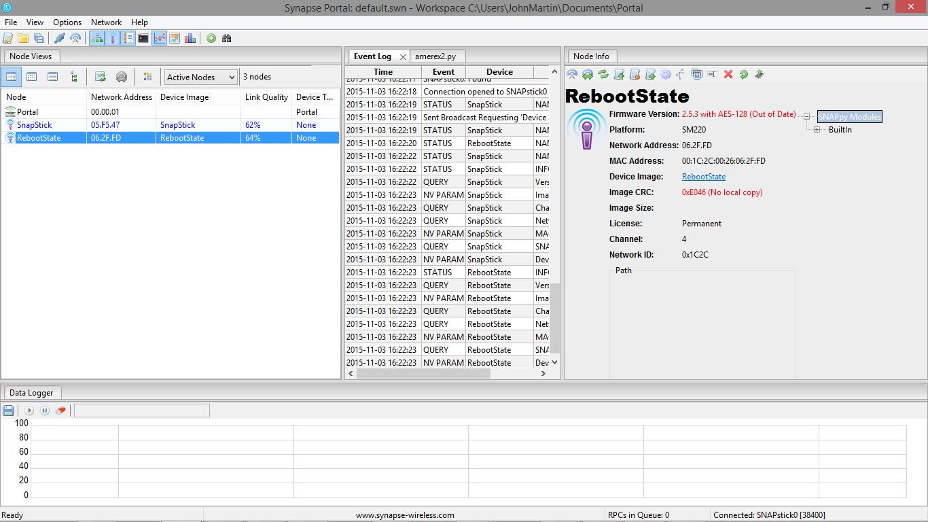
Site Controller
Start-up Portal and connect a snap stick to the PC or laptop as described earlier.
Ensure the site controller is switched on.

Slide 4
Site Controller
The site controller will be visible in the Node View window, as shown above ‘RebootState’. This could have a different name so check the network ID of the device to ensure it is the site controller.
Notes:
For example call it SC001 (Site Controller 001). SC001 designation allows you to identify the node is a site controller and it is No.1 as there may be more than one site controller deployed

Slide 5
Site Controller
The name of the site controller can be changed at any time by going to the ‘Rename Node’
Notes:
For example call it SC001 (Site Controller 001). SC001 designation allows you to identify the node is a site controller and it is No.1 as there may be more than one site controller deployed

Slide 6
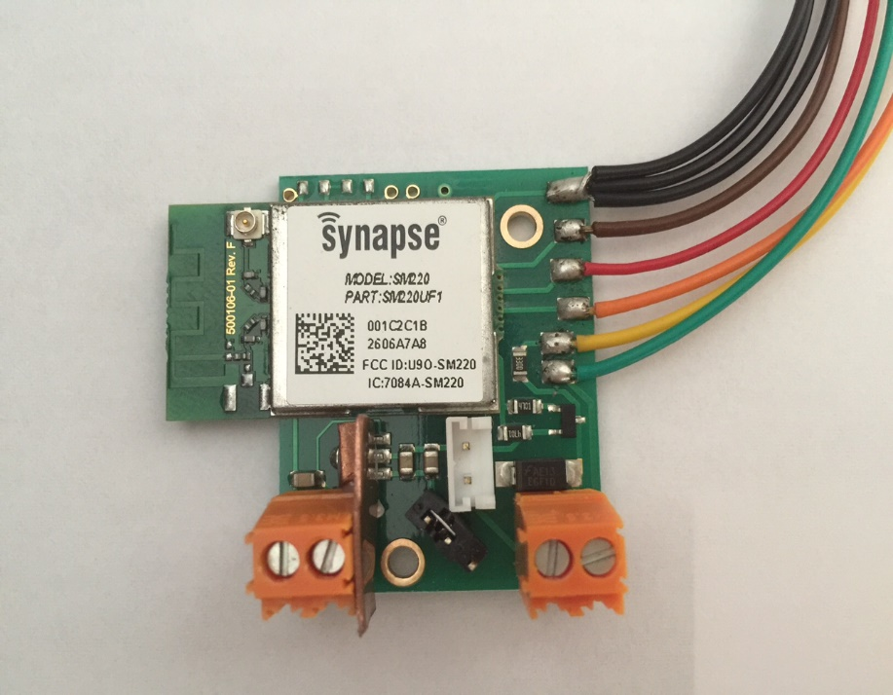
Site Controller
Make a note of the last six digits of the MAC address of the node you wish to connect to the network and is to be re-programed.
Make a note of the type of node it is (Model: SM220).
The MAC address in this case;
001C2C1B2606A7AB
The node address for the network is the last six digits of the MAC address;
In this case – ‘06A7AB’
Notes:
Make a note of the type of node it is (example Model: SM220).

Slide 7
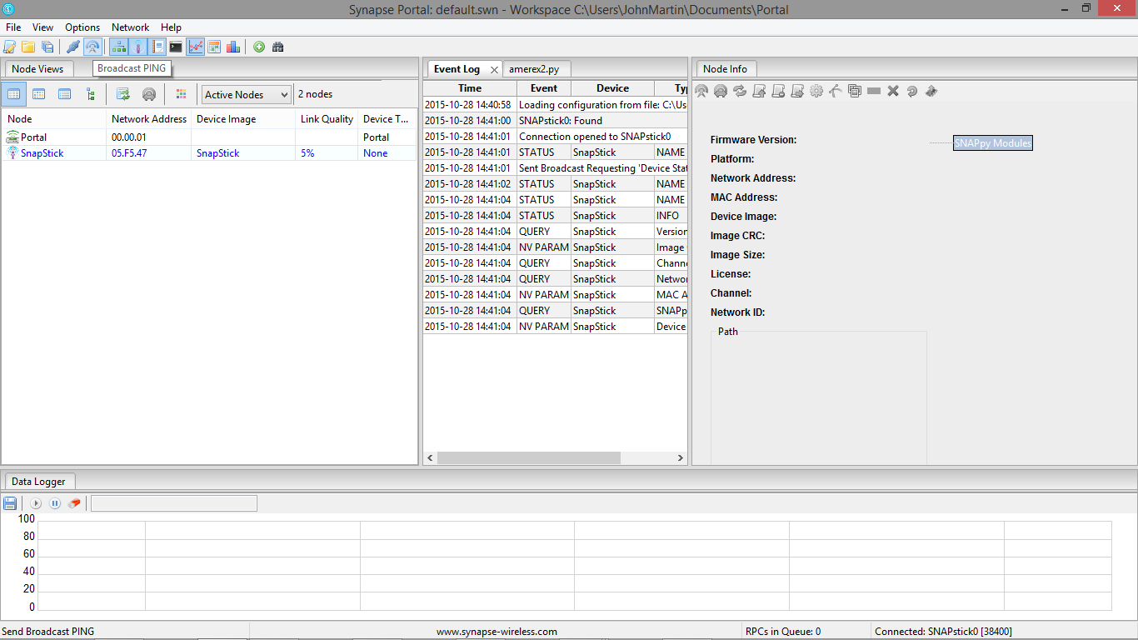
Site Controller
Finding a Node
If the node does not appear automatically in the Node View window of Portal, use the Broadcast PING icon to locate the node(s) on the network.
Notes:
This has previously been discussed in an earlier presentation

Slide 8
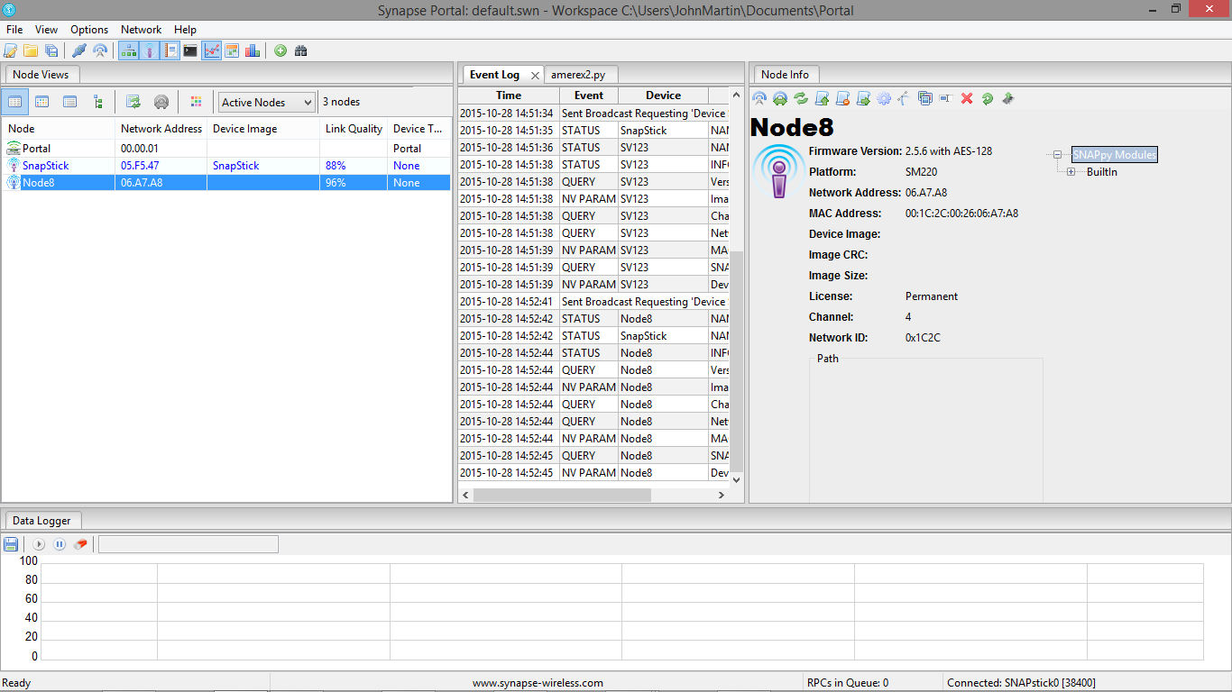
Site Controller
Once the node has been correctly identified, in this case Node 8 with a network address of 06A7AB the programming of the node can commence.

Slide 9
Site Controller
There is no entry in the ‘Device Image’ section of the ‘Node View’ window.
Only when a ‘snappy Image’ has been loaded into the node will there be an entry in this column.
Notes:
Note - No snappyImage has been load yet. Remember - A snappyImage is the program that contains the instruction code for the node.

Slide 10
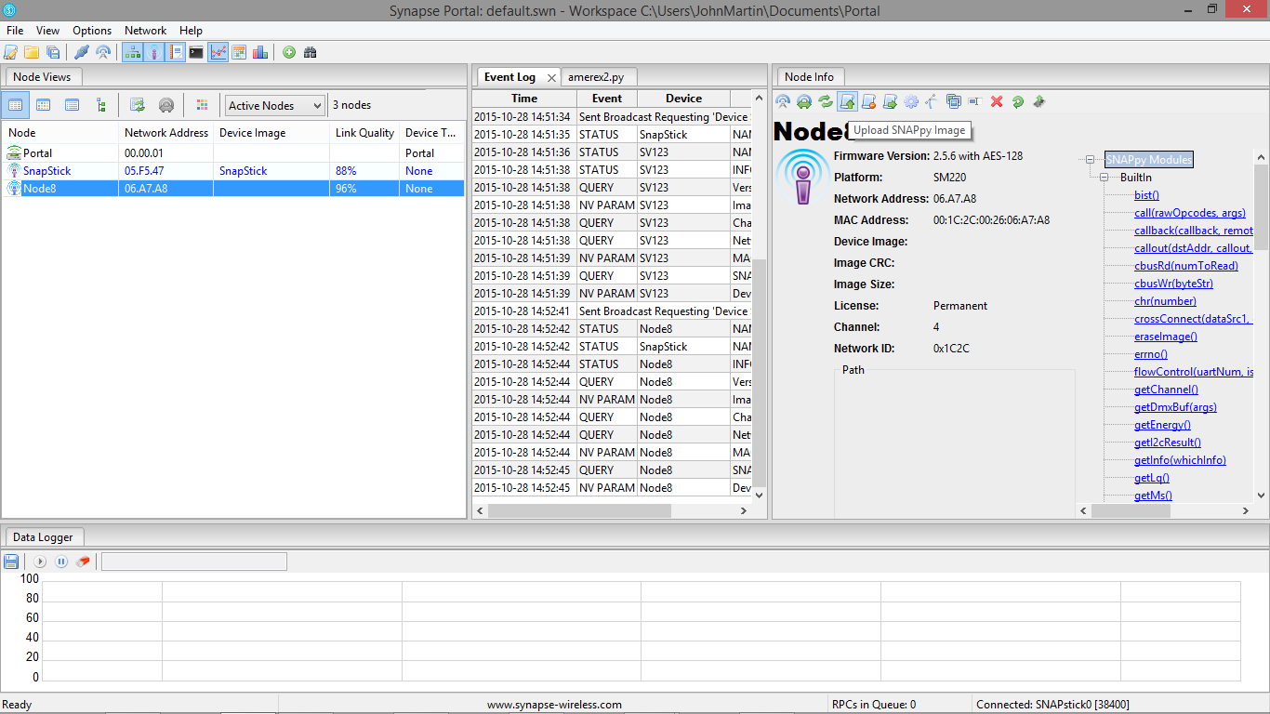
Site Controller
To load a Snappy Image onto a node. Highlight the node you wish to program (Node 8)
Click on the Node Info tab
Click on the icon with a scroll and upward pointing arrow.
Notes:
This is the Upload Snappy Image icon.

Slide 11
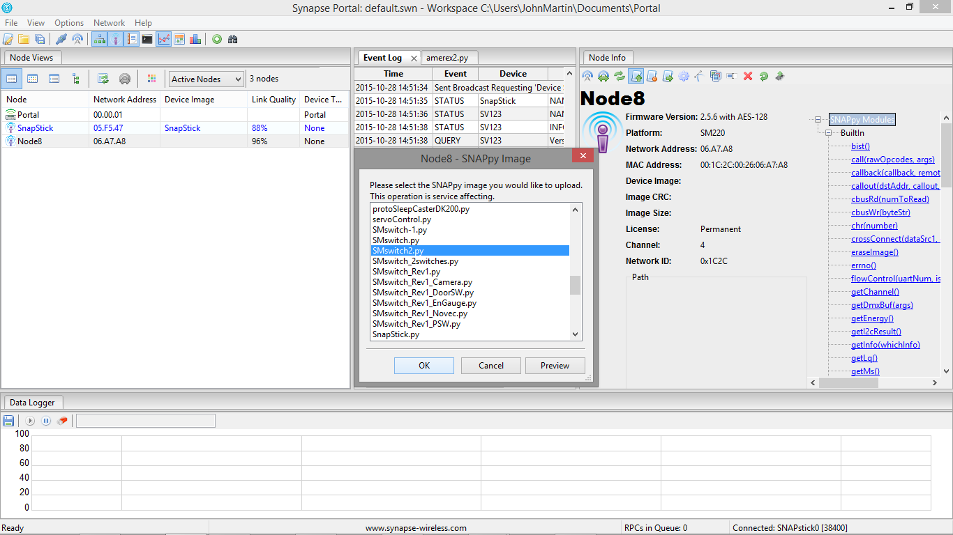
Site Controller
Click on the scroll icon and new window will appear showing all the Snappy Images which have been loaded in the Portal when installed.
Chose the SnappyImage you wish to download from the list.
Notes:
We have chosen SMswitch.py

Slide 12
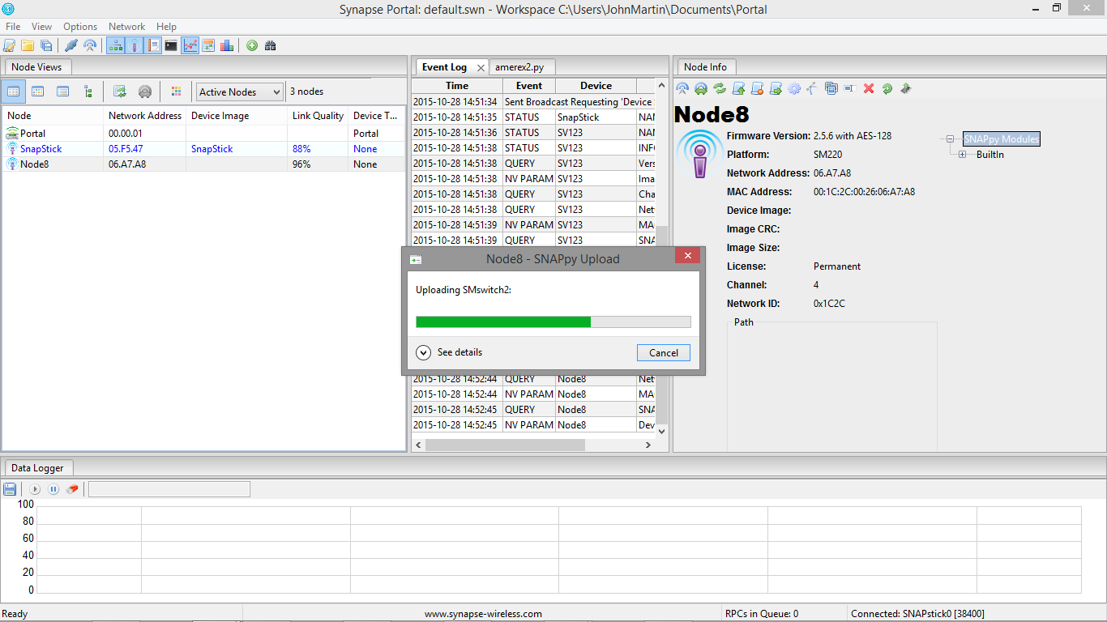
Site Controller
Once you have pressed OK the down load window shall appear showing the progress of the download

Slide 13
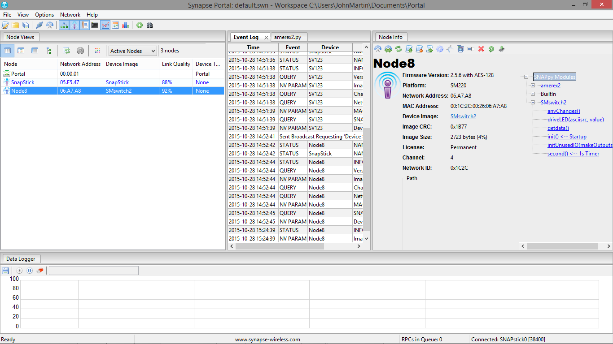
Site Controller
After the download has been completed the Node Info window will show the Snappy Image with a ‘Device Image’ name, in this case is SMswitch2.
The sub routines in the snappyImage are also listed

Slide 14
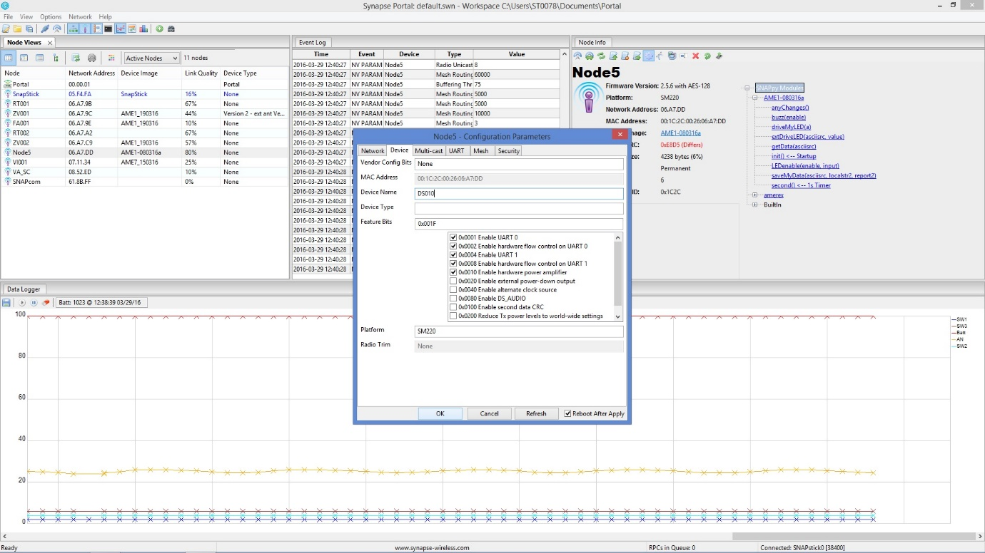
Site Controller
To add a node to the system.
Click on the node in Node View
Click the gear wheel icon in the command line of the Node Info window that you wish to interrogate.
Notes:
A new window will appear – this window is where configuring on the node takes place

Slide 15
Site Controller
Click the gear wheel icon and a window shall appear requesting the node details. Select ‘Device’ tab.
Enter the node name, in this case DS010 and enter the Device Type, in this case SM220.

Slide 16
Site Controller
If the node has an external antenna click on click the ‘Vendor Config Bits’ line and enter ‘0x0010’.
Press ‘OK’ and return to the main Portal screen.
External antenna connection
Notes:
We recommend the ‘Reboot After Apply’ tick box is ticked at all times and for every node.

Slide 17
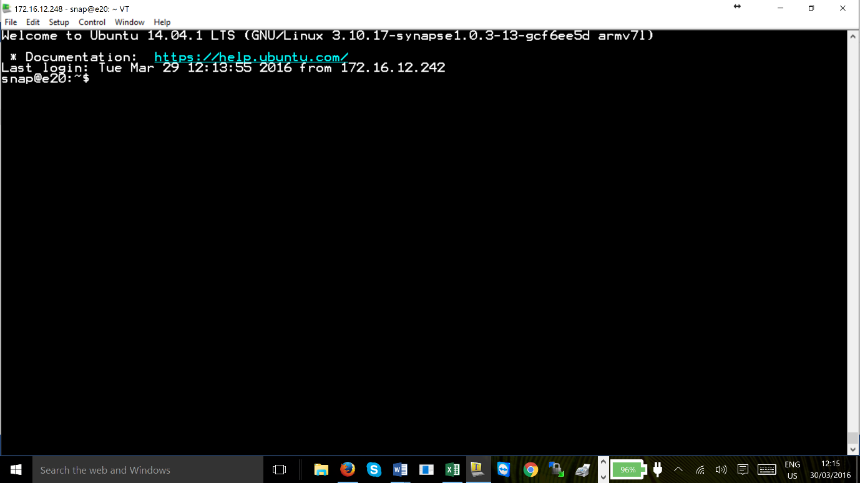
Site Controller
To assign a new device designation
Log-on to the site controller via Tera Term com port or via the IP address and login to the site controller in the example above we have chosen to connect via the IP address. Press OK

Slide 18
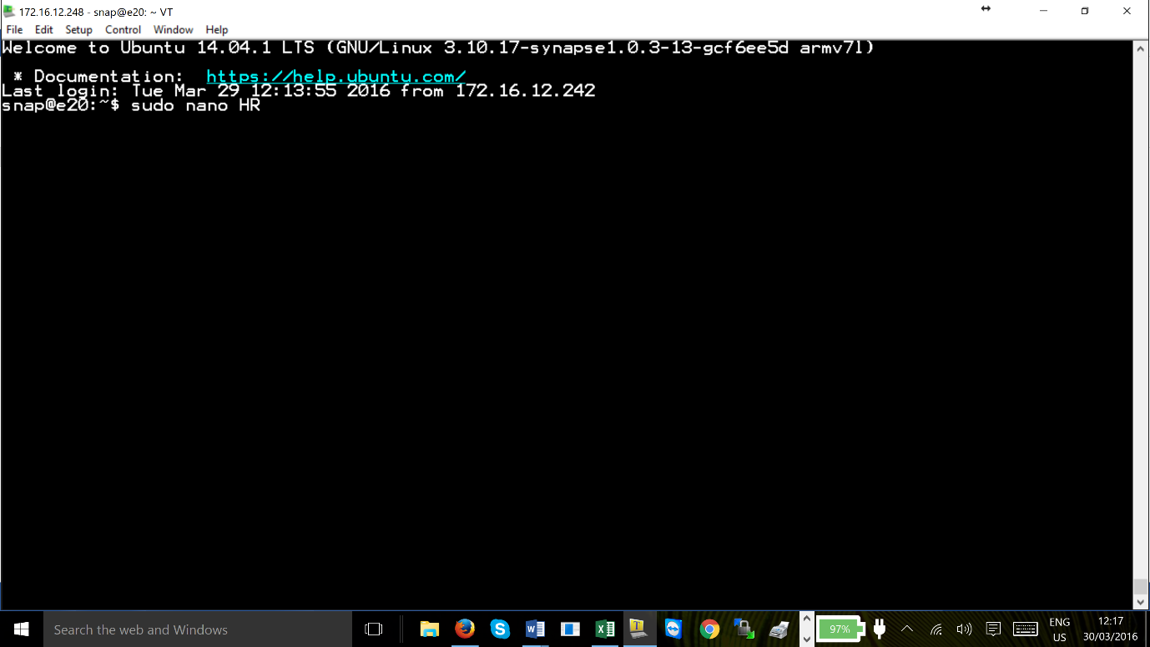
Site Controller
Remember to use the Supervisor stop and restart command prior to changing, adding or modifying the site controller programming.
sudo /etc/init.d/supervisor stop
To create a new designation simply decide the two letter designation.
Type sudo nano HR
We suggest the new designation is relevant to the device being added for example, a Hose Reel – HR.
Notes:
Stop the supervisor program
sudo /etc/init.d/supervisor stop

Slide 19
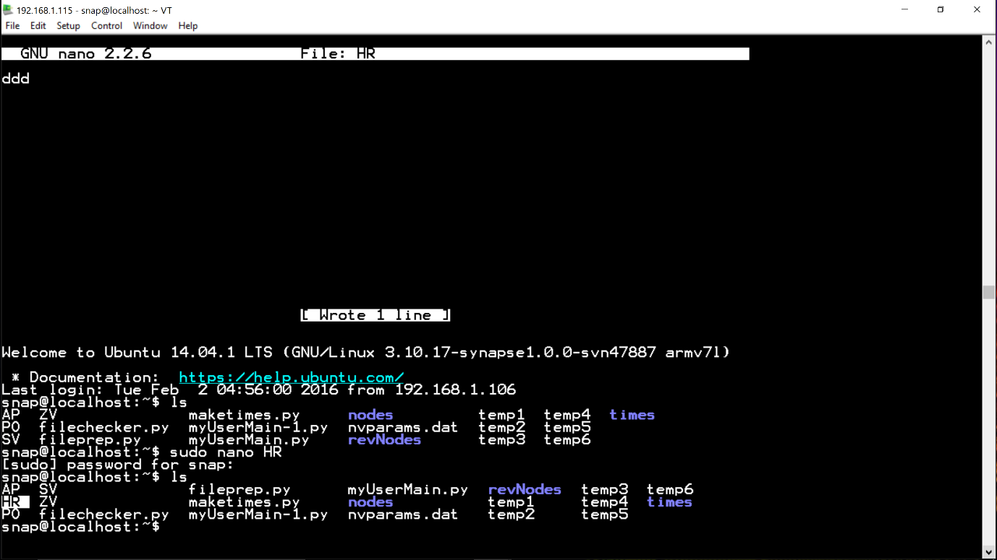
Site Controller
Enter the following ‘sudo nano HR’ and press enter. The Tera Term editor window will appear.
Type in ‘ddd’ and or ‘a’ which are required for this new designation.
The data string entered here will depend on the type of node you are using for the particular application.

Slide 20
Site Controller
The ‘d’ is for a digital input on/off and ‘a’ is for an analogue input 4-20mA.
For example ‘ddd’ which would be for the hose reel - door open, pressure ok and the hose activated, this makes three digital inputs.
Data String Matrix
Board type | Part No. | Description | Data string possibilities
AME1 | 30112 | 3 digital inputs | d | d,d | d,d,d
AME7 | 30110 | 1 analogue and 3 digital inputs | a | a,d | a,d,d | a,d,d,d
AME4 | 30109 | 2 analogue and 4 digital inputs | a | a,a | a,a,d | a,a,d,d | a,a,d,d,d | a,a,d,d,d,d
AME5 | 20115 | 5 analogue and 8 digital inputs | Any combination of 5 analogue and 8 digital inputs
Notes:
Slide shows the possible combinations for the data pints in each node

Slide 21
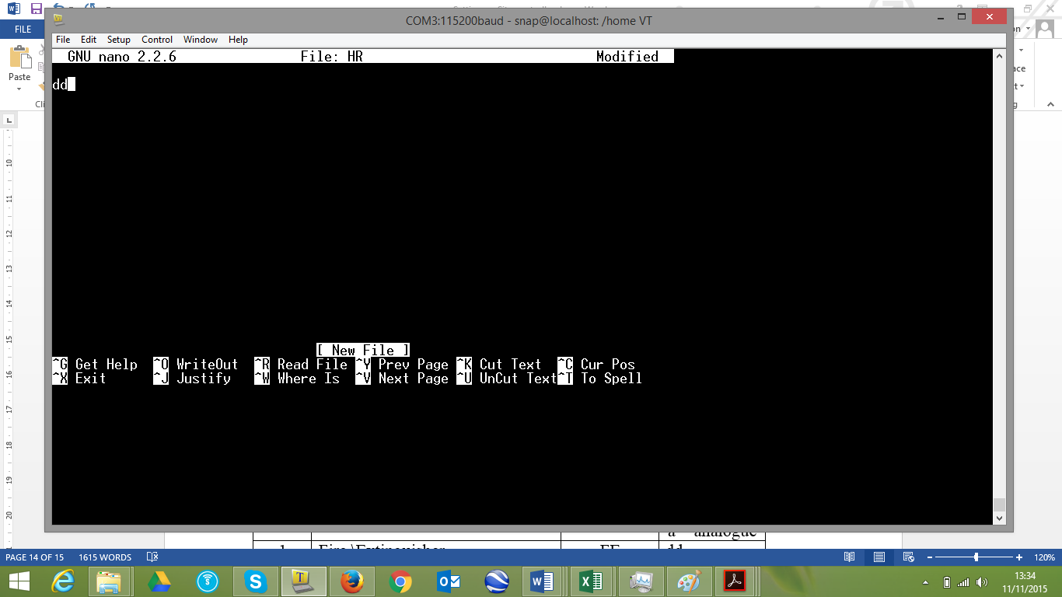
Site Controller
In this example we will chose ‘d,d,d’
Press CTRL and X to exit the editor, press Y to save the file.

Slide 22
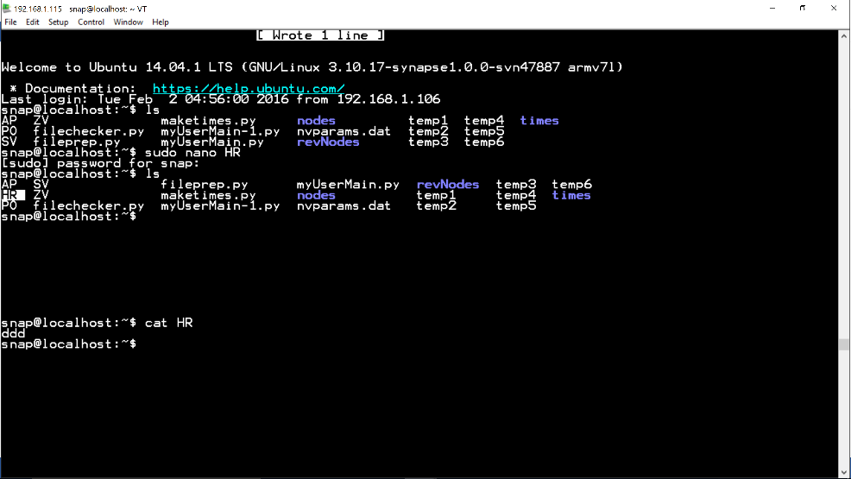
Site Controller
To check the file data, enter ‘cat HR’ and press enter.
The window will now show the ‘ddd’ that was entered earlier

Slide 23
Site Controller
Continue this process for any and all new device designations.
Once all the designations have been saved in the site controller and all changes have been made restart ‘supervisor’
sudo /etc/init.d/supervisor restart

Slide 24
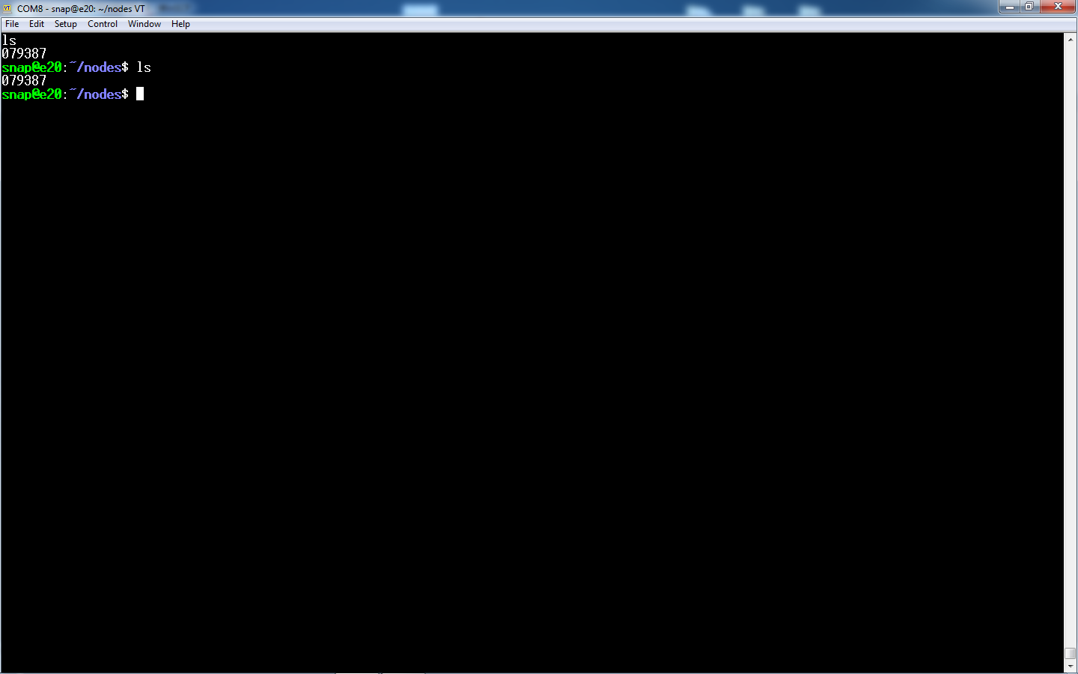
Site Controller
We now need to configure the site controller and add the new nodes manually.
Open up the Tera Term window and change the folder to ‘nodes’
Type sudo nano 07145f – the node ID
Notes:
Remember the node ID is the last six digits of the MAC address

Slide 25
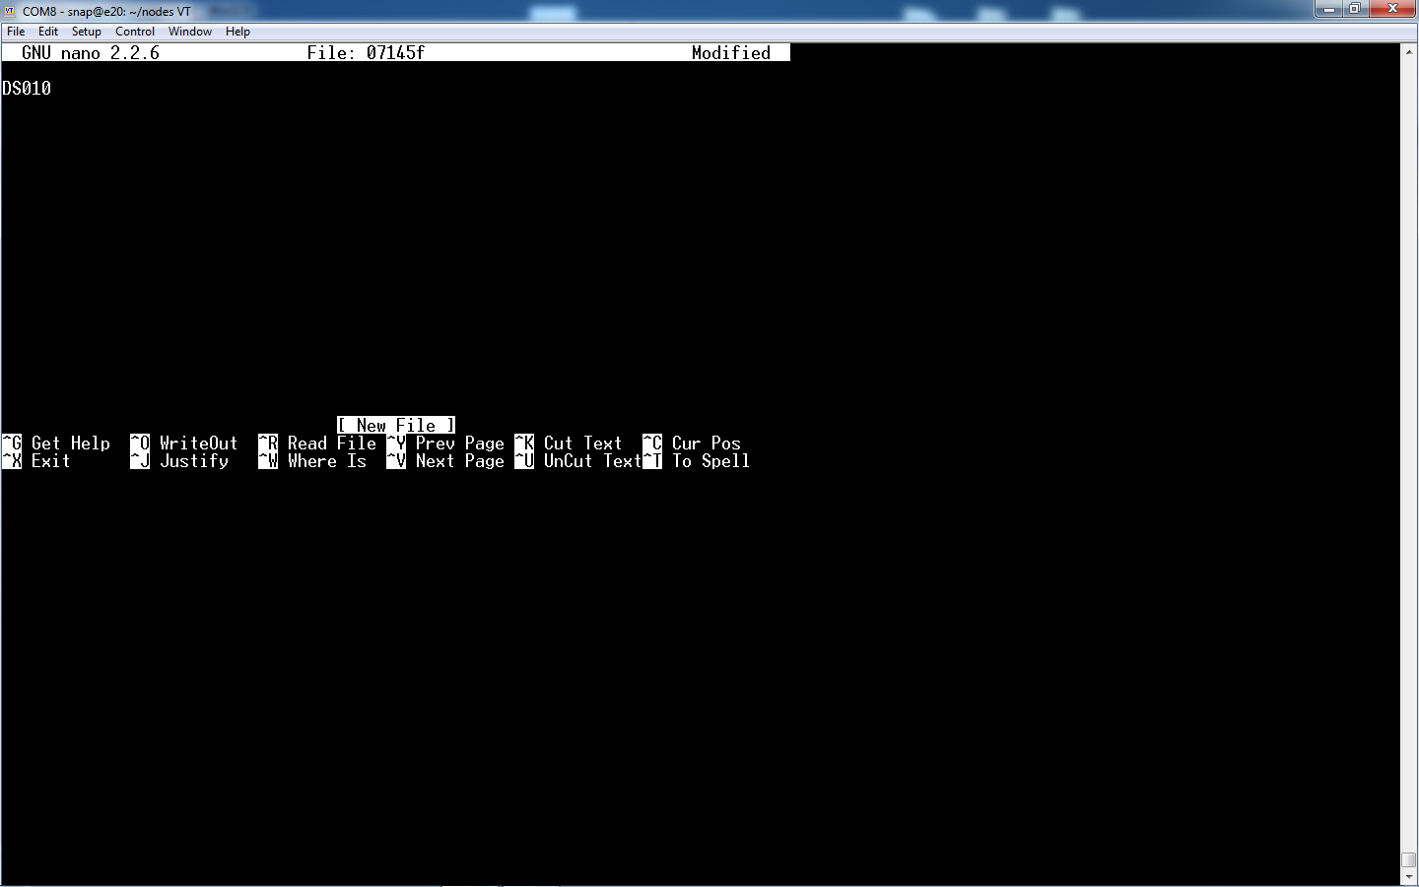
Site Controller
In the editor window type the name of the node you wish to call it
DS010 for example
Press CTRL X and it will ask you to save the file press Y and then press enter
Notes:
Remember the node name must be two letters followed by 3 digits (DS010)

Slide 26
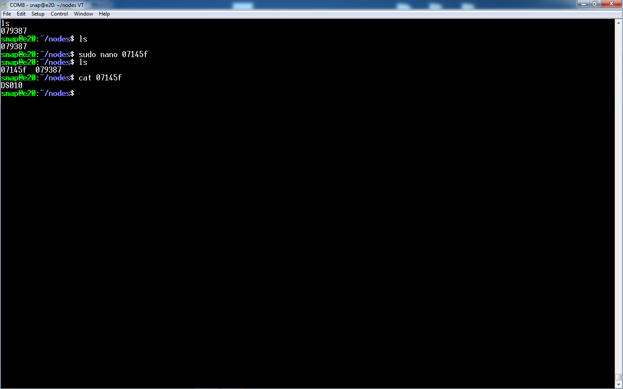
Site Controller
In ‘nodes’ type ls to see if the file has been saved and then type cat to read the data in the file which should be the name of the node.
DS010
Notes:
Remember the node name must be two letters followed by 3 digits (DS010)

Slide 27
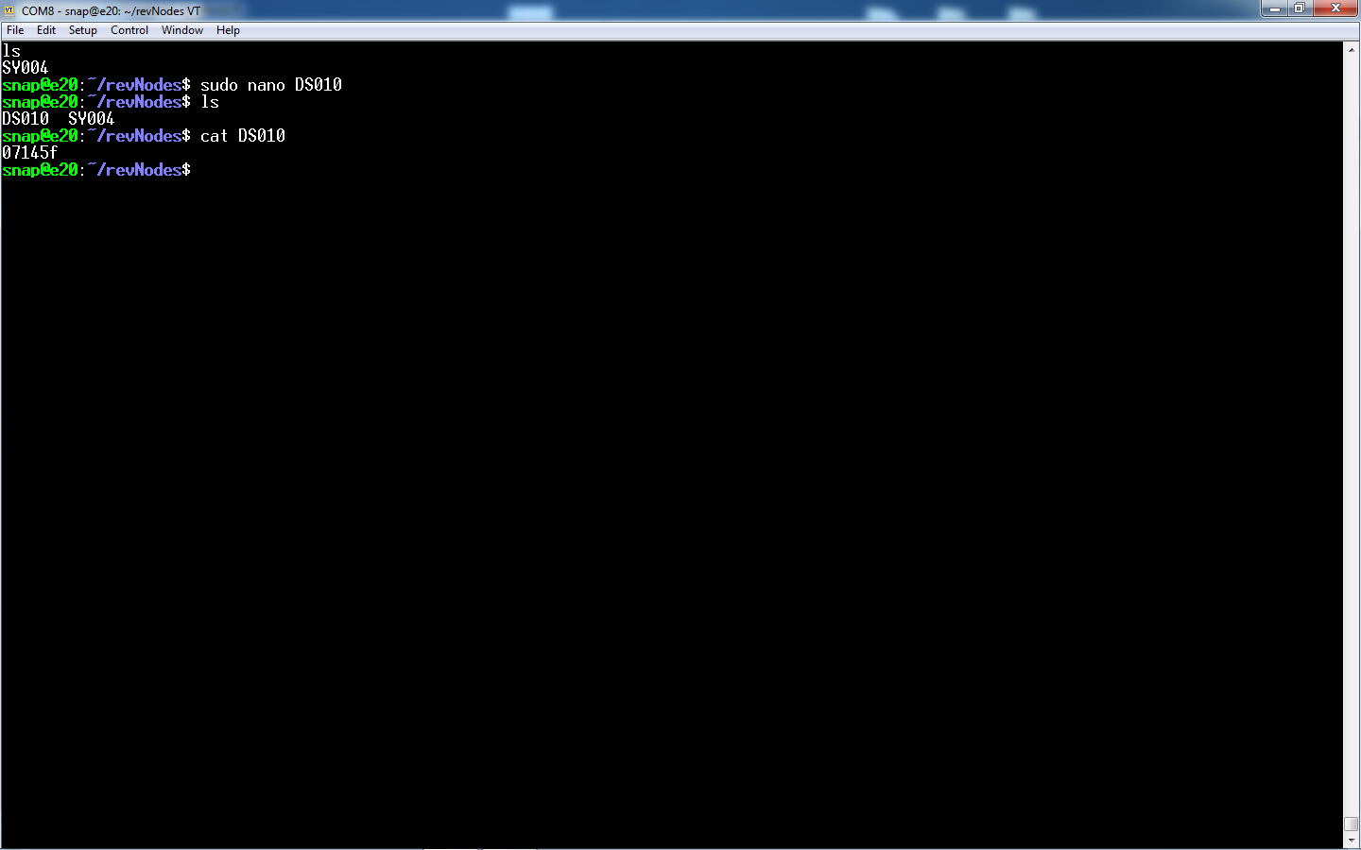
Site Controller
Now do the same but in the revNodes folder.
Here the base file will be the name of the node DS010 and the data in the file will be the ID address 07145f
Notes:
Remember the node name must be two letters followed by 3 digits (DS010)

Slide 28
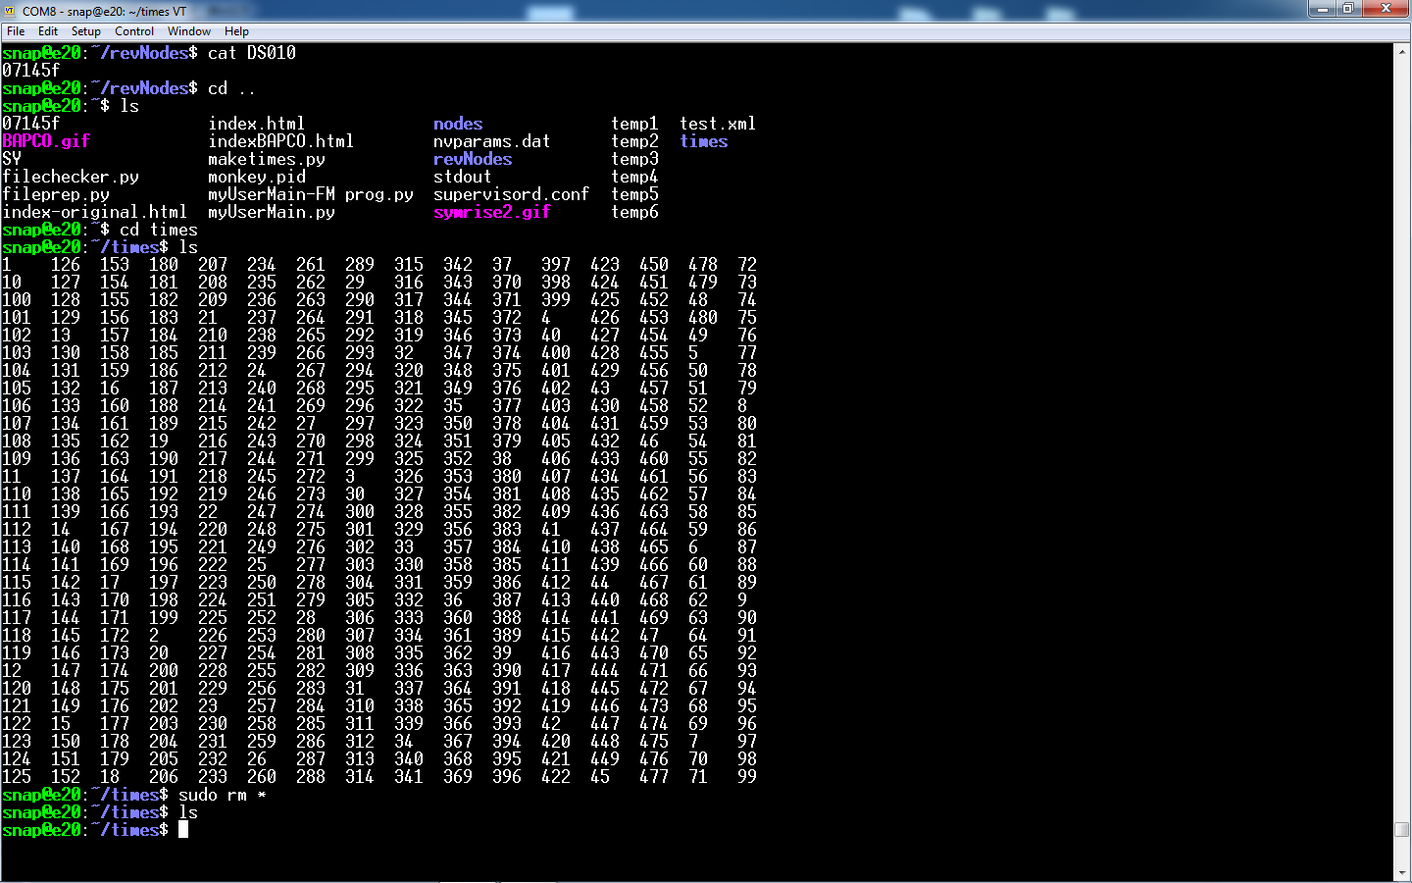
Site Controller
The Supervisor program should be stopped.
New nodes added to the system we must delete the data in the ‘times’ folder.
Change to the ‘times’ folder and type sudo rm *
Type ls to check the times folder is empty
Notes:
Make sure you are in the times folder as this command will delete all the files.

Slide 29
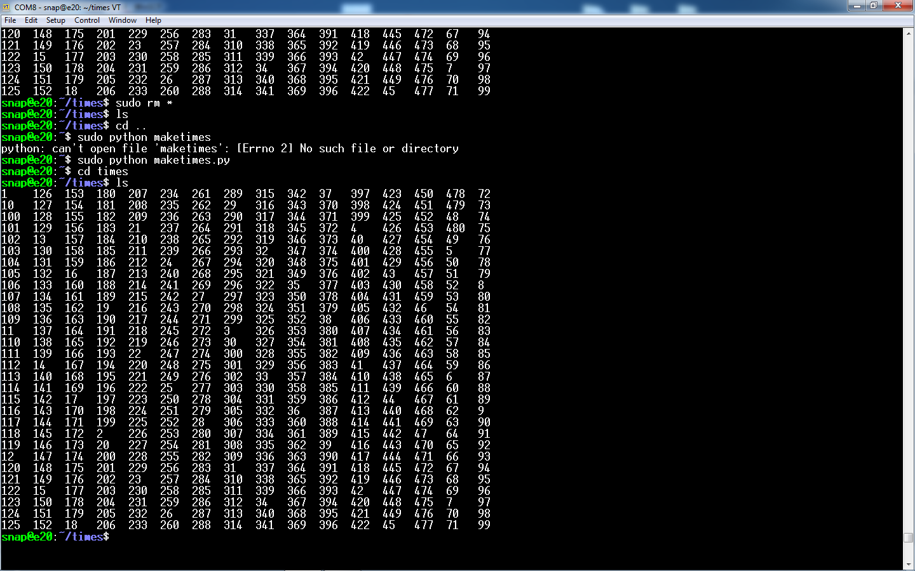
Site Controller
Change to the snap folder ( cd ..)
Type in the snap folder
sudo python maketimes.py
…and press enter
This command remakes the times folder to accommodate the new nodes.
Check the times folder by using the cd and ls commands

Slide 30
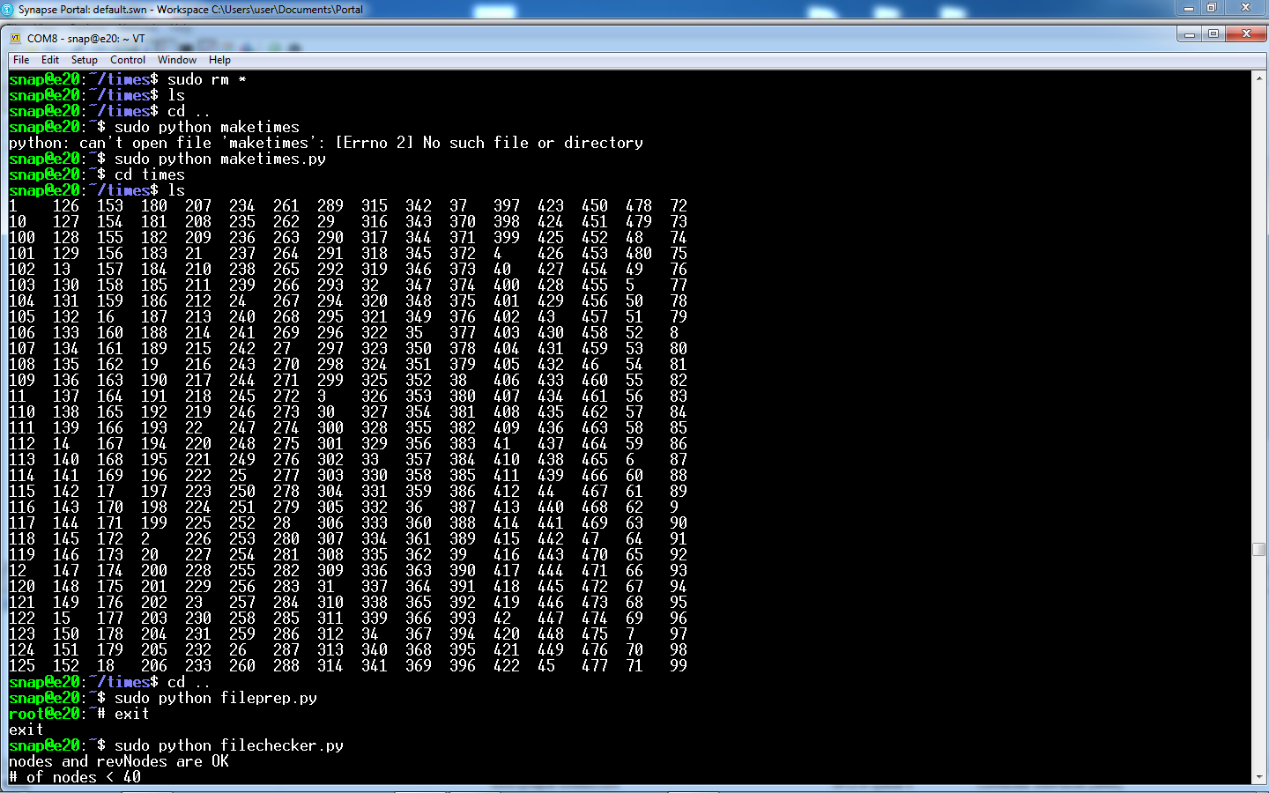
Site Controller
Change to the snap folder ( cd ..)
Type in the snap folder
sudo python fileprep.py
…and press enter
This command prepares the system for the new nodes
Check the times folder by using the cd and ls commands
Now type ‘exit’ in the command line and it will return you to the snap folder

Slide 31
Site Controller
Change to the snap folder ( cd ..)
Type in the snap folder
sudo python filechecker.py
…and press enter
This command checks if the nodes and revNodes are equal.
It should return with OK

Slide 32
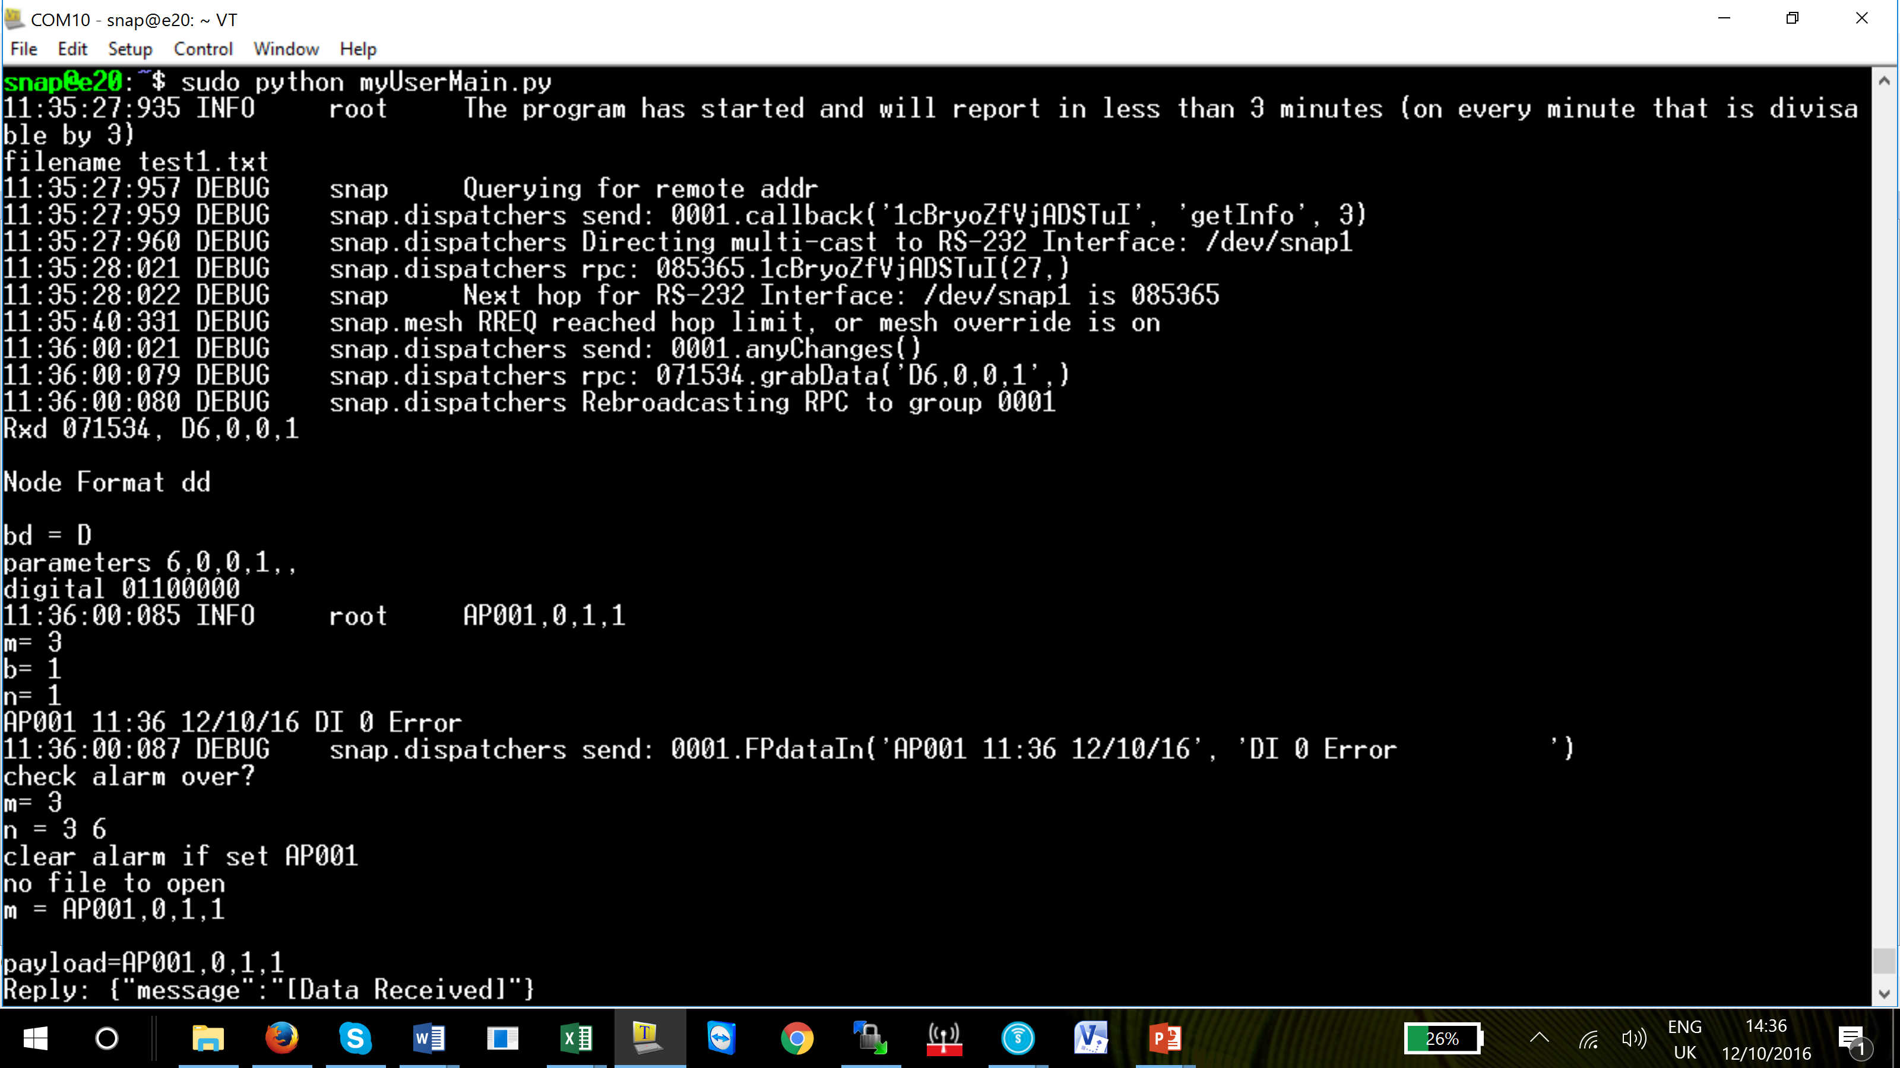
Site Controller
Type in the snap folder
sudo python myUserMain.py
…and press enter
myUserMain.py once activated will connect to the nodes and provide data from each node.

Slide 33
Site Controller
Digital - Example of device information using 30112
Designation Letters HR
Range of devices 1 to 999
Data ddd
Analogue - Example of device information using 30110
Designation Letters GD
Range of devices 1 to 999
Data addd

Slide 34
Site Controller
Analogue and Digital - Example of device information using 30109
Designation Letters FT
Range of devices 1 to 999
Data aadddd
Analogue and Digital - Example of device information using 30115
Designation Letters PH
Range of devices 1 to 999
Data aaaaadddddddd
The number of data points will depend on the module being employed.

Slide 35
Questions?
Notes:
Note –

Slide 36
Return

