Slide 2
Site Controller
Installing software
Programs in the
site controller

Slide 3
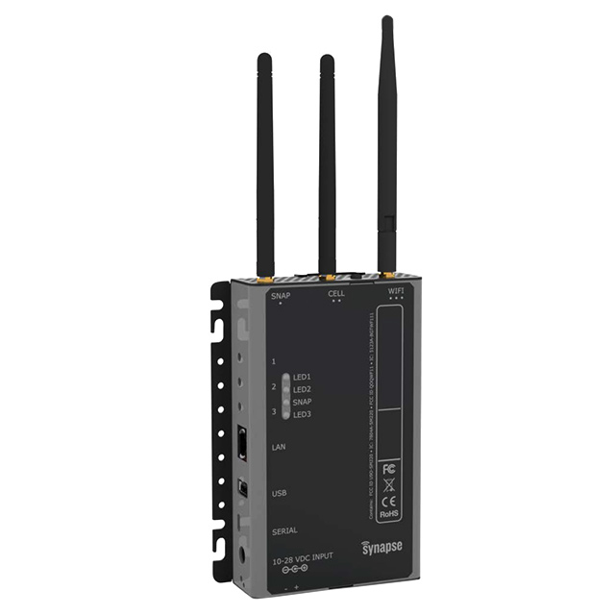
Site Controller
Installing software in the site controller
There are two ways the main programs can be installed on the site controller.
Manual Method – the user will be required to have some knowledge of how to cut and paste functions within programs and by following the section below ‘Manual installation of myUserMain.py’
Drag and Drop method – this does not require as much technical know-how as section a) but still requires the user to have some knowledge of moving files between screens and programs.

Slide 4
Site Controller
Whichever method is chosen there are certain files that must be copied and loaded into the site controller.
filechecker.py
fileprep.py
maketimes.py
myUserMain.py
These files will be available from your tutor
Notes:
Note – Before carrying out any changes, additions, modifications etc., to the site controller programming we recommend you carry out the following.

Slide 5
Site Controller
The ‘supervisor’ program runs in the back ground and controls all aspects of the programs running in the site controller. Supervisor requires stopping to make any changes to the site controller.
To stop and restart the ‘supervisor’ program use the following commands in the Tera Term editor window.
sudo /etc/init.d/supervisor stop
this should be used before any changes to the site controller
sudo /etc/init.d/supervisor restart
use the restart supervisor to run the new information.
Notes:
Note – the supervisor program should have been activated during the previous slide show

Slide 6
Site Controller
  Manual Method
The files below need to be loaded onto the site controller
filechecker.py
fileprep.py
maketimes.py
myUserMain.py

Slide 7
Site Controller
Creating folders / files on the site controller
The following folders or directories are required to be created in the snap@e20:~ $ folder (this may also be snap@........:~$ format depending on your site controller).
We now need to use the ‘sudo’ command to allow access to the site controller.
nodes
revNodes
times

Slide 8
Site Controller
To do this, ensure the selected folder or directory is snap@......:~ $
Type in the following after the $ sign
sudo mkdir nodes and press the enter key
Check if the folder has been created by typing ls after the $ sign. The ‘nodes’ folder should be indicated in blue bold text. Repeat the same for the other folders – revNodes and times.
sudo mkdir revNodes
sudo mkdir times
You will need Notepad++ to be open to copy files later
Notes:
Opening notepad ++ allows the three files filechecker, fileprep and myUseMain to be copied into the site controller

Slide 9
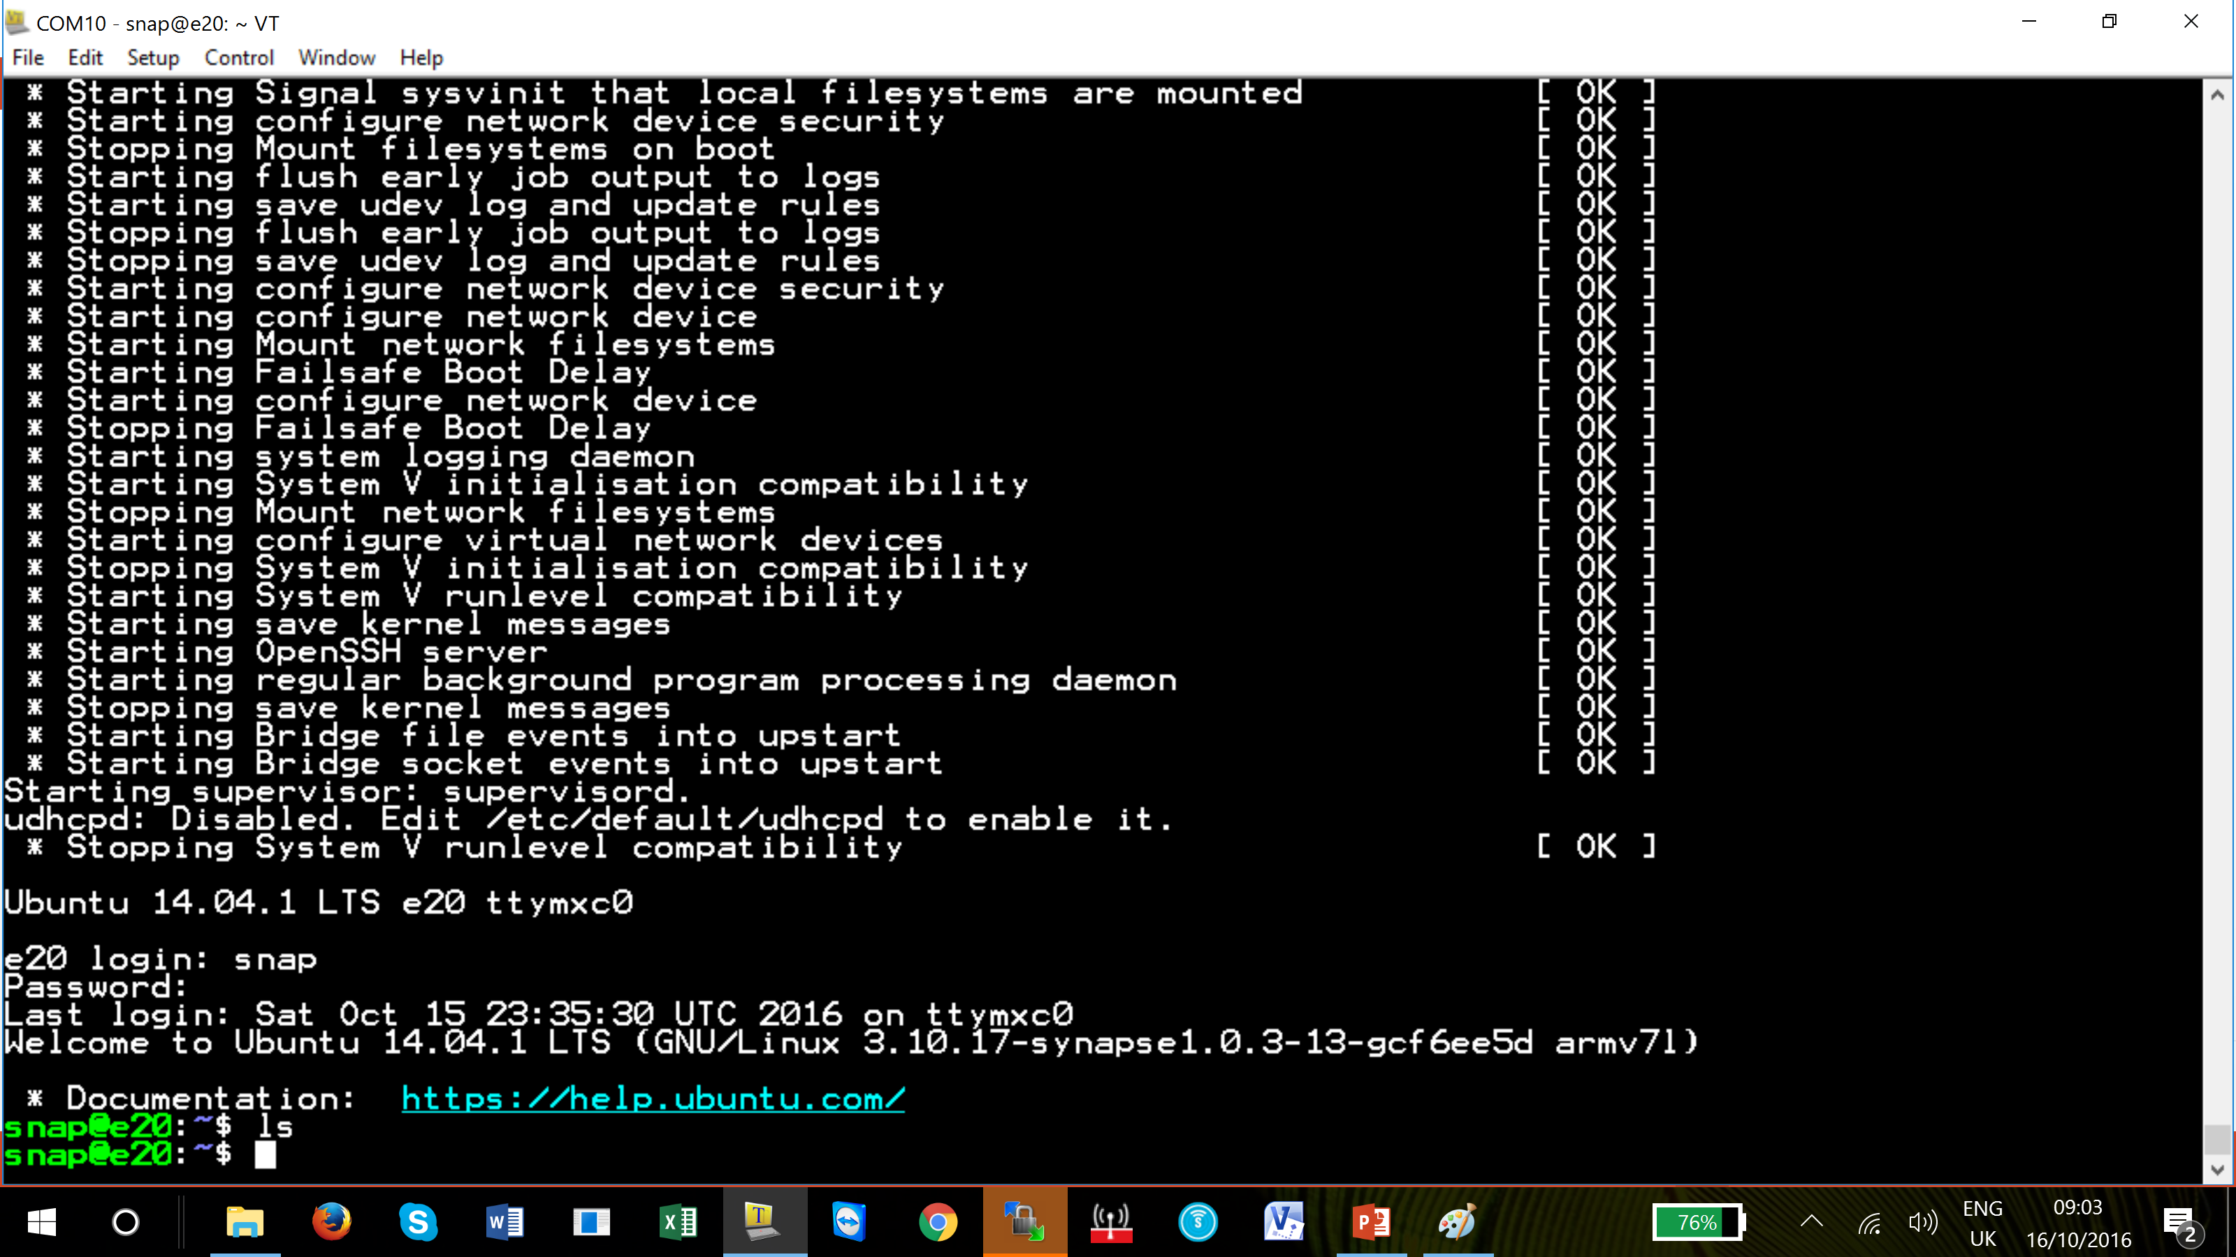
Site Controller
After the embedded files/programs have been activated and/or uploaded Snap folder can now be populated.
Type the ls commend in the Snap folder line.
This folder will have no data stored in it and so nothing will be inserted in the Tera Term editor window.

Slide 10
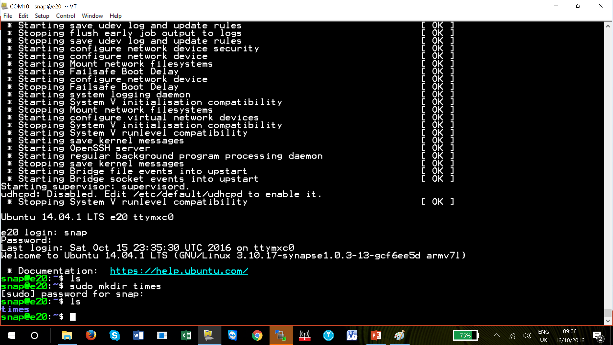
Site Controller
Folders must now be created.
Type sudo mk times in the editor window and press enter.
Now type the ls command and you will see times folder (in blue) has been created.

Slide 11
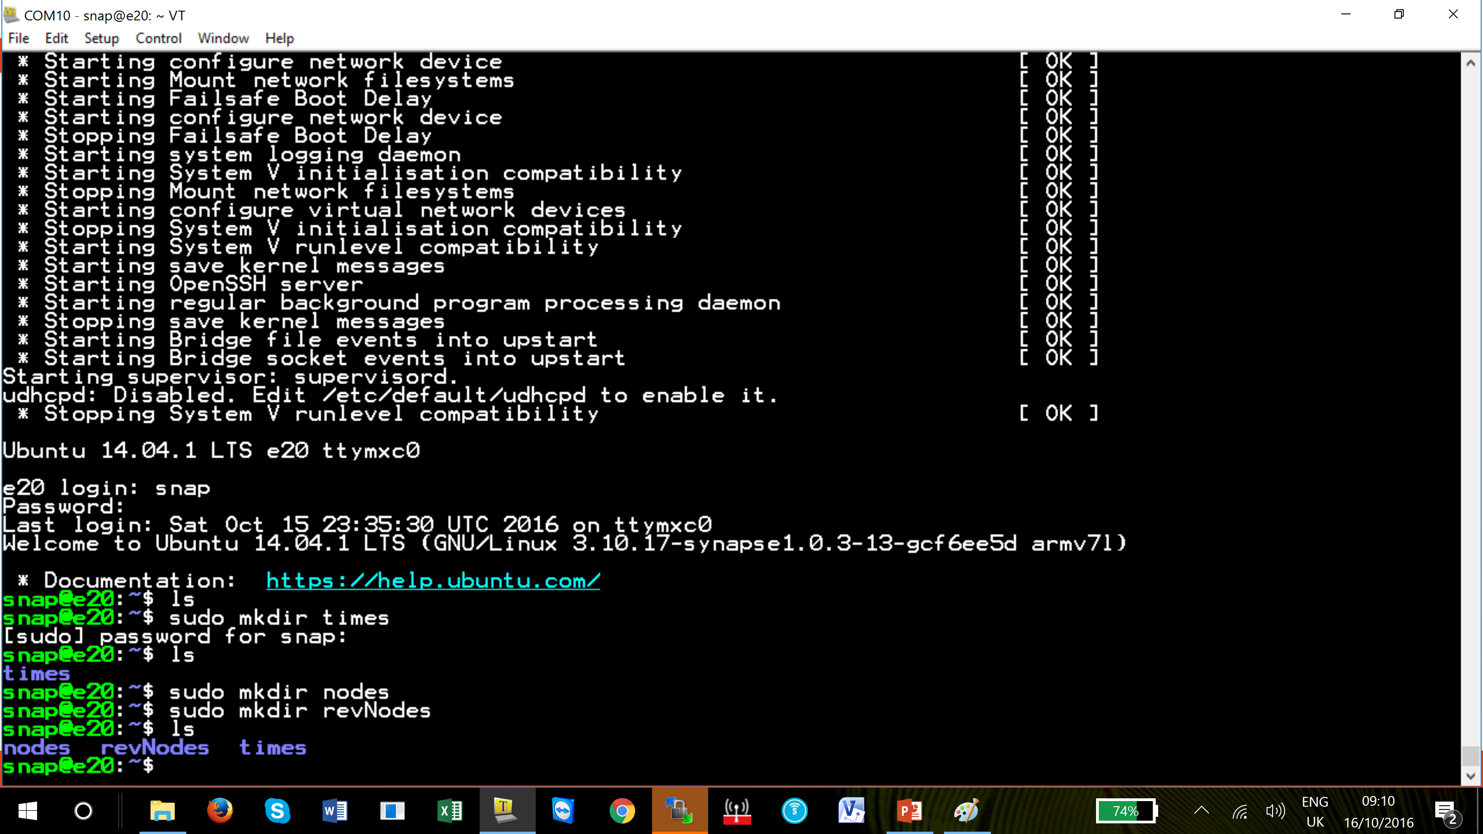
Site Controller
Folders must now be created.
Carry out the same procedure for nodes and revNodes
Type sudo mk nodes in the editor window and press enter.
Now type the ls command and you will see nodes and revNodes folder (in blue) has been created.

Slide 12
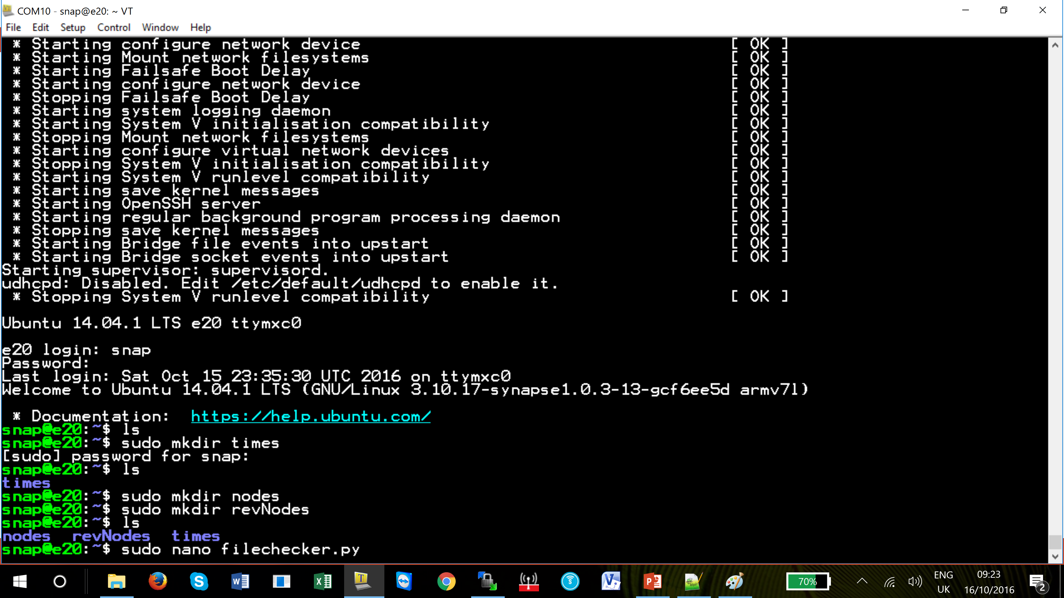
Site Controller
Files must now be copied into the Snap folder.
Type in the editor window
sudo nano filechecker.py

Slide 13
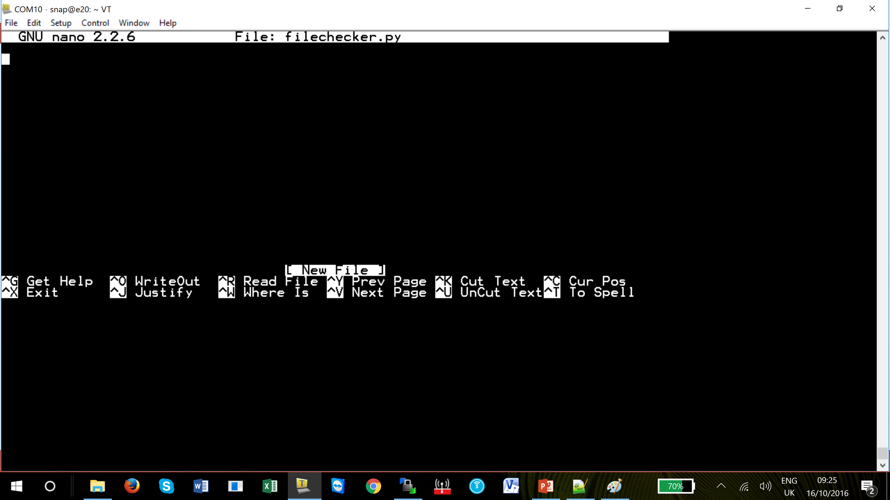
Site Controller
The nano editor window will appear.
By using NotePad ++ locate the folder where you have saved the three files ‘filechecker.py’, ‘fileprep.py’ and ‘myUsermain.py’

Slide 14
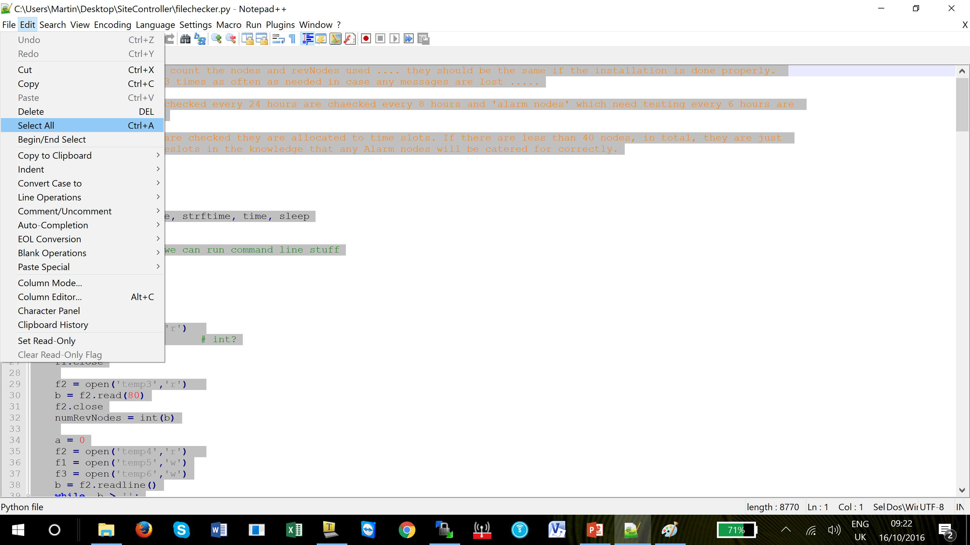
Site Controller
Open the file ‘filechecker.py’ as shown.
Click on edit tab and the select all.

Slide 15
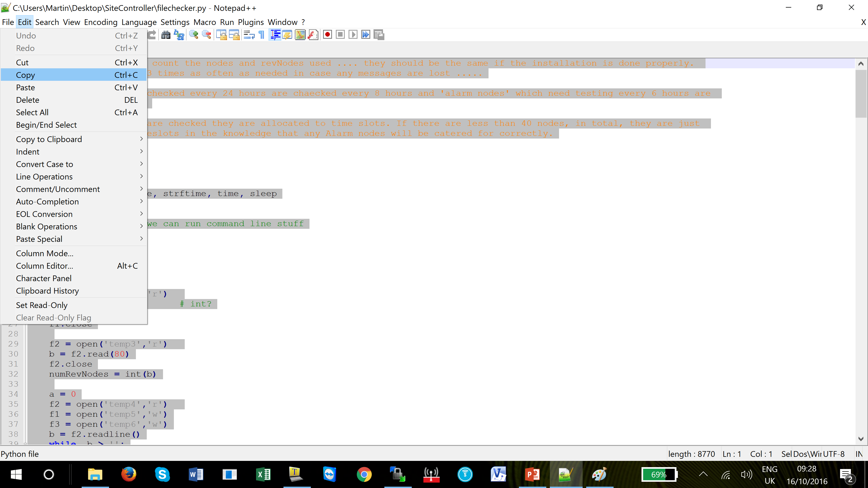
Site Controller
Click on copy

Slide 16
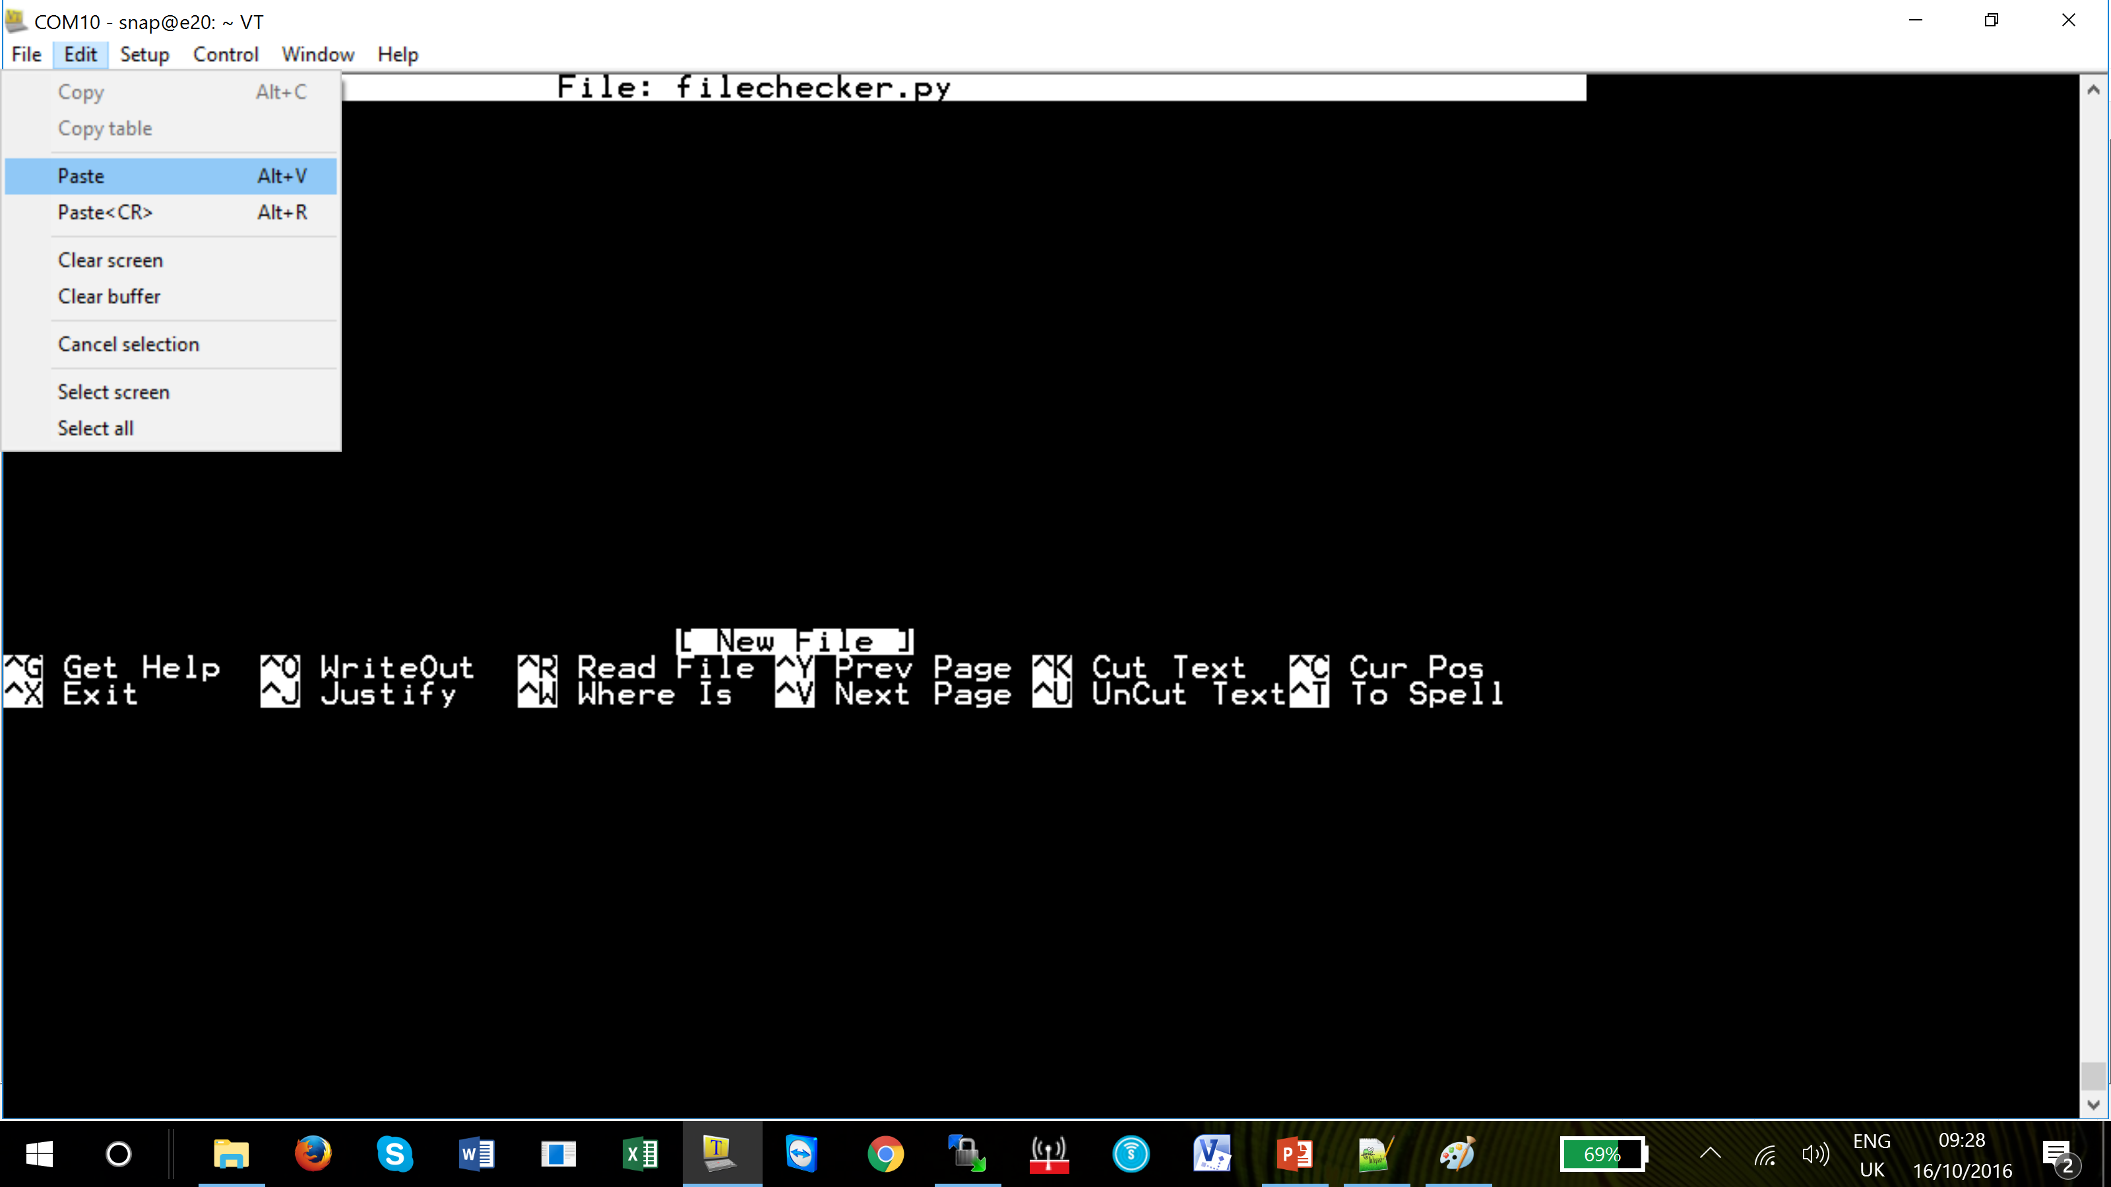
Site Controller
In Tera Term click on Edit tab and then Paste.

Slide 17
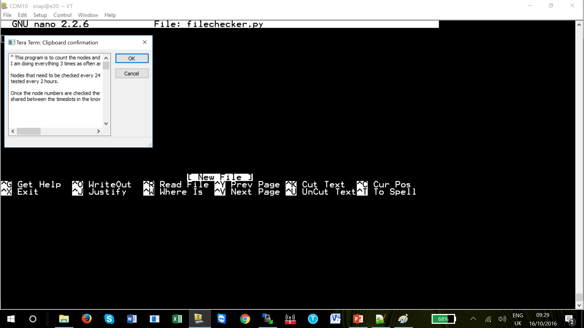
Site Controller
In Tera Term click on Edit tab and then Paste.
A pop up window will appear, click OK

Slide 18
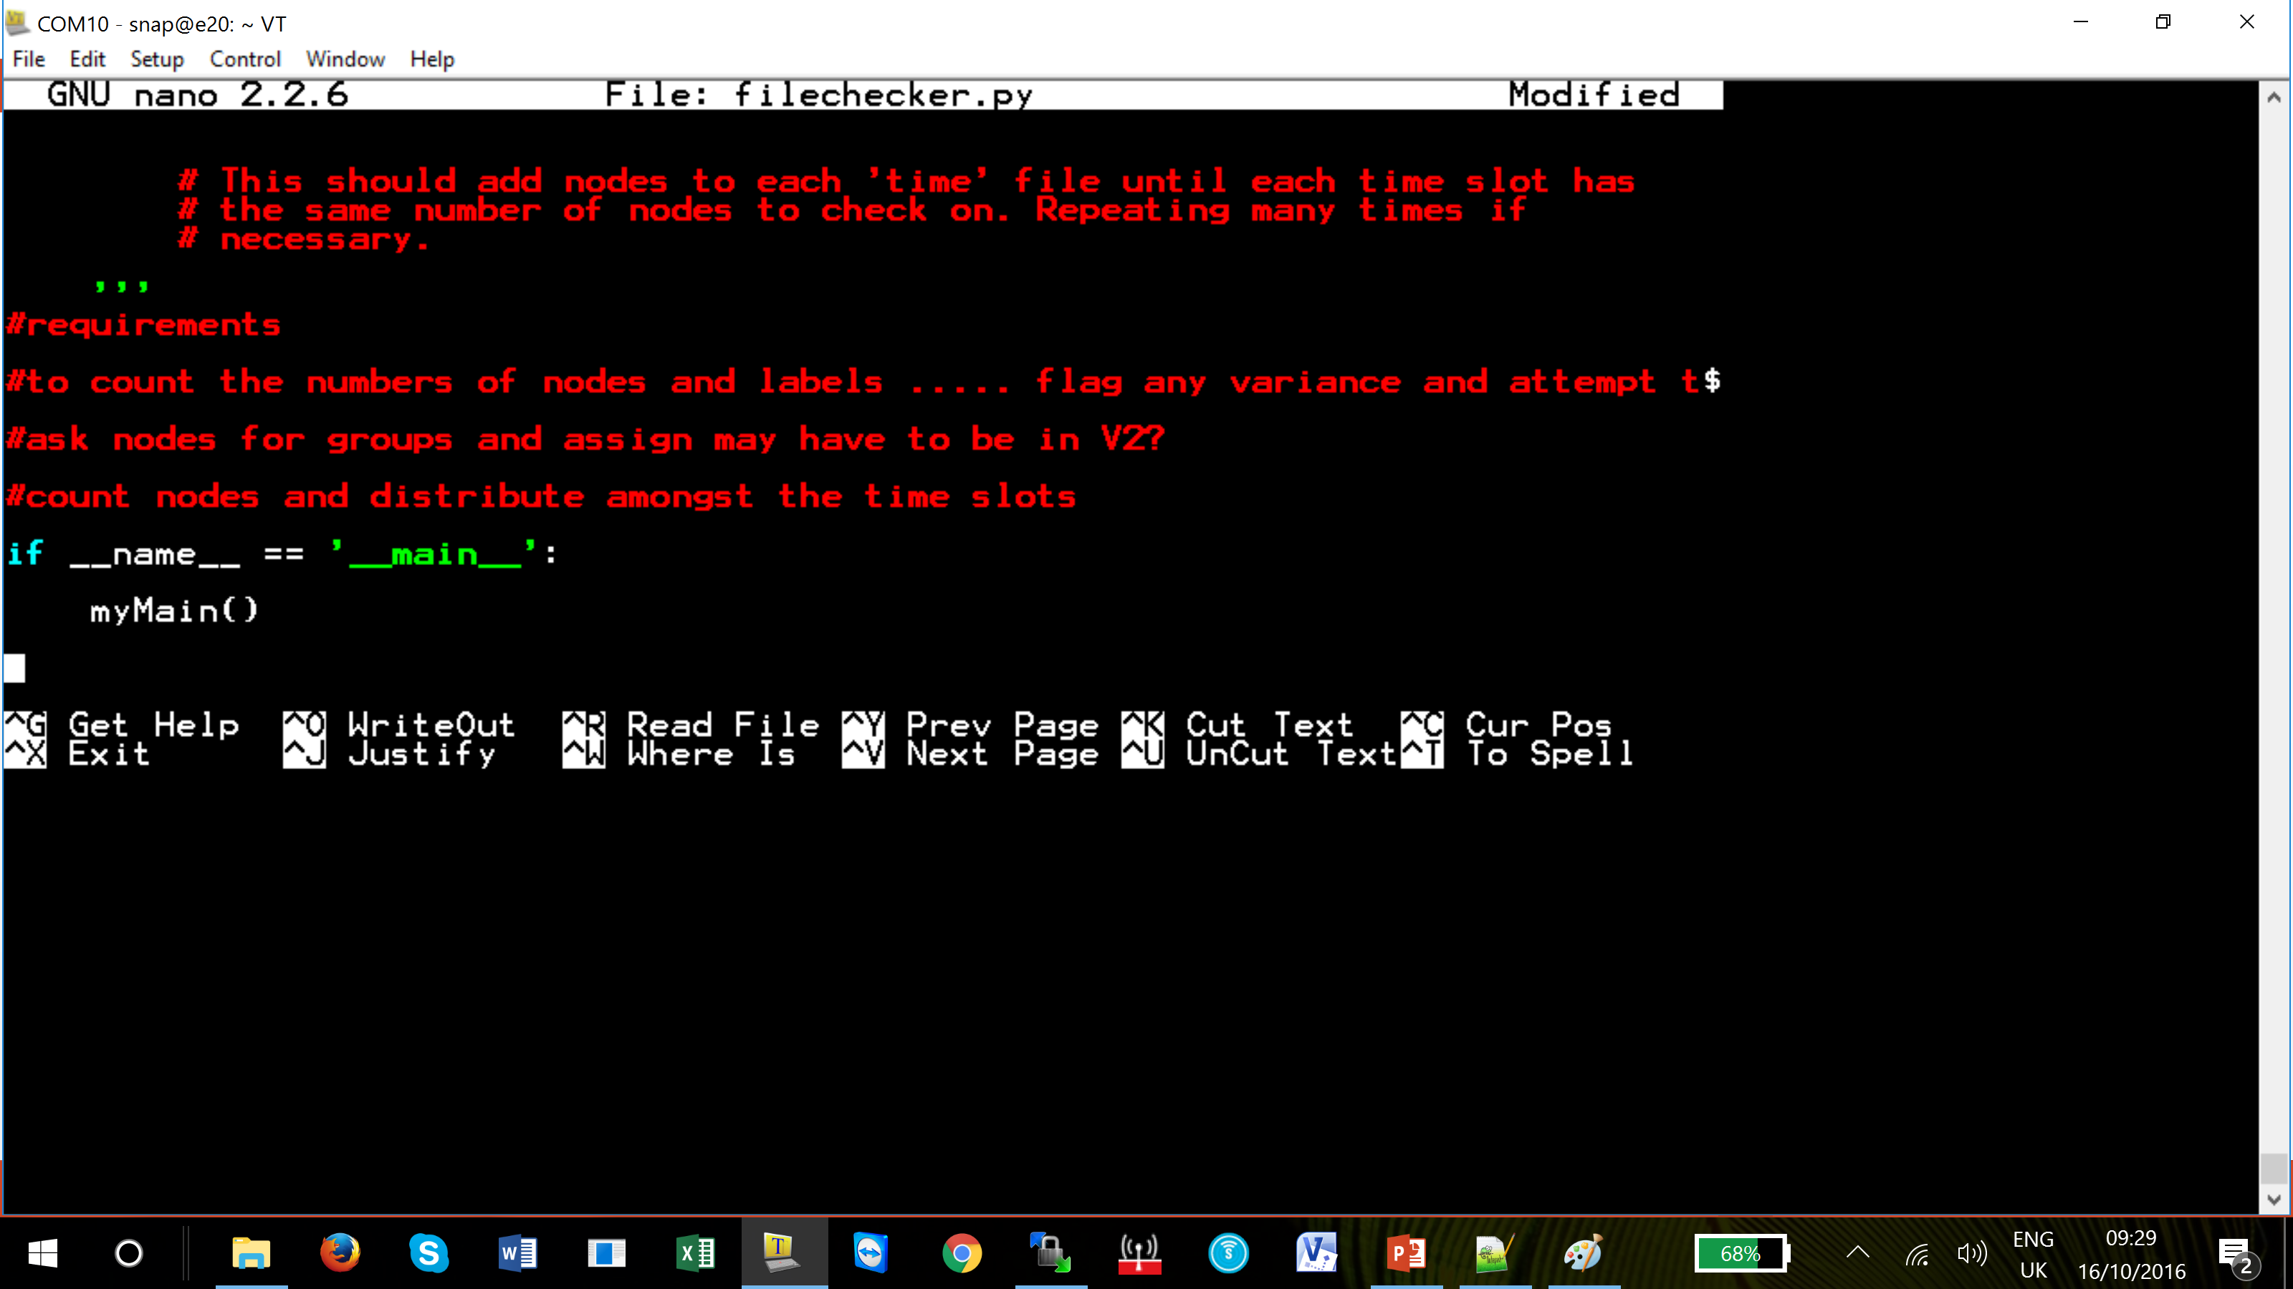
Site Controller
Check in NotePad++ that all the file has been copied across by looking at the last line in each file.
Press Ctrl and x, it will ask you to save the file, enter Y then enter.

Slide 19
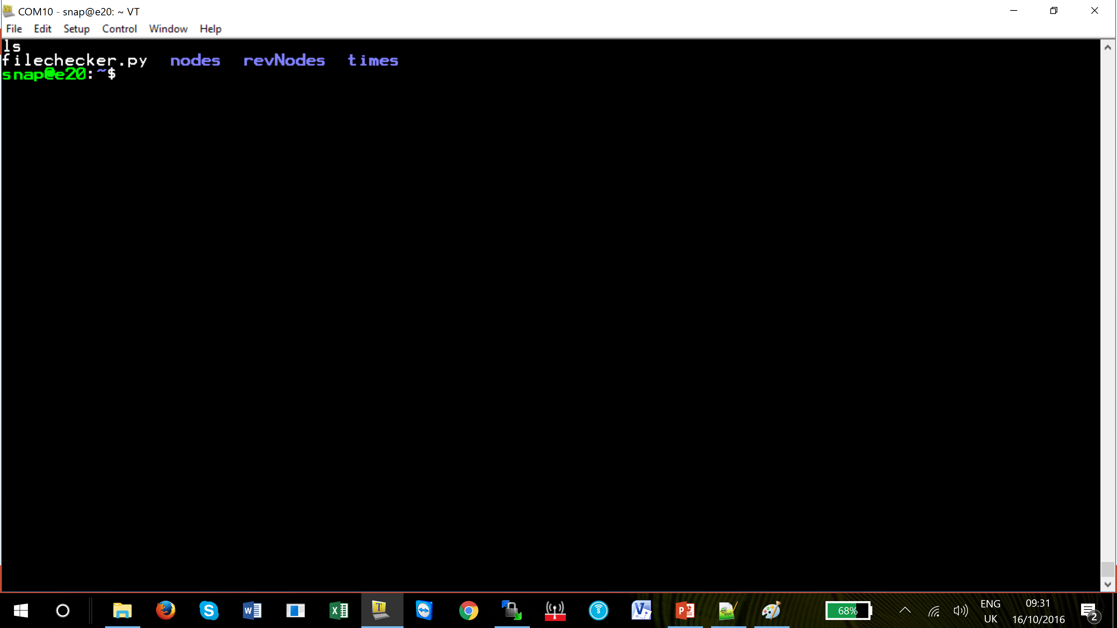
Site Controller
In the Snap line enter the ls command.
The file ‘filechecker.py has been added to the Snap folder.

Slide 20
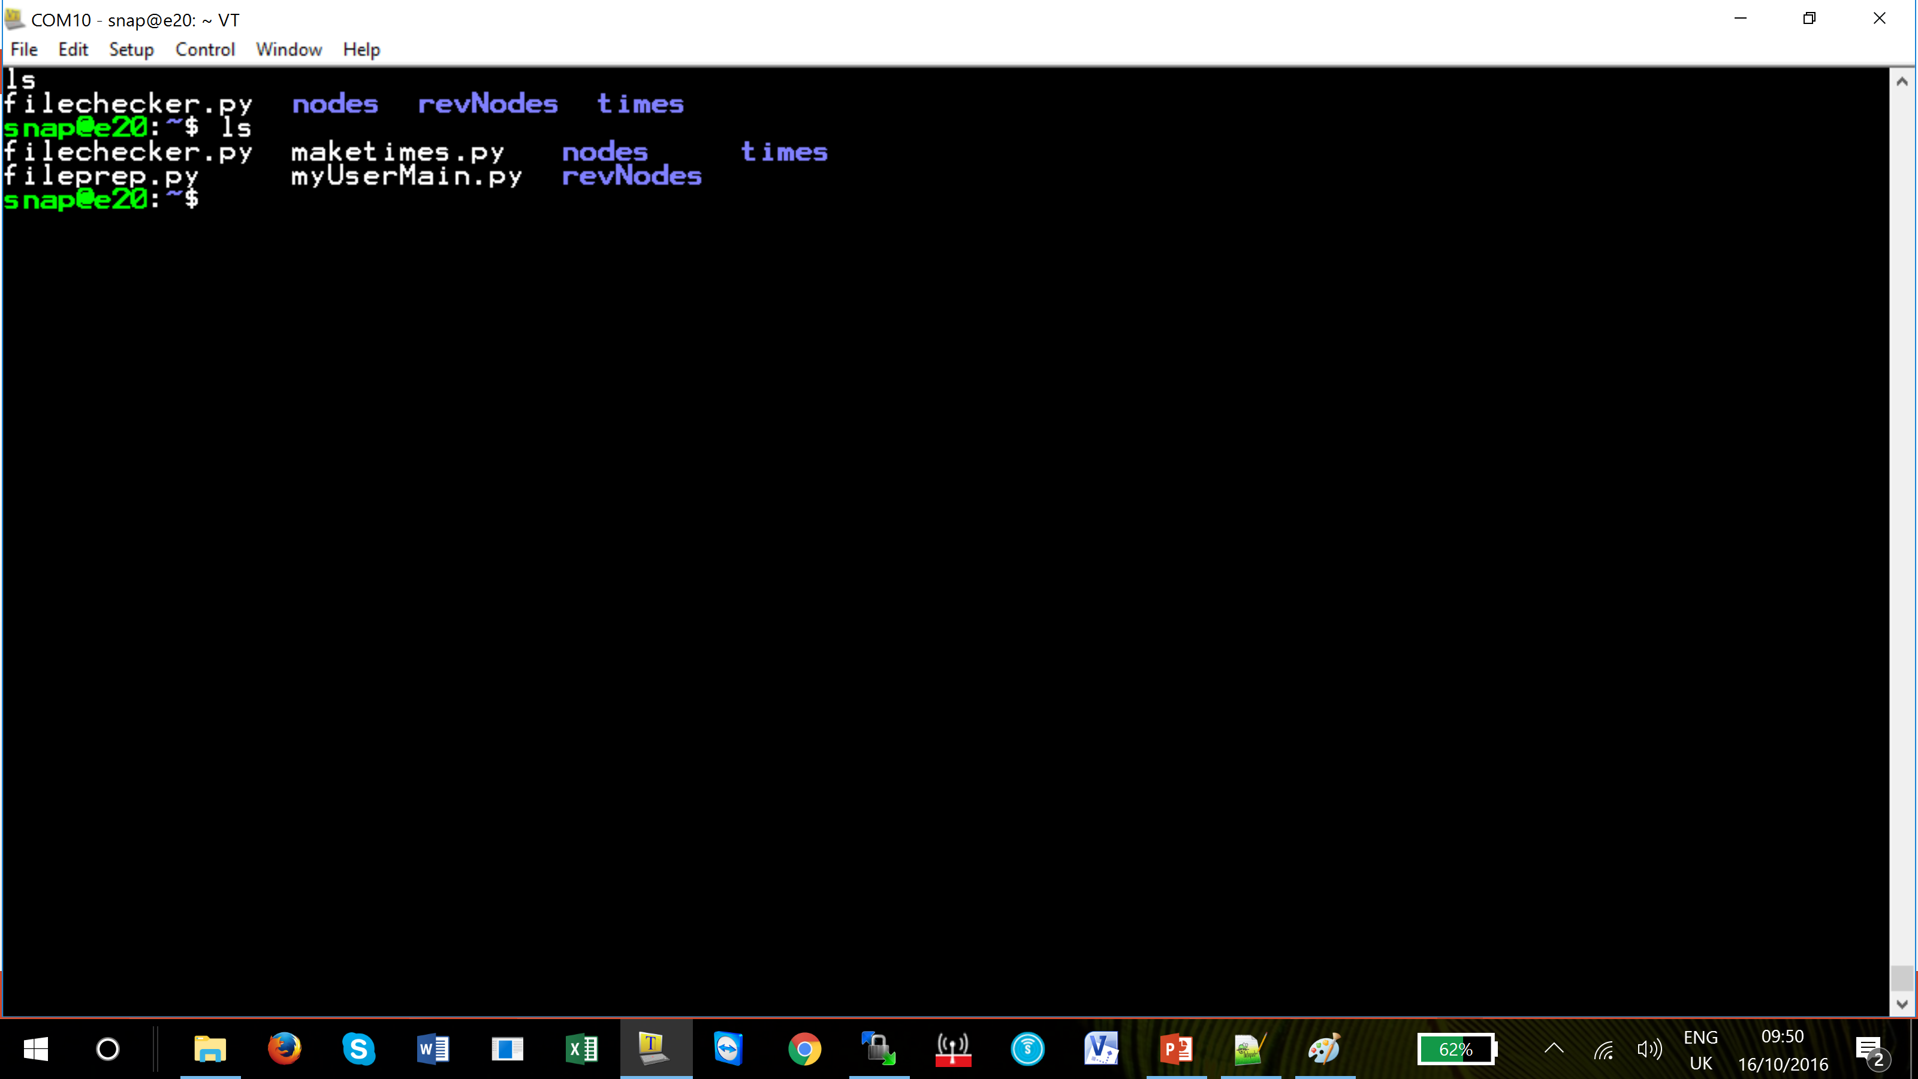
Site Controller
Carry out the same procedure for the reaining files.
When this is complete use the ls command to see the files in the Snap folder

Slide 21
Site Controller
The site controller is now ready for populating with the site nodes

Slide 22
Site Controller
  2. Drag and Drop Method
The files below need to be loaded onto the site controller
filechecker.py
fileprep.py
maketimes.py
myUserMain.py

Slide 23
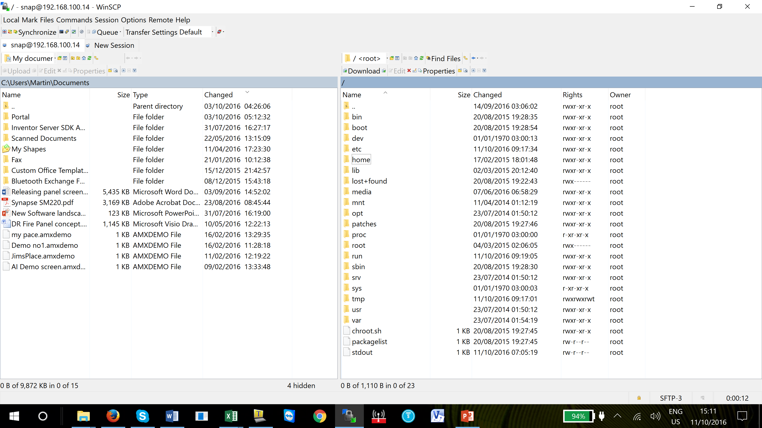
Site Controller
Using WinSCP to edit the site controller.
Once the PC has logged into WinSCP, as previously described, the default screen will appear.
The left hand side is the PC, the right hand side is the site controller.
Click on the Home folder and select the Snap folder

Slide 24
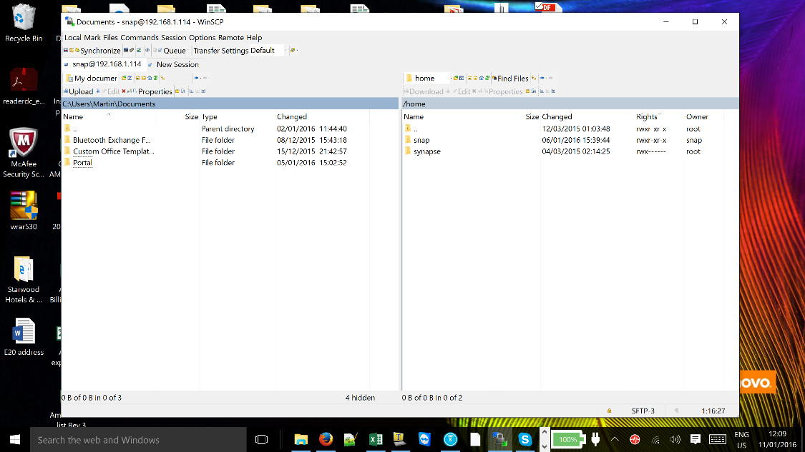
Site Controller
Using WinSCP to edit the site controller.
The left hand side is the PC, the right hand side is the site controller. The Snap folder will be visible
We recommend you create a folder in ‘Portal’ for all the files that will be transferred to the site controller.

Slide 25
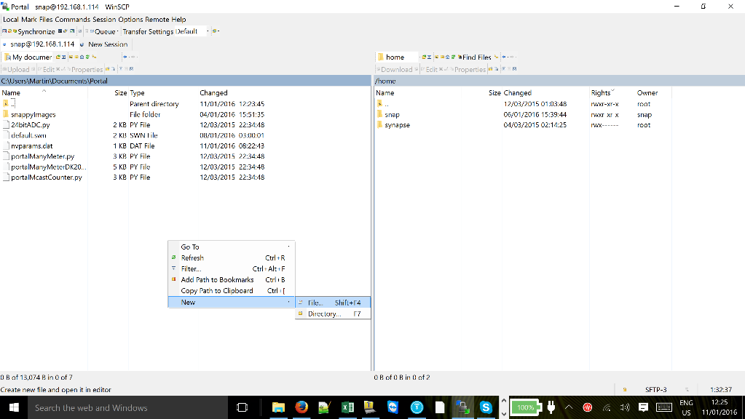
Site Controller
Using WinSCP to edit the site controller.
This also acts as a back-up for all the files on the site controller in case any changes are made at a later date

Slide 26
Site Controller
Using WinSCP to edit the site controller.
To make the folder.
Double click on ‘Portal’ folder and then right mouse click below the last file name. Click on ‘New’ and select ‘Directory’.
The new Directory name will appear in the left hand side window.
Notes:
We have called ours Site Controller

Slide 27
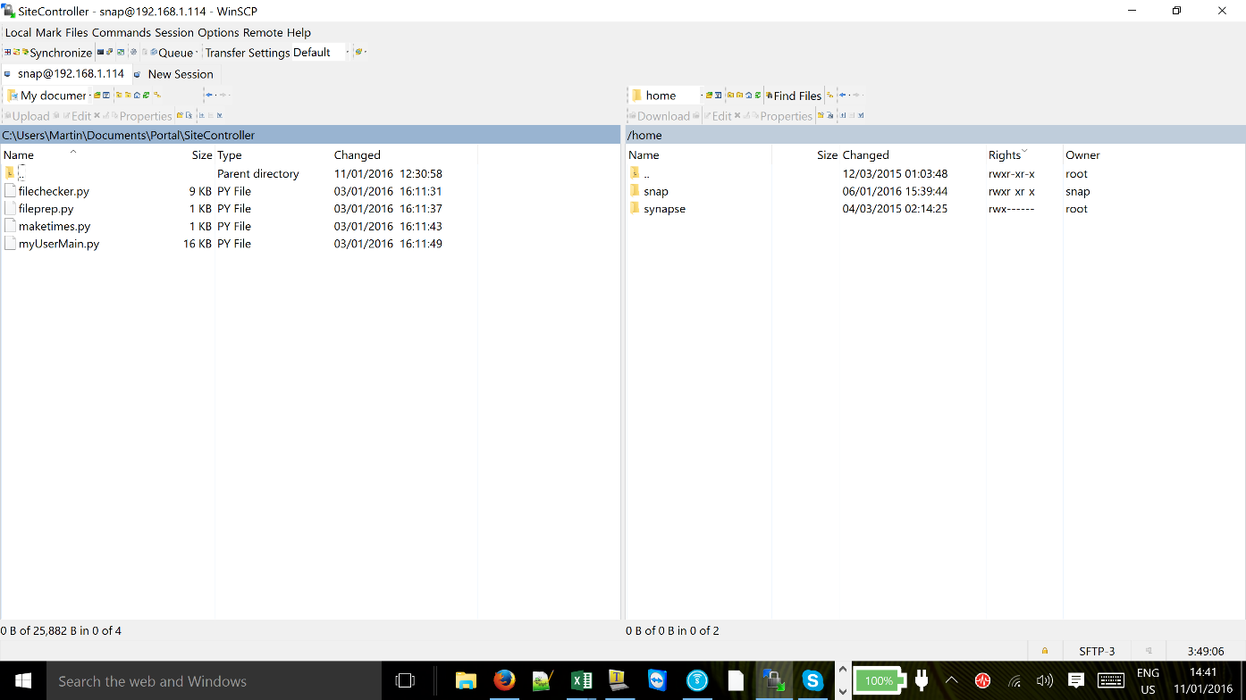
Site Controller
Using WinSCP to edit the site controller.
Open the ‘Site Controller’ folder.
Copy the four files into this folder.
This repository can be used as a safe area to store all the files in case they corrupted in anyway.
Double click the Snap folder in the right hand window – this will allow access to the Snap folder.

Slide 28
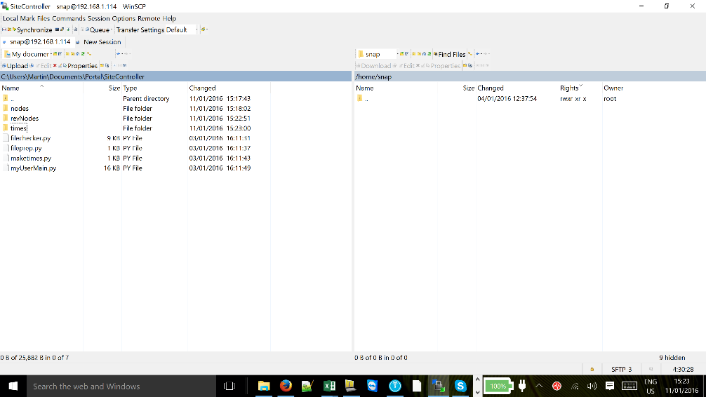
Site Controller
Using WinSCP to edit the site controller.
In the left hand window click right hand mouse key, select ‘New’ and then ‘Directory’. In the same manner as creating Site Controller folder
Create a folder called ‘nodes’.
Carry out the same procedure for the folders ‘revNodes’ and ‘times’.
There should now be four files and three folders in the new Site Controller folder

Slide 29
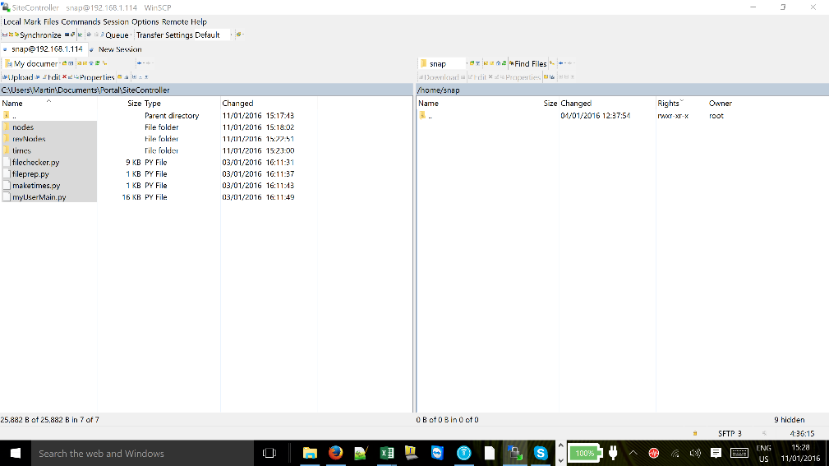
Site Controller
Using WinSCP to edit the site controller.
Click on and highlight ‘nodes’ folder or whichever file or folder is first on the list (not the double dot folder). Press CTRL A and all the folders and files will be selected.
If you wish you can select them individually by the normal windows method CTRL and click on file or Shft and click on the last files

Slide 30
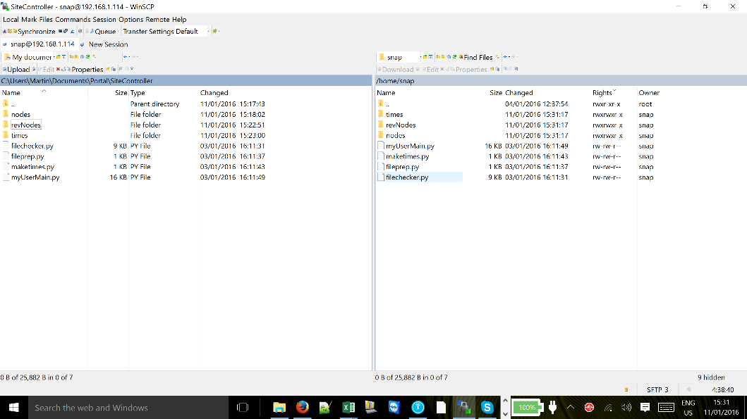
Site Controller
Using WinSCP to edit the site controller.
Click on the highlighted files with the right mouse and drag all the files over to the right hand side of the screen.
These files have now been copied into the ‘snap’ folder on the site controller.
If you wish you can drag and drop individual files into the Snap folder on the right hand side window.

Slide 31
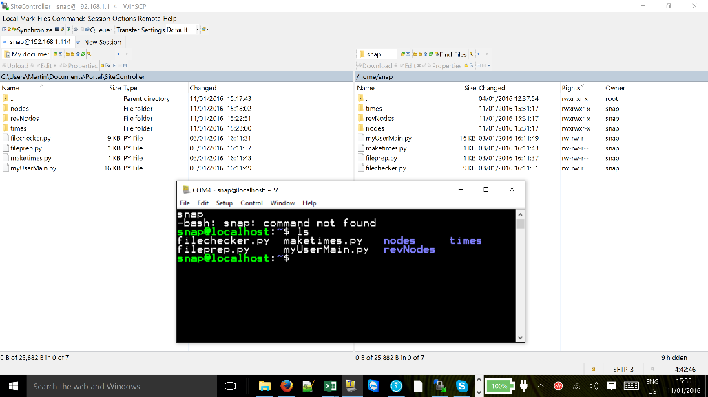
Site Controller
Configuring the site controller.
Log into the site controller using Tera Term and type ls after the ‘snap@........:~.
With the ls command you can see the files have been transferred from your PC to the site controller.

Slide 32
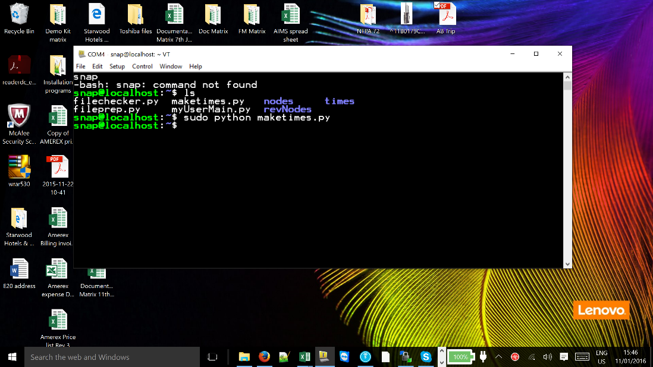
Site Controller
Configuring the site controller.
Type the following in Tera Term editor window,
sudo python maketimes.py
and press enter.
At this point you may be requested to enter the password, enter your password you have chosen.

Slide 33
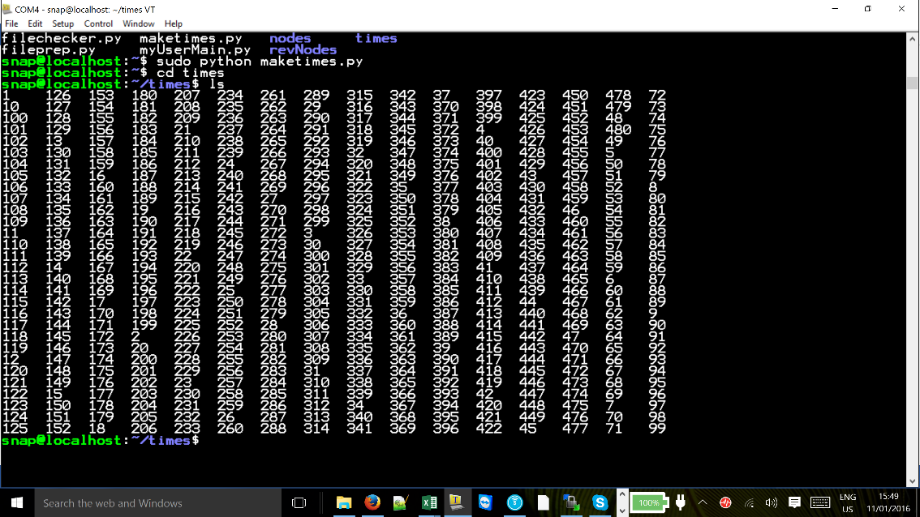
Site Controller
Configuring the site controller.
Type cd times, press enter
Type ls – this will show a list of numbers which have now populated the folder ‘times’.
Now type cd .. and you will return to the main ‘snap’ folder.

Slide 34
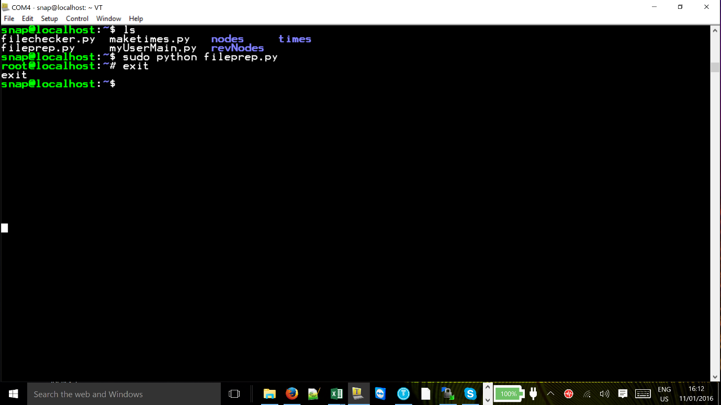
Site Controller
Configuring the site controller.
Once back into the ‘snap’ folder, type ls, this shows the files and folders that are held in the snap folder.
Carry out the same procedure for fileprep.py and filechecker.py in that order.
Type sudo python fileprep.py and press enter.

Slide 35
Site Controller
Configuring the site controller.
This program is running a “shell program” and therefore requires to be stopped. You will have noticed the fileprep.py file has changed the folder to root@localhost:~$.
Type exit and you will return to the ‘snap’ folder.

Slide 36
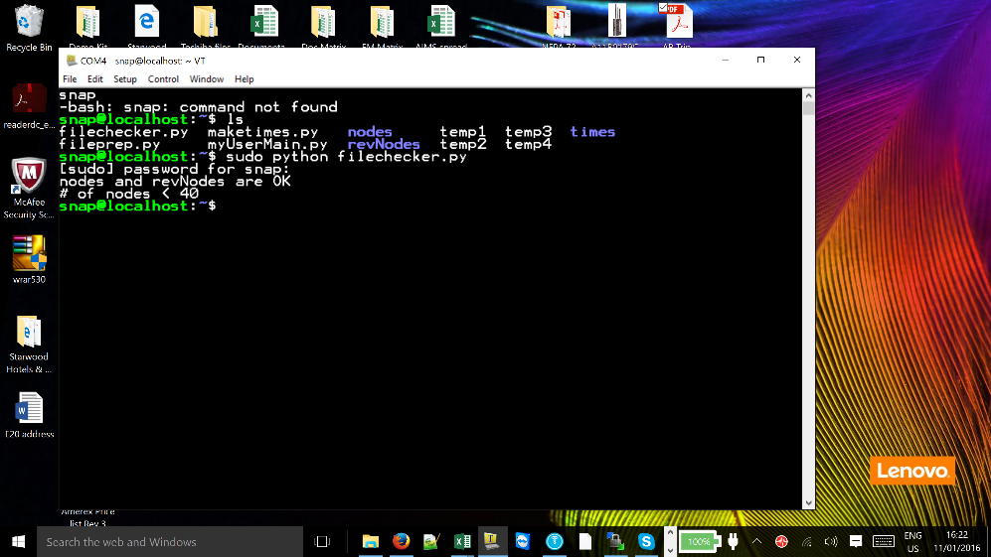
Site Controller
Configuring the site controller.
Now after snap@localhost:~ $ type sudo python filechecker.py
This file checks to see if there is any node information in ‘nodes’ and ‘revNodes’. These folders must at all times be equal and if not an error will occur. As we have not entered and node information into the site controller we receive an ‘OK’ from the system.
Notes:
We recommend filechecker.py is run after loading the node information as described in the new node procedure manual.

Slide 37
Site Controller
Configuring the site controller.
Restarting Supervisor
The site controller is now ready to be populated with the new nodes.
We shall now proceed to populate the snap folder with the new nodes.
To restart and stop the supervisor program by typing in the Tera Term editor window the following;
sudo /etc/supervisor restart and then sudo /etc/supervisor stop
Please refer to the manual ‘Procedure for new node to be entered onto the network’ for up-dating and automatically populating the site controller with the field node information.
Notes:
Note - the supervisor routine must be stopped and restarted before and after any changes are made to the site controller systems.

Slide 38
Questions?
Notes:
Note –

Slide 39
Return

