Slide 1
SC No.2

Slide 2
Site Controller
Loading software

Slide 3
Site Controller
Installation of software
After downloading the Tera Term and the other software programs save the files in a folder called ‘Installed Programs’ in a location you can easily get to from your desktop or on your desk top itself.
This ‘Installed programs’ folder will need to be created by the user.
We recommend saving all the downloaded programs to this folder.

Slide 4
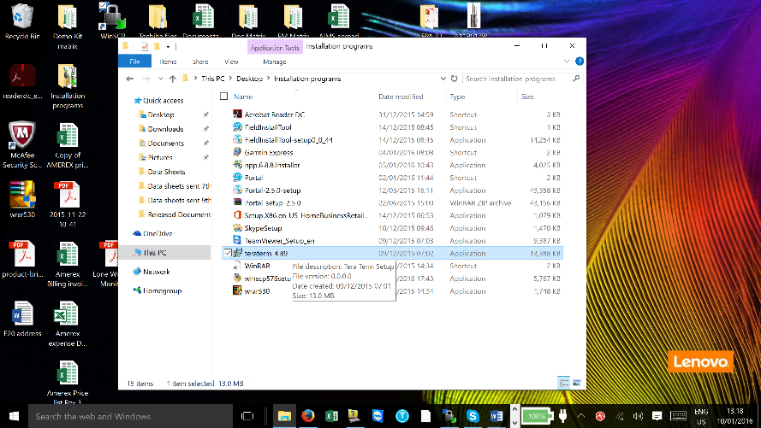
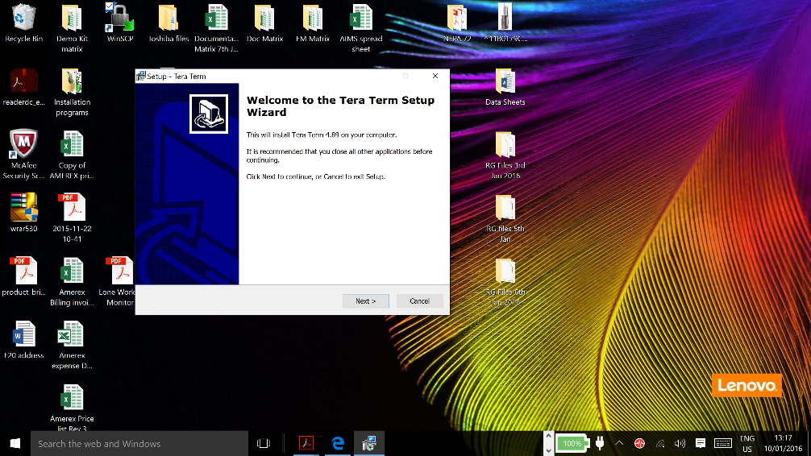
Site Controller
Installation of Tera Term
Tera Term is a program that allows you create and edit files in a ‘Dos’ type environment but using Linux commands
Double click on the downloaded file and follow the instruction on how to install the software.
Click ‘Next’

Slide 5
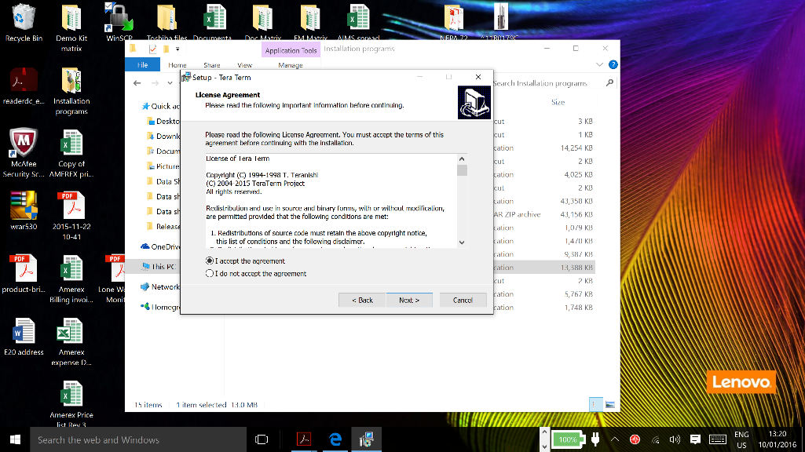
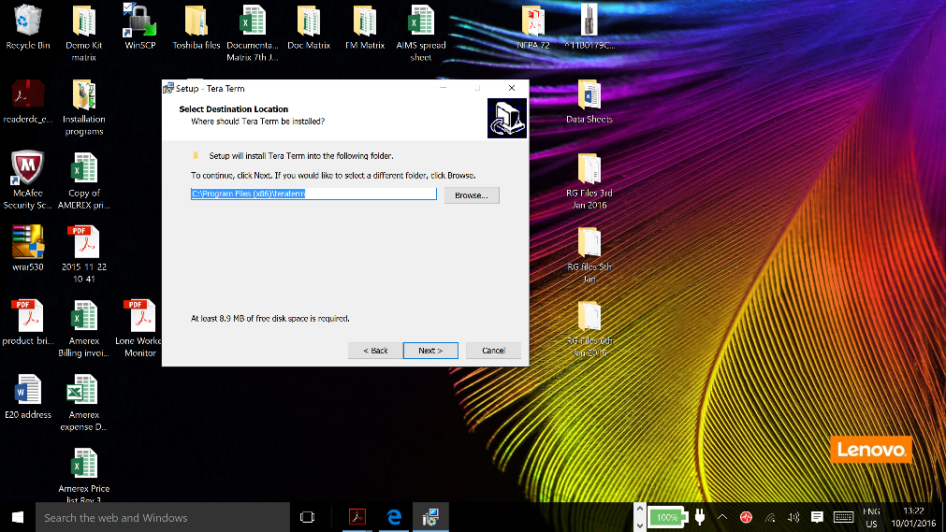
Site Controller
Installation of Tera Term
Accept the agreement and click ‘Next’.
Click ‘Next’ unless you wish to change the target folder

Slide 6
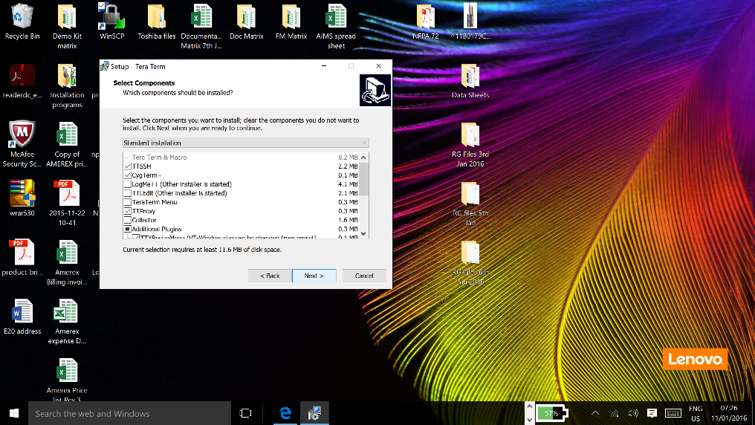
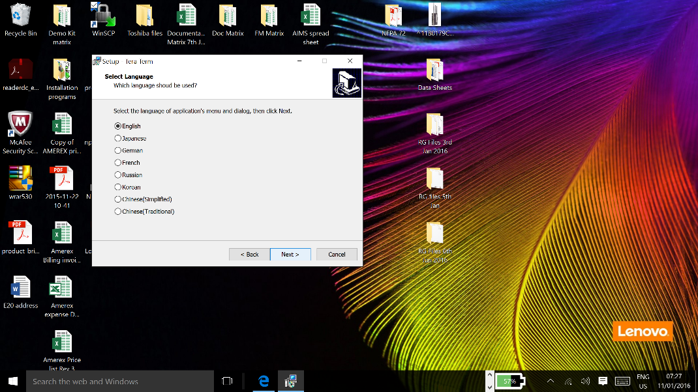
Site Controller
Installation of Tera Term
Click ‘Next’
Select a language and
press ’Next’

Slide 7
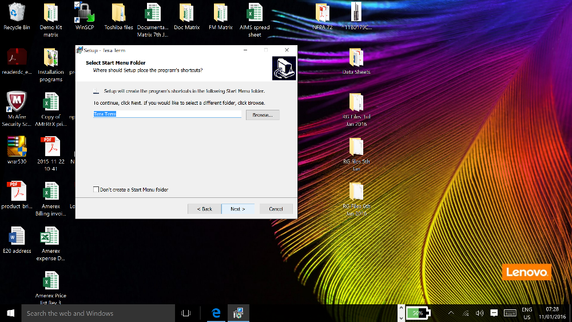
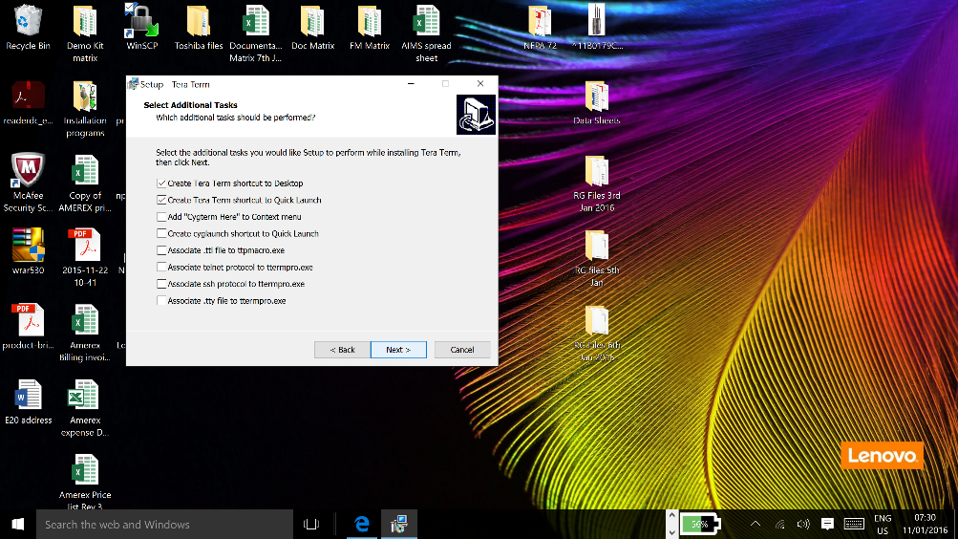
Site Controller
Installation of Tera Term
Press ‘Next’ unless you wish to change anything
Click ‘Next’

Slide 8

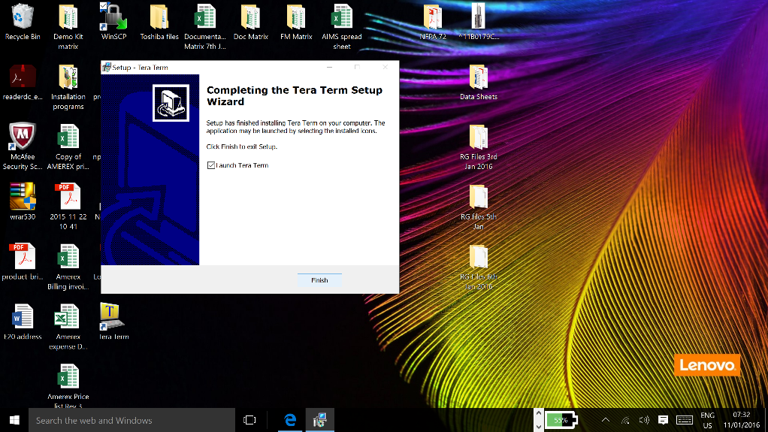
Site Controller
Installation of Tera Term
Click ‘Install’
If you wish Tera Term to launch after closing the window tick the check box.
Click ‘Finish’

Slide 9
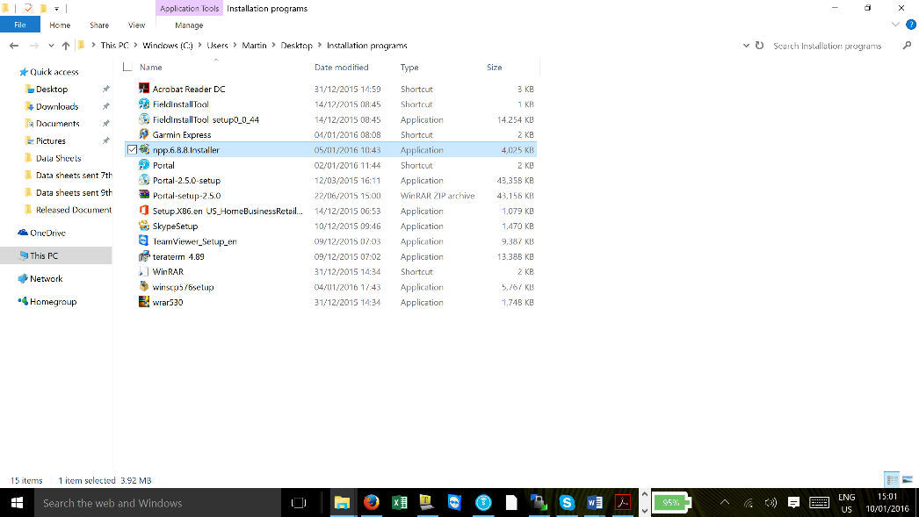
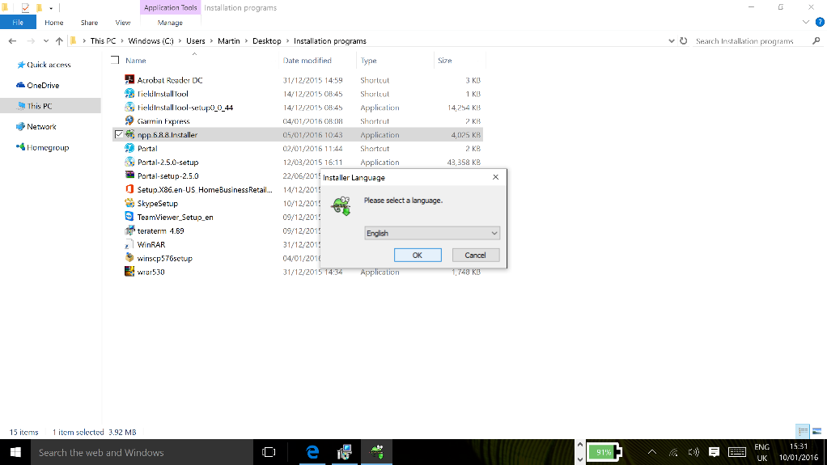
Site Controller
Installation of NotePad ++
Double click on the downloaded file and follow the instruction on how to install the software.
Click OK for English or scroll down until the language required is shown in the window.

Slide 10
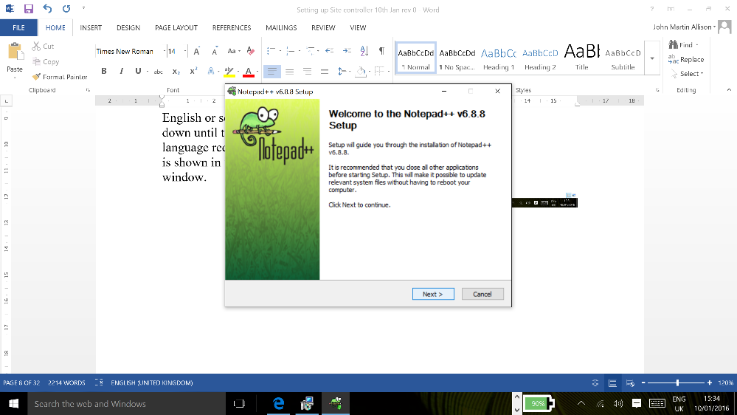
Site Controller
Installation of NotePad ++
Click ‘Next’

Slide 11
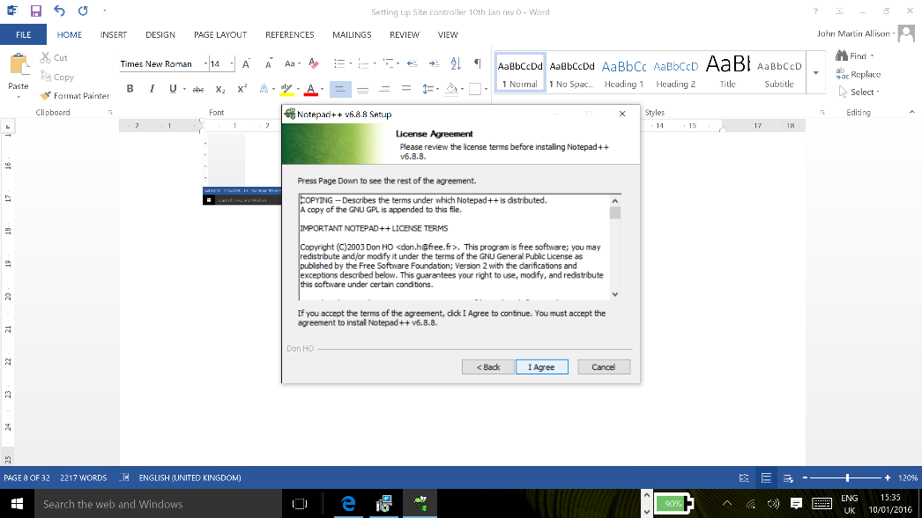
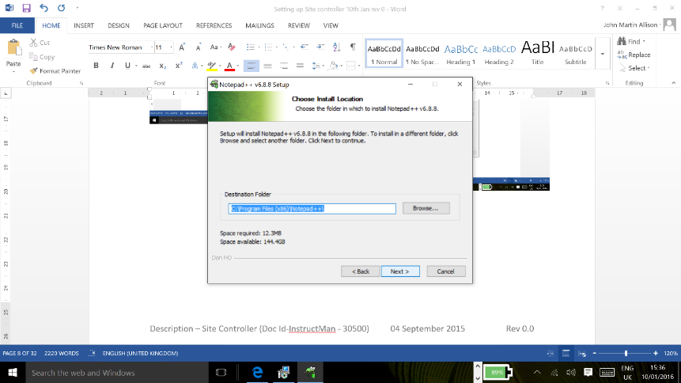
Site Controller
Installation of NotePad ++
Click ‘I Agree’
Click ‘Next’

Slide 12
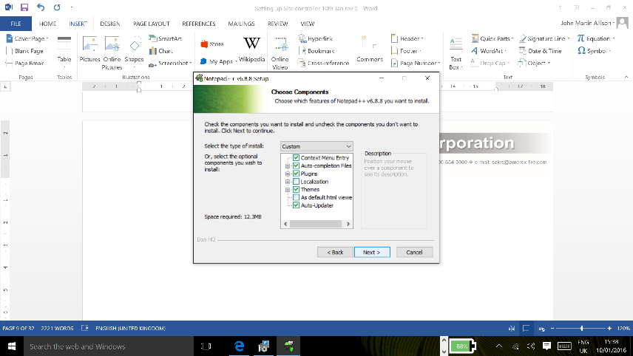
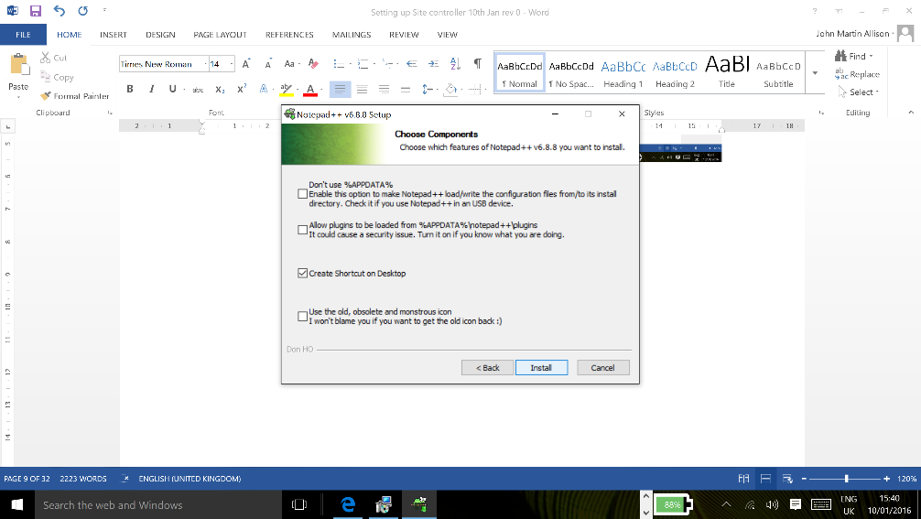
Site Controller
Installation of NotePad ++
Click ‘Next’
Tick the ‘Create Shortcut on Desktop’ and press ‘Install’

Slide 13
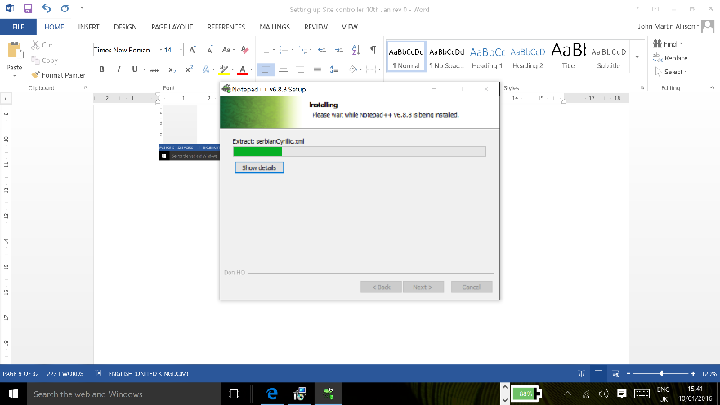
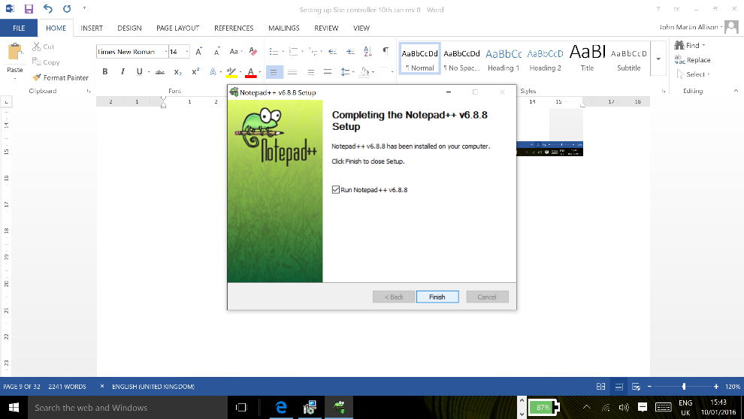
Site Controller
Installation of NotePad ++
A progress bar will show the status of the program.
Click ‘Finish’ and NotePad++ and the installation is complete and is ready to run.

Slide 14
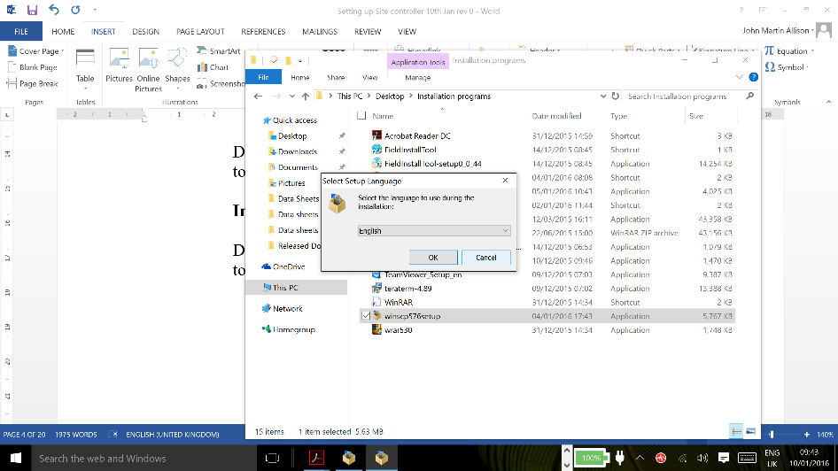
Site Controller
Installation of WinSCP
Double click on the downloaded file and follow the instructions on how to install the software.
Select the language you wish to use – for the example we have chosen English

Slide 15
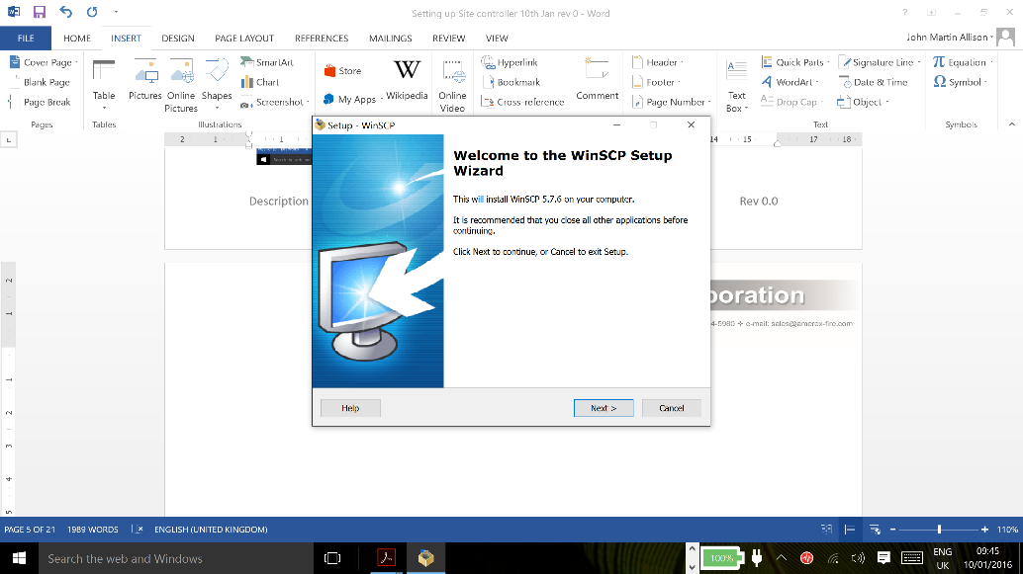
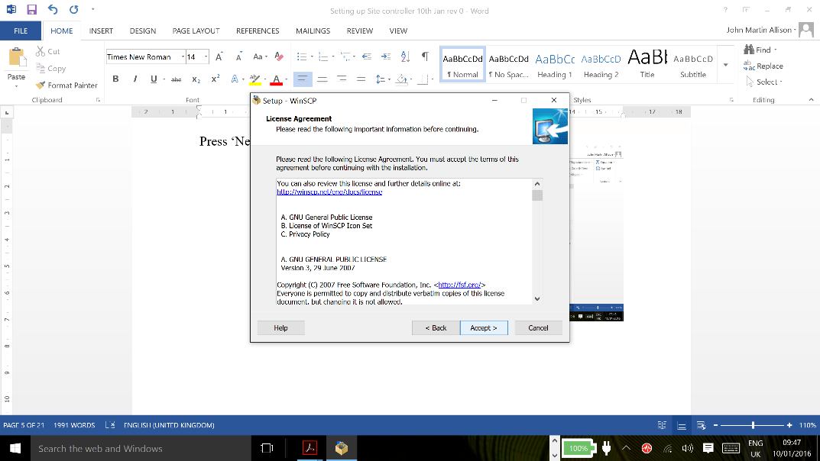
Site Controller
Installation of WinSCP
Press ‘Next’
and
click ‘Accept’

Slide 16
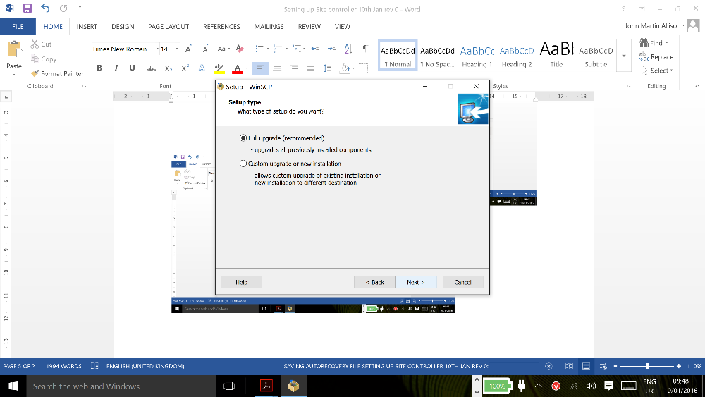
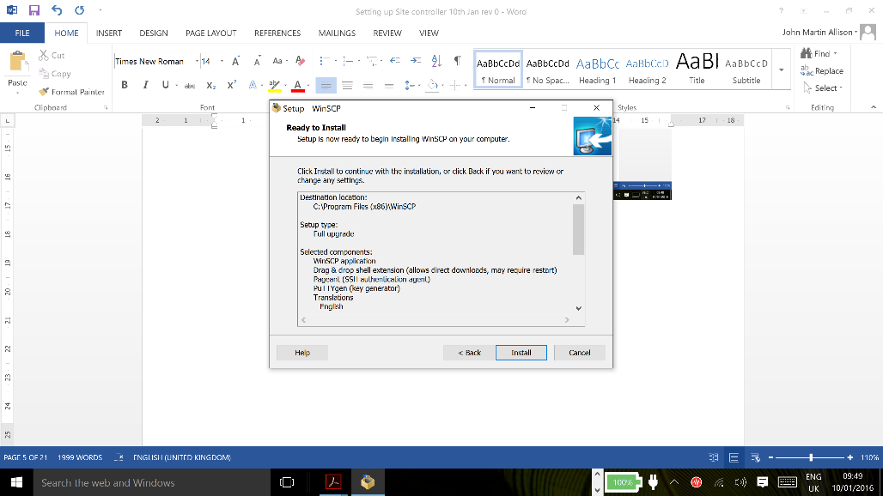
Site Controller
Installation of WinSCP
Click ‘Next’ for Full Upgrade
Click ‘Install

Slide 17
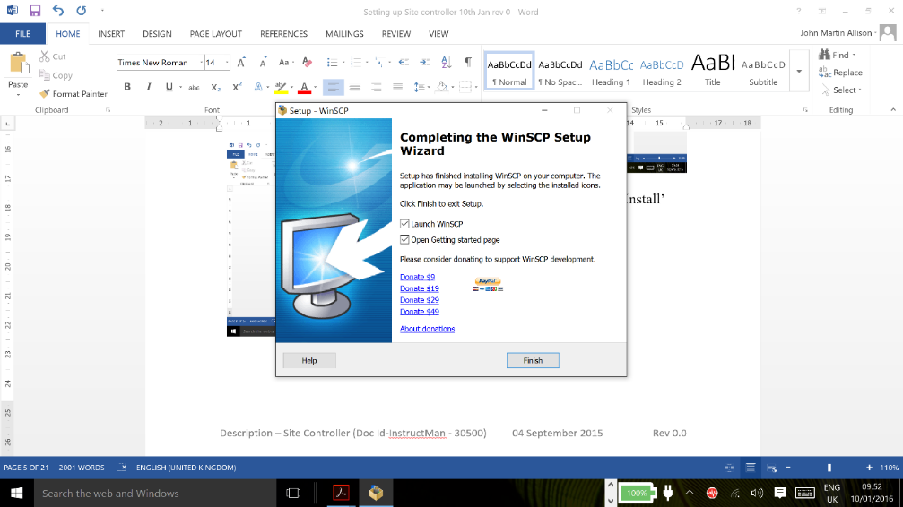
Site Controller
Installation of WinSCP
….and then click ‘Finish’.

Slide 18
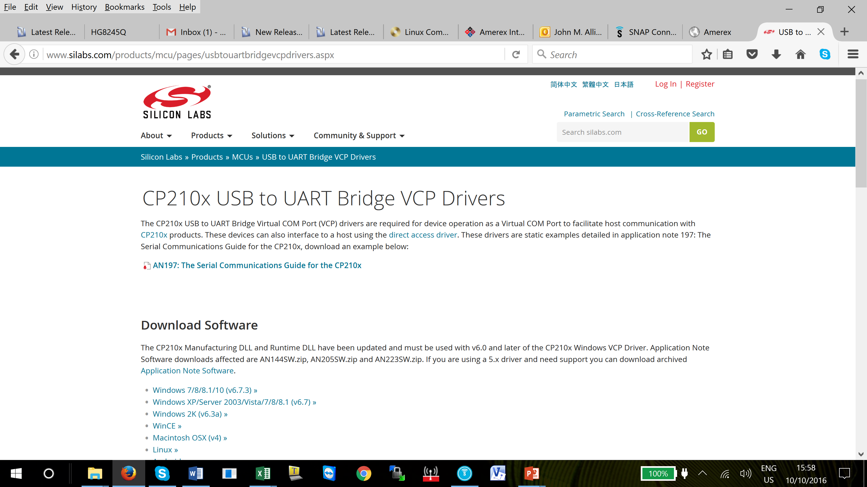
Site Controller
Site Controller driver
A driver may be required depending on which version of Windows you have running on your machine.
Load the driver and restart Windows
http://www.silabs.com/products/mcu/pages/usbtouartbridgevcpdrivers.aspx

Slide 19
Questions?
Notes:
Note –

Slide 20
Return

