Slide 1
SC No.1

Slide 2
Site Controller
Modifying existing files

Slide 3
Site Controller
Changes to supervisord.conf file
At this point we need to modify the supervisord.conf file which is located in the /root/etc/supervisor folder.
This change can be completed by WinSCP.
The changes to the file are highlighted in yellow. We recommend these to copied and pasted into the file.

Slide 4
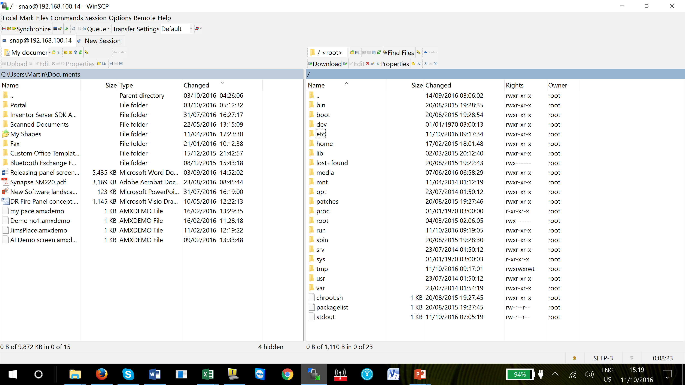
Site Controller
At this point we need to modify the supervisord.conf file which is located in the /root/etc/supervisor folder.

Slide 5
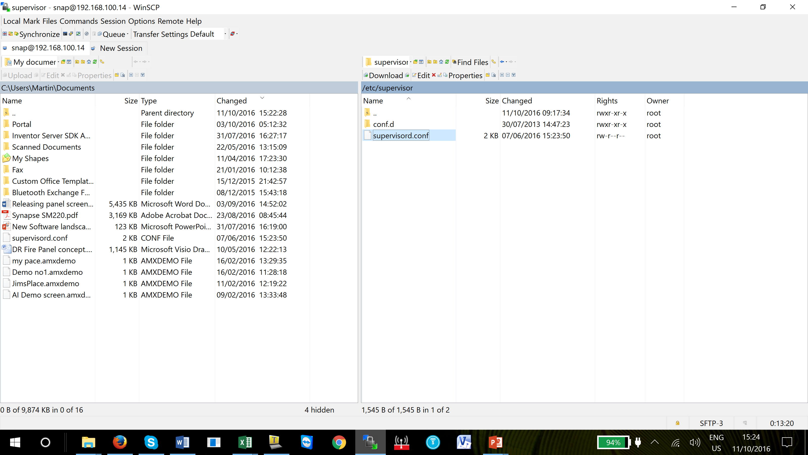
Site Controller
Drag and then
drop the supervisord.conf file
from the site controller window to the PC window.

Slide 6
Site Controller
Open the file by double clicking on the highlighted supervisord.conf and add in the lines which are highlighted.
Once completed, save the file and copy it from the PC window to the root/etc/supervisor folder.
; supervisor config file
[unix_http_server]
file=/var/run/supervisor.sock ; (the path to the socket file)
chmod=0700 ; sockef file mode (default 0700)
[supervisord]
logfile = /media/ramdisk/supervisord.log
logfile_maxbytes = 1MB
logfile_backups = 5
logfile=/var/log/supervisor/supervisord.log ; (main log file;default $CWD/supervisord.log)
pidfile=/var/run/supervisord.pid ; (supervisord pidfile;default supervisord.pid)
childlogdir=/var/log/supervisor ; ('AUTO' child log dir, default $TEMP)
Notes:
See supervisord.conf file in the site controller manual

Slide 7
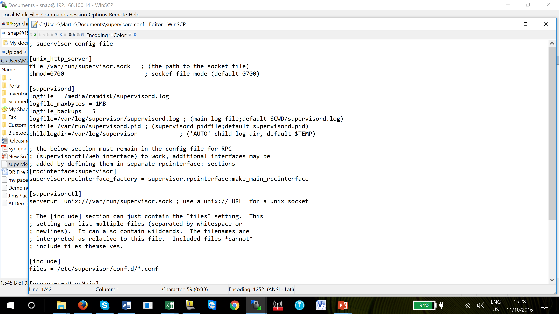
Site Controller
Open the file by double clicking on the highlighted supervisord.conf and add in the lines which are highlighted.
See supervisord.conf file in the site controller manual

Slide 8
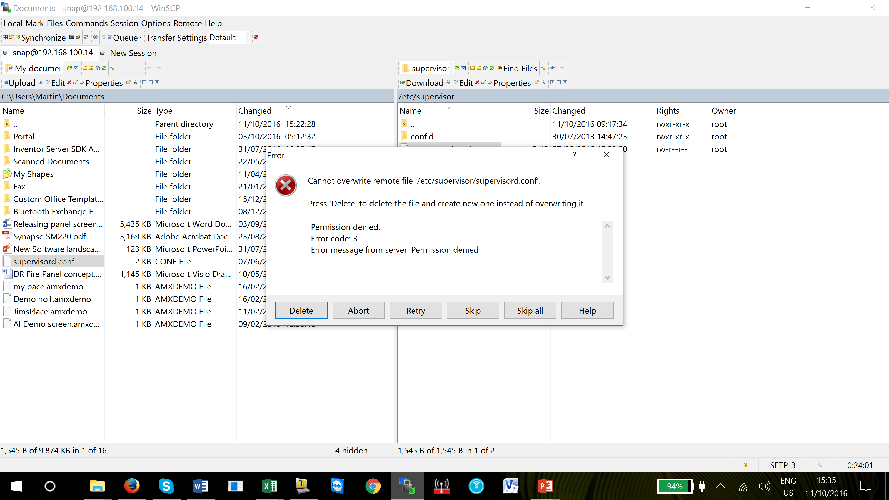
Site Controller
If the WinSCP denies access to the copying the file then we can use Tera Term to copy the file into the Supervisor folder.

Slide 9
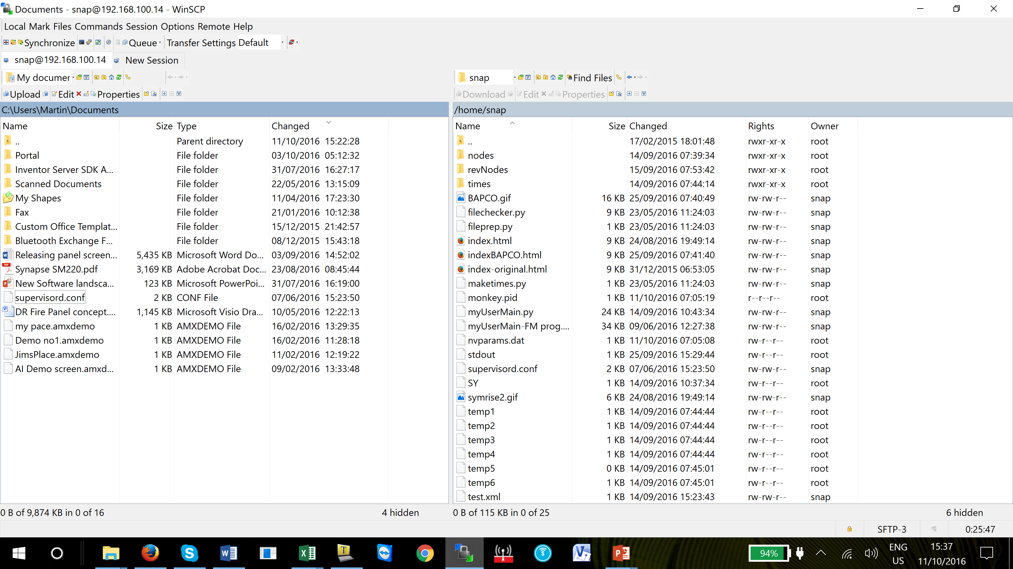
Site Controller
Drag and drop the supervisord.conf file into the Snap folder.

Slide 10
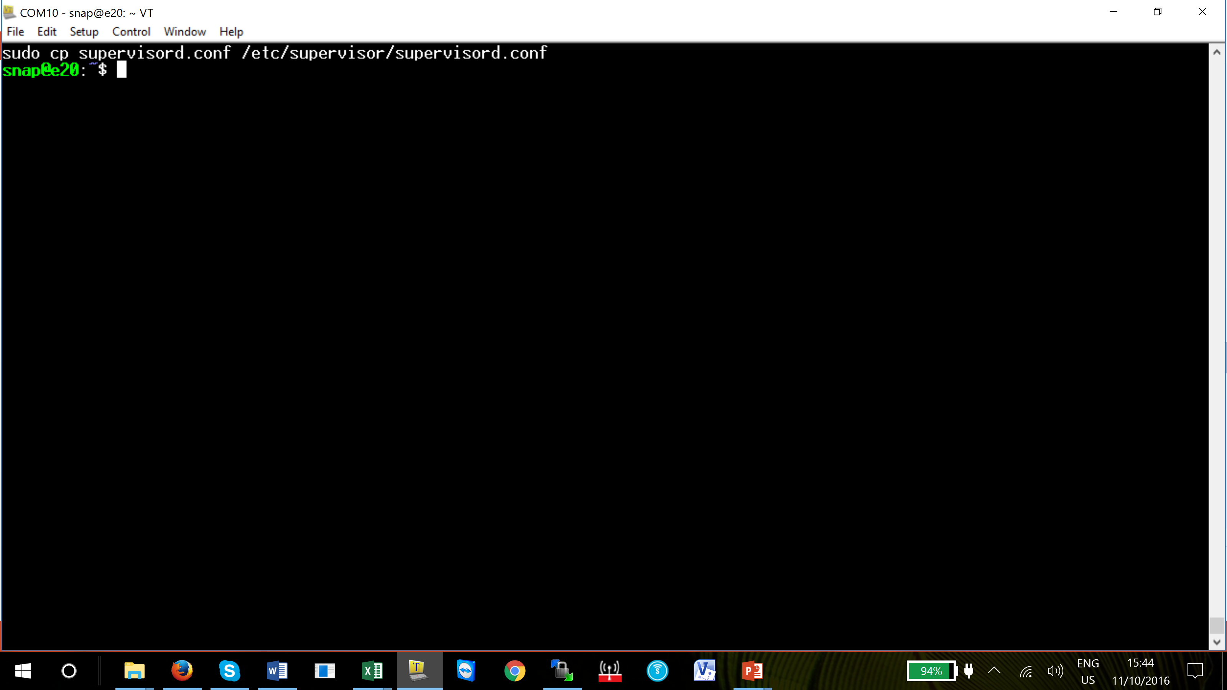
Site Controller
Connect to Tera Term and in the editor window type the command
sudo cp supervisord.conf /etc/supervisor supervisord.conf
Press enter and the file will be copied to the appropriate location

Slide 11
Site Controller
Changes to interfaces file
The site controller must have a fixed IP address. If the network allows the IP port to be a dedicated fixed IP address and will always be dedicated then this procedure will not be required, if not, it is recommended this procedure should be followed.
This change can be completed by WinSCP. We recommend this file to be copied and pasted into the saved file.
Notes:
Note – Use the IP address and other information of your site controller not the IP address used in the example below

Slide 12
Site Controller
Find the interfaces file which is in root/etc/network folder, copy interfaces file from the site controller window to the PC window.
Open the file by double clicking on the highlighted interfaces file and add in the lines and copy the following lines over the existing file. Once completed, save the file and copy it from the PC window to the root/etc/network folder.
Follow the same procedure as previously described.
Notes:
Note – Use the IP address and other information of your site controller not the IP address used in the example below

Slide 13
Questions?
Notes:
Note –

Slide 14
Return

