Slide 1
SC No.3

Slide 2
Site Controller
Setting up the
downloaded programs

Slide 3
Site Controller
Setting up the site controller
This section shows how to connect to the site controller with the different software packages – Tera Term and WinSCP.
…. and how to connect to the site controller via the serial port and LAN connections.

Slide 4
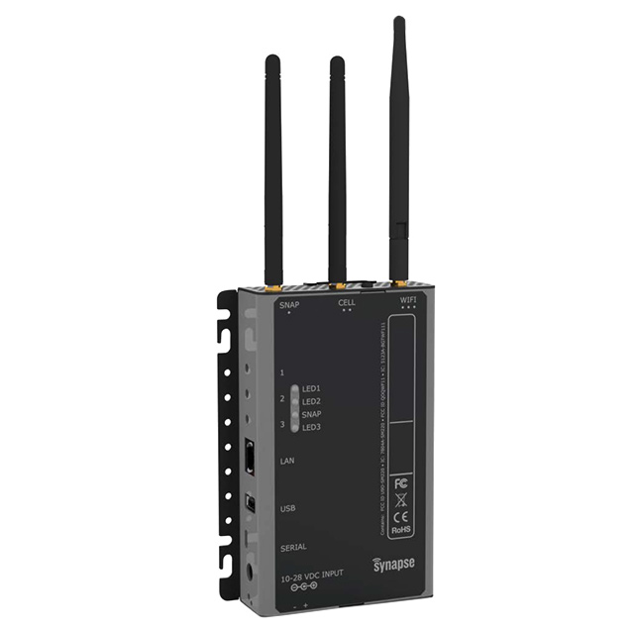
Site Controller
Programmable LED’s (x3)
Programmable buttons (x3)
LAN connection
USB connector
microUSB connector
24v d.c. terminal rail
a.c. Barrel connector

Slide 5
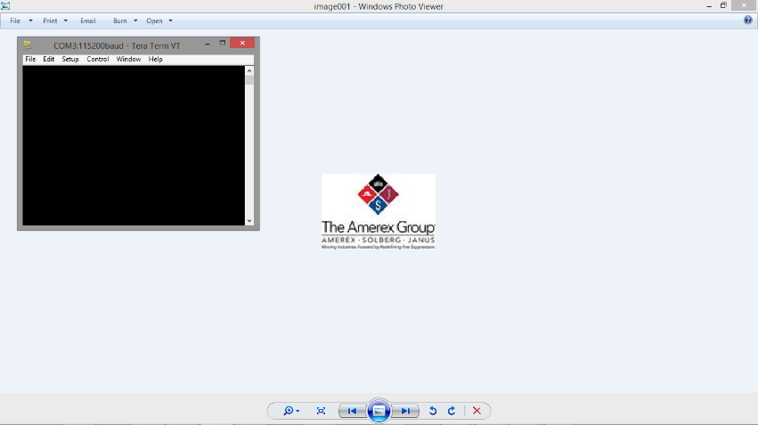

Site Controller
Setting up of Tera Term
After ‘Tera Term’ has been installed on your PC or laptop, connect the micro-usb to the site controller and the USB connector to your PC or laptop.
Double the icon on your desk top to start Tera Term.
A similar screen to the one shown in the above insert, should now be on the screen of the PC/Laptop.

Slide 6
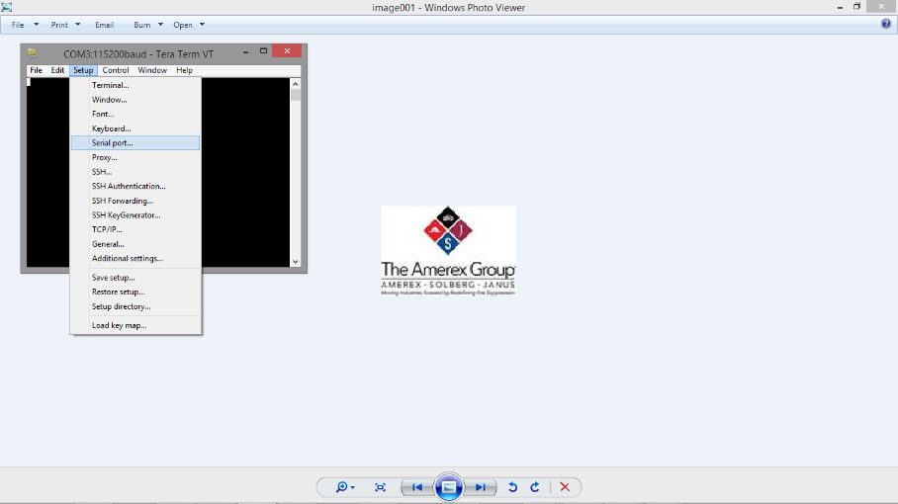
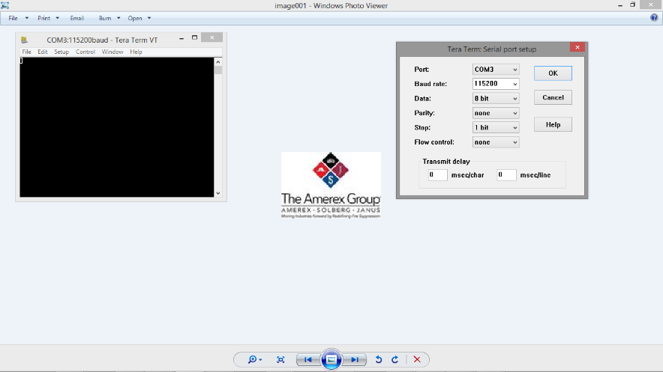
Site Controller
Installation of Tera Term
From the Menu line, select the Set Up tab in the Tera Term window.
A drop down menu shall appear. Select ‘Serial Port’
Select the Baud Rate 115200 and click OK.
To change the font size click the Setup tab select Font and change to the size you require and click OK

Slide 7

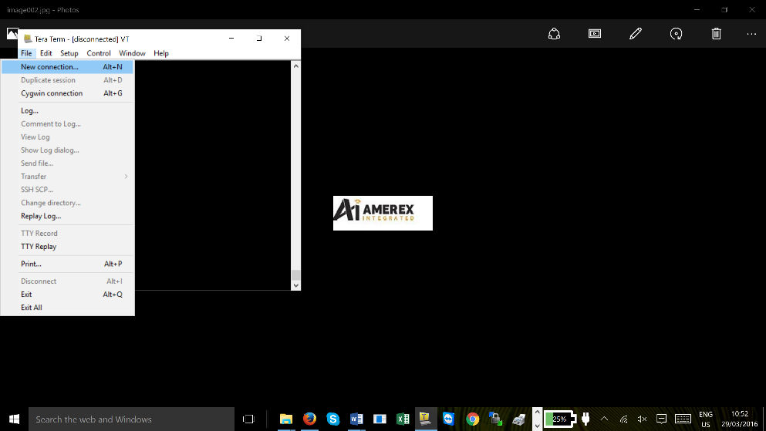
Site Controller
Connecting your PC, Laptop to the Site Controller
Once the set-up has been completed you are now able to connect to the site controller via Tera Term.
There two ways of connection to the site controller, one via the USB port and two via the IP address of the site controller. Both methods are basically the same. Click on ‘File’ and then ‘New connection’

Slide 8
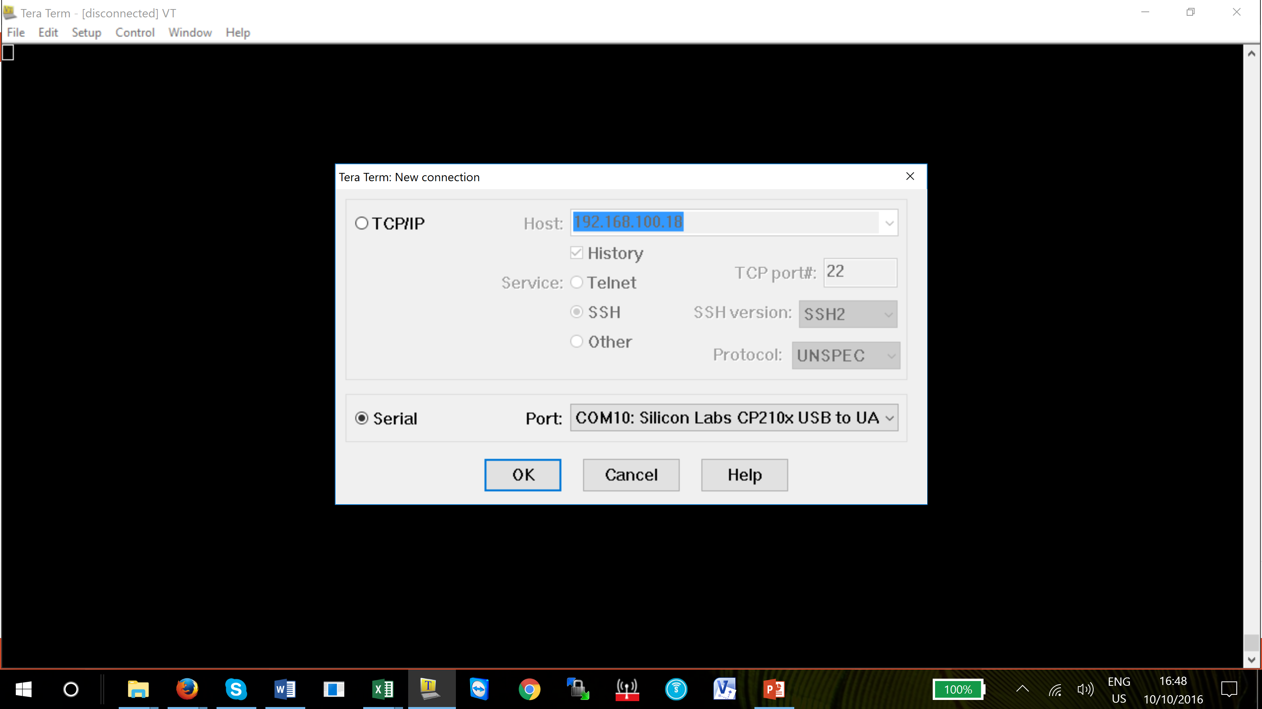
Site Controller
Connecting your PC, Laptop to the Site Controller
If you are using the IP method you need to know the IP address of the site controller.
If you are using the USB port click on Serial and the com port number will appear in the window.
When you have chosen - click OK
Notes:
Note – Ensure the Silicon driver is loaded when you chose the serial port method

Slide 9
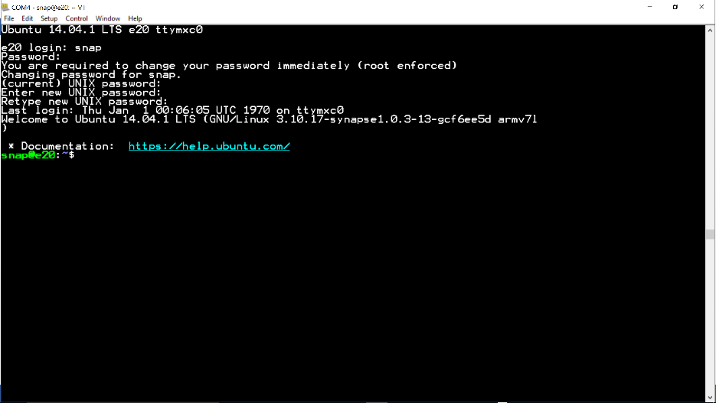
Site Controller
Connecting your PC, Laptop to the Site Controller
Once connected you will be asked to set a password.
The Login is ‘snap’ and the default password for a first time is ‘root’.
For the new password we have chosen in this case ‘synapse1’.
Notes:
Be careful when entering the password as no letters/numbers are displayed.

Slide 10
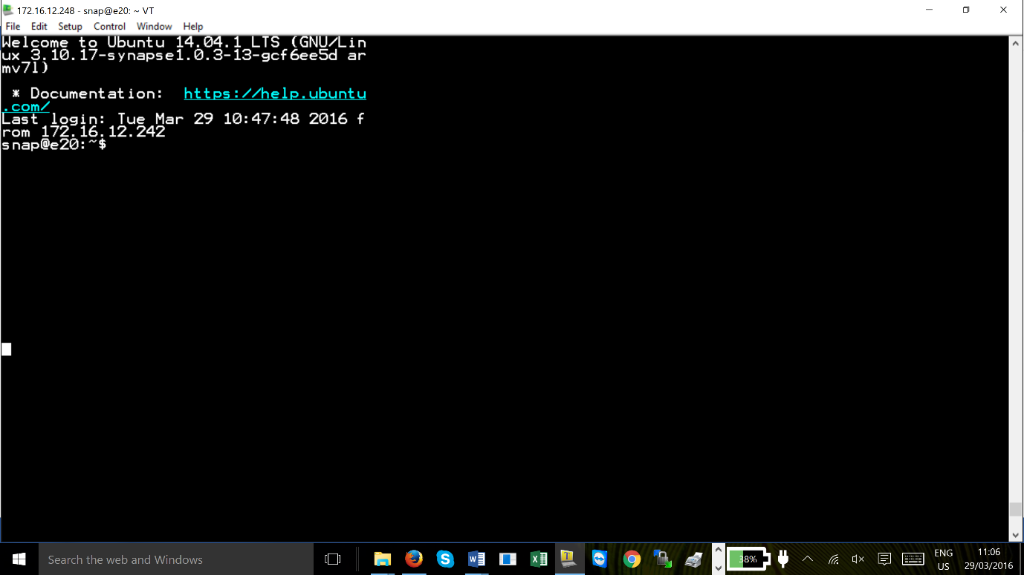
Site Controller
Connecting your PC, Laptop to the Site Controller
The Tera Term window shall show text indicating you are connected to the Site Controller.
snap@e20:~$ is the main folder where all the files will be stored.
The PC or laptop is now connected to the site controller.
Notes:
Note – the directory indicated above snap@e20:~$ may be different depending on the version of the site controller you have but it will be of this format snap@.......:~$

Slide 11
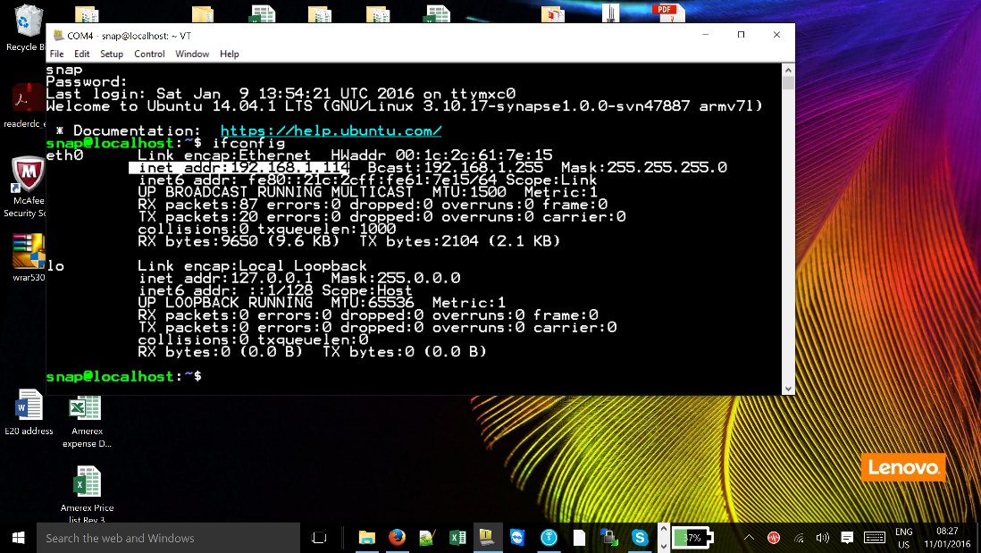
Site Controller
Connecting your PC, Laptop to the Site Controller – finding the IP address
After the ……:~$, enter ifconfig in the editor window. The IP address will be indicated with the details of the site controller connections, if it is connected to the network.
The IP address is highlighted and in this case it is;
192.168.1.114
Notes:
Make a note of the address as it will be required during the setup of WinSCP.

Slide 12
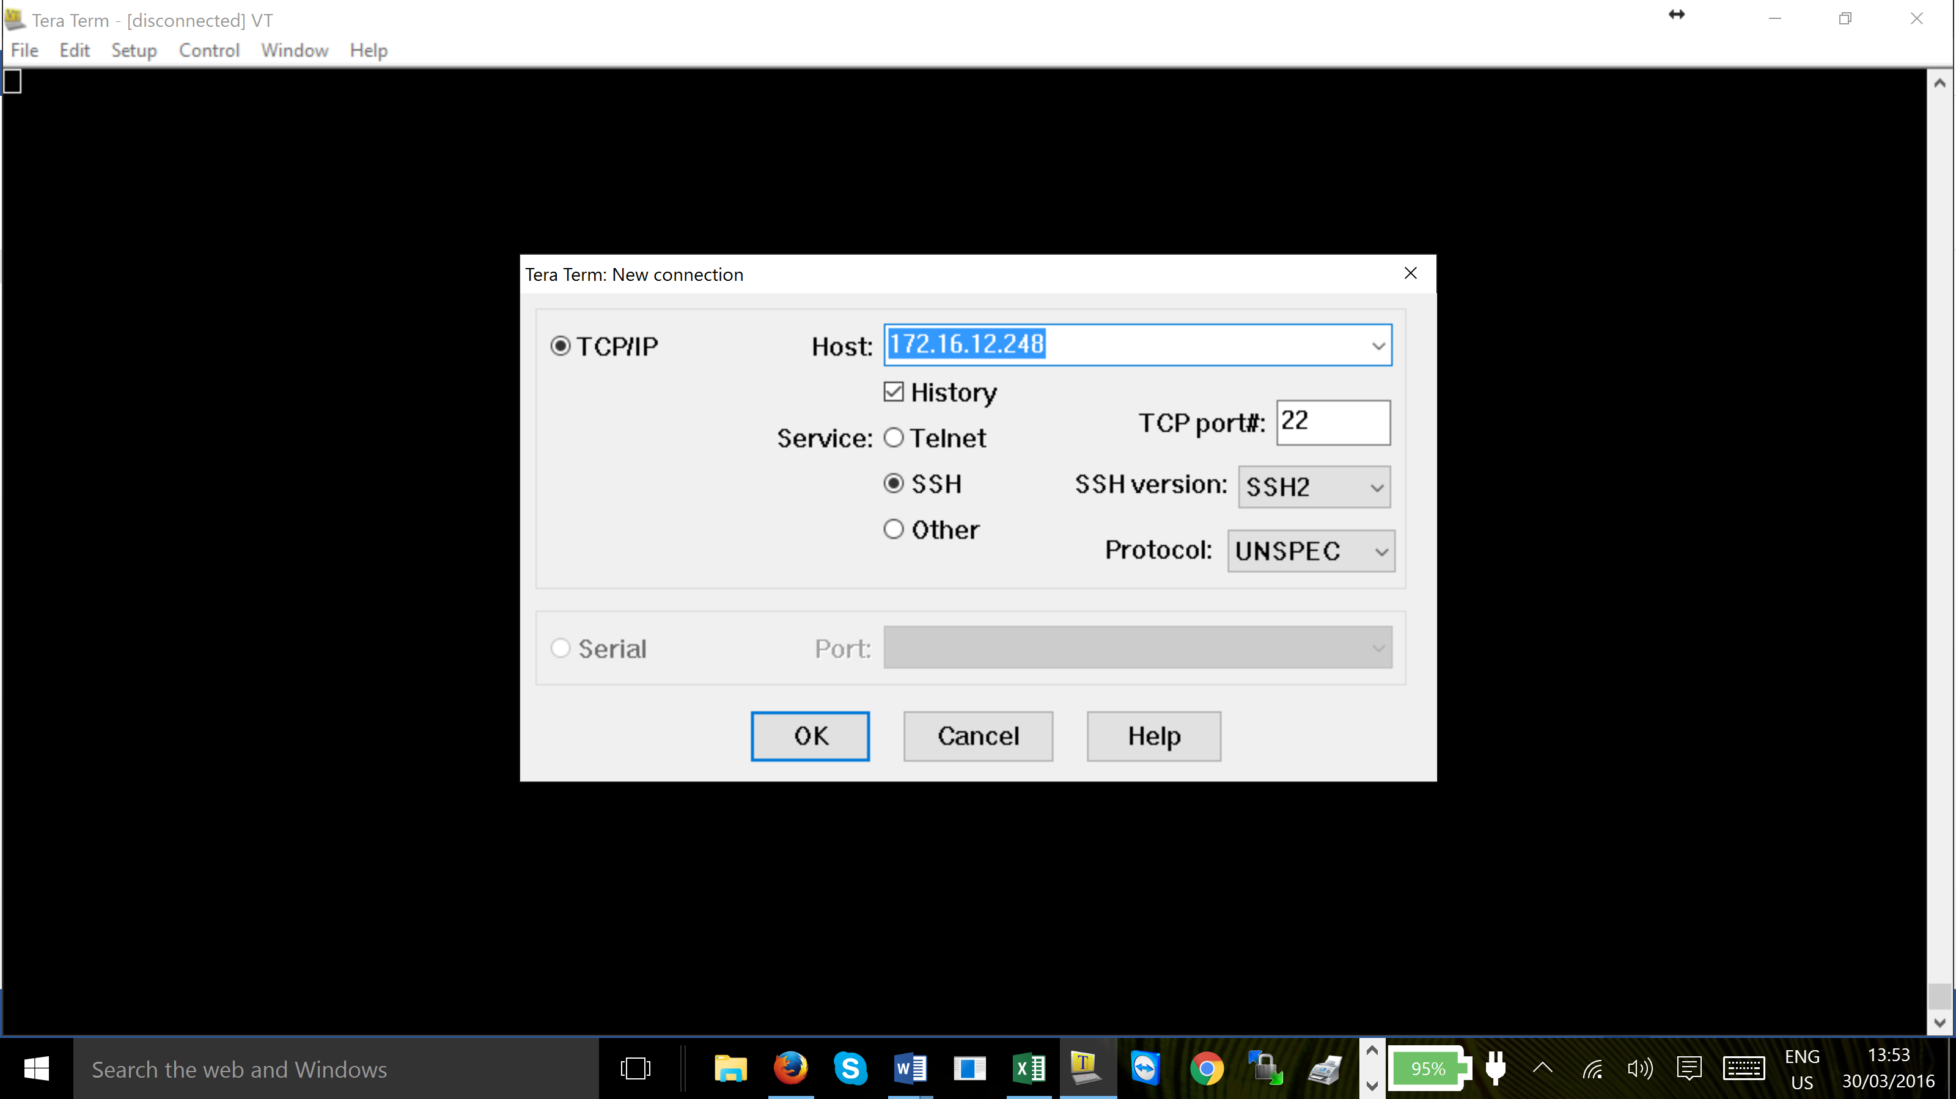
Site Controller
Connecting your PC, Laptop to the Site Controller
To use Tera Term via IP, check the TCP/IP box and enter the IP address in Host: window.
Ensure the settings (TCP port#, Service, etc ) are as indicated.
Click on ‘OK’

Slide 13
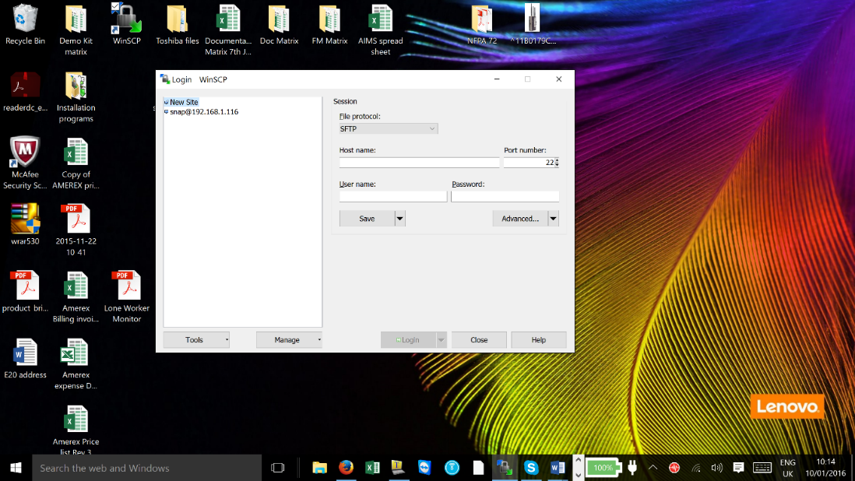
Site Controller
Connecting your PC, Laptop to the Site Controller
Double click the short cut icon for WinSCP.
From the drop down menu ‘File Protocol’ select SFTP.
The host name is the IP address of the site controller by using Tera Term.

Slide 14
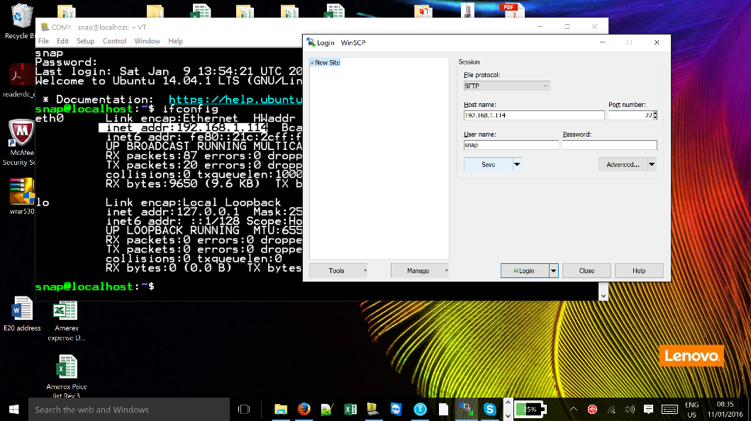
Site Controller
Connecting your PC, Laptop to the Site Controller
Enter the IP address of the site controller.
The Port Number should be 22 (default),
User Name - ‘snap’ do not enter a password.

Slide 15
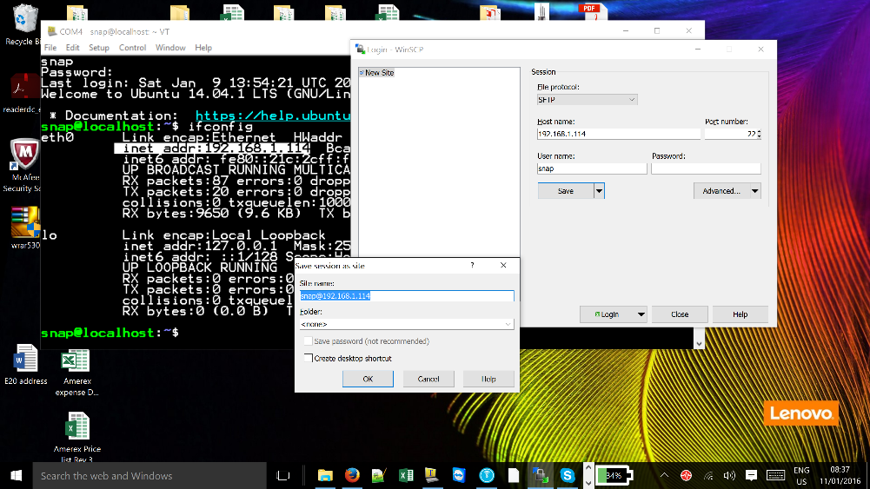
Site Controller
Connecting your PC, Laptop to the Site Controller
Click ‘Save’
Click ‘OK’ and if you wish to have Desktop shortcut tick the check box.
Note – the IP address of the site controller must be a static address – see the onsite IT department to arrange this facility

Slide 16

Site Controller
Connecting your PC, Laptop to the Site Controller
Log in by clicking the ‘LogIn’ button.

Slide 17
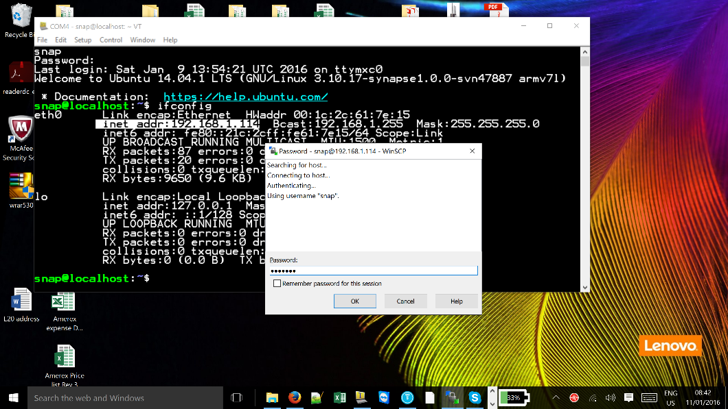
Site Controller
Connecting your PC, Laptop to the Site Controller
Enter the password you entered when started the site controller, we chose ‘synapse1’
Click ‘OK’.

Slide 18
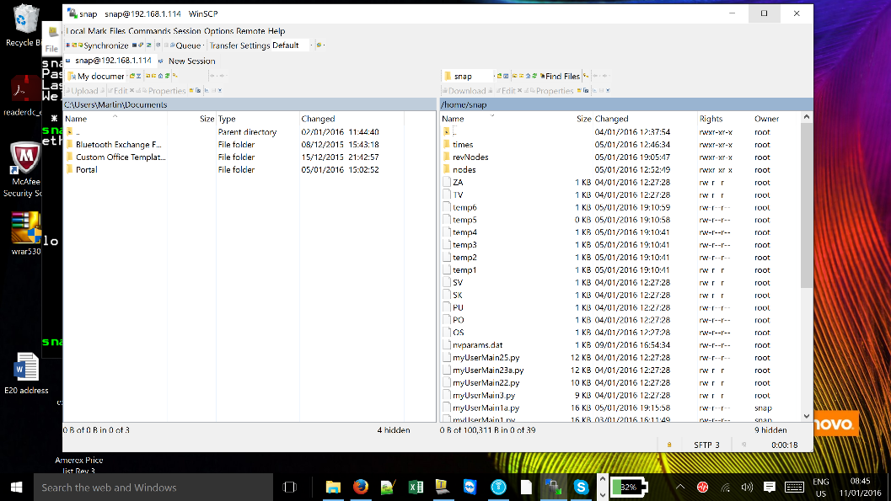
Site Controller
Connecting your PC, Laptop to the Site Controller
Well done…. WinSCP has been launched successfully.
On the screen you can see two windows
the left hand side is your PC and the right hand side is the site controller ‘snap’ folder.

Slide 19
Questions?
Notes:
Note –

Slide 20
Return

