Slide 1
SC No.4

Slide 2
Site Controller
Setting up the
site controller

Slide 3
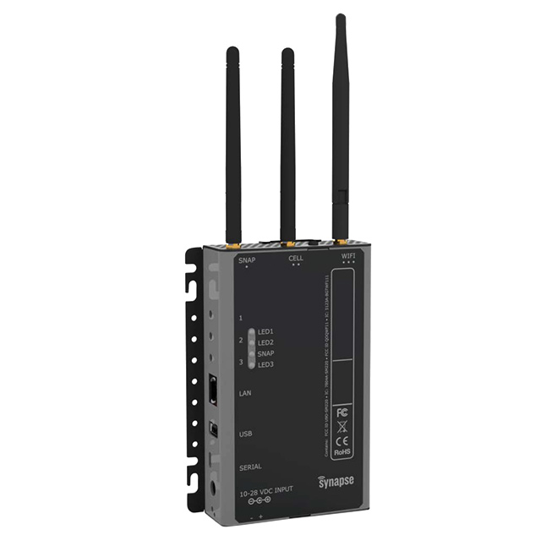
Site Controller
Setting up the site controller
The site controller is supplied with programs already installed but are not activated.
The following section will show you how to activate these programs.

Slide 4
Site Controller
The following programs must be installed in the site controller prior to connecting to the mesh network.
sudo mkdir -p /media/ramdisk
sudo mount -t tmpfs -o size=64M tmpfs /media/ramdisk
grep /media/ramdisk /etc/mtab | sudo tee -a /etc/fstab
sudo apt-get install e20-snap-utils
sudo apt-get install supervisor
sudo pip install -i https://update.synapse-wireless.com/pypi snapconnect

Slide 5
Site Controller
Copy each line of the above and paste it in the editor window of Tera Term. Check the folder you are in, snap@e20:~ $ .
Note - this may be slightly different depending on the site controller you have but it should be of a similar format as snap@..........:~$

Slide 6
Site Controller
Once the line has been typed in Tera Term window or pasted into the window press the Enter / Return key and the program will install automatically.
Repeat this for first five items.
For the last item the Site Controller must be connected to a network to download the latest software, copy the following into the Tera Term editor window and press enter.
sudo pip install -i https://update.synapse-wireless.com/pypi snapconnect
Note:
The site controller must be connected to the network / internet for this to download the latest version.
The site controller will down load the latest software – this may take a few minutes depending upon the connection with the internet.
Notes:
We recommend copying the line directly from the slide or from the manual provided

Slide 7
Site Controller
Once the line has been typed in Tera Term window or pasted into the window press the Enter / Return key and the program will install automatically.
Repeat this for first five items.
For the last item the Site Controller must be connected to a network to download the latest software, copy the following into the Tera Term editor window and press enter.
sudo pip install -i https://update.synapse-wireless.com/pypi snapconnect
Notes:
Note:
The site controller must be connected to the network / internet for this to download the latest version.
The site controller will down load the latest software – this may take a few minutes depending upon the connection with the internet.
We recommend copying each line directly from the slide or from the manual provided

Slide 8
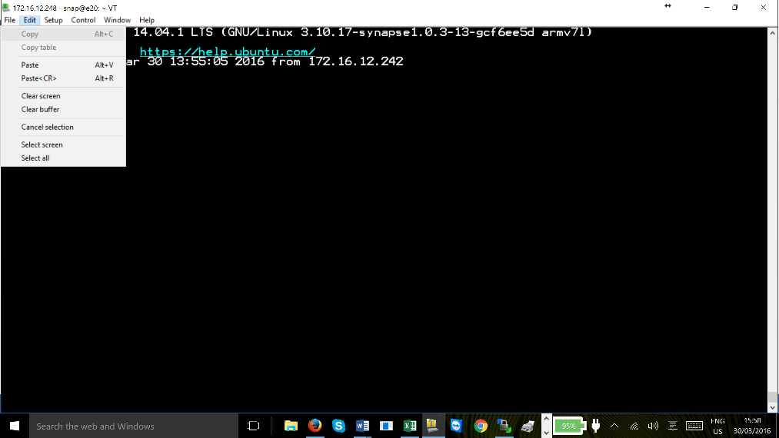
Site Controller
Tera Term does not use the normal CTRL C or CTRL V for copy and paste
You must use the command bar ‘Edit’ tab at the top of Tera Term editor window.

Slide 9
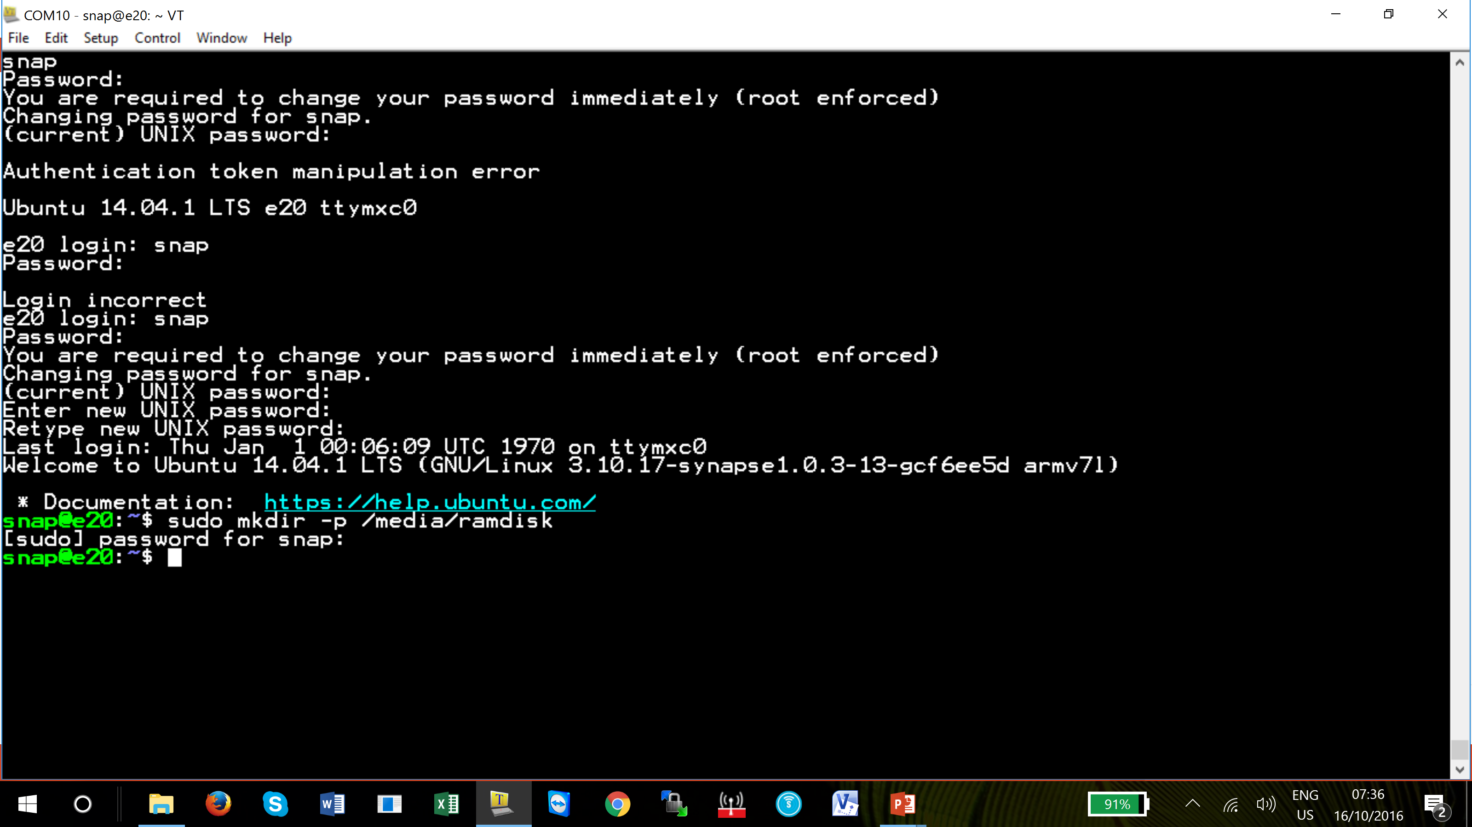
Site Controller
Paste each line using the Edit tab drop down menu as previously described.
Click OK in the pop up window to paste the copied line.
It will ask for the password. Check the ramdisk folder by using WinSCP

Slide 10
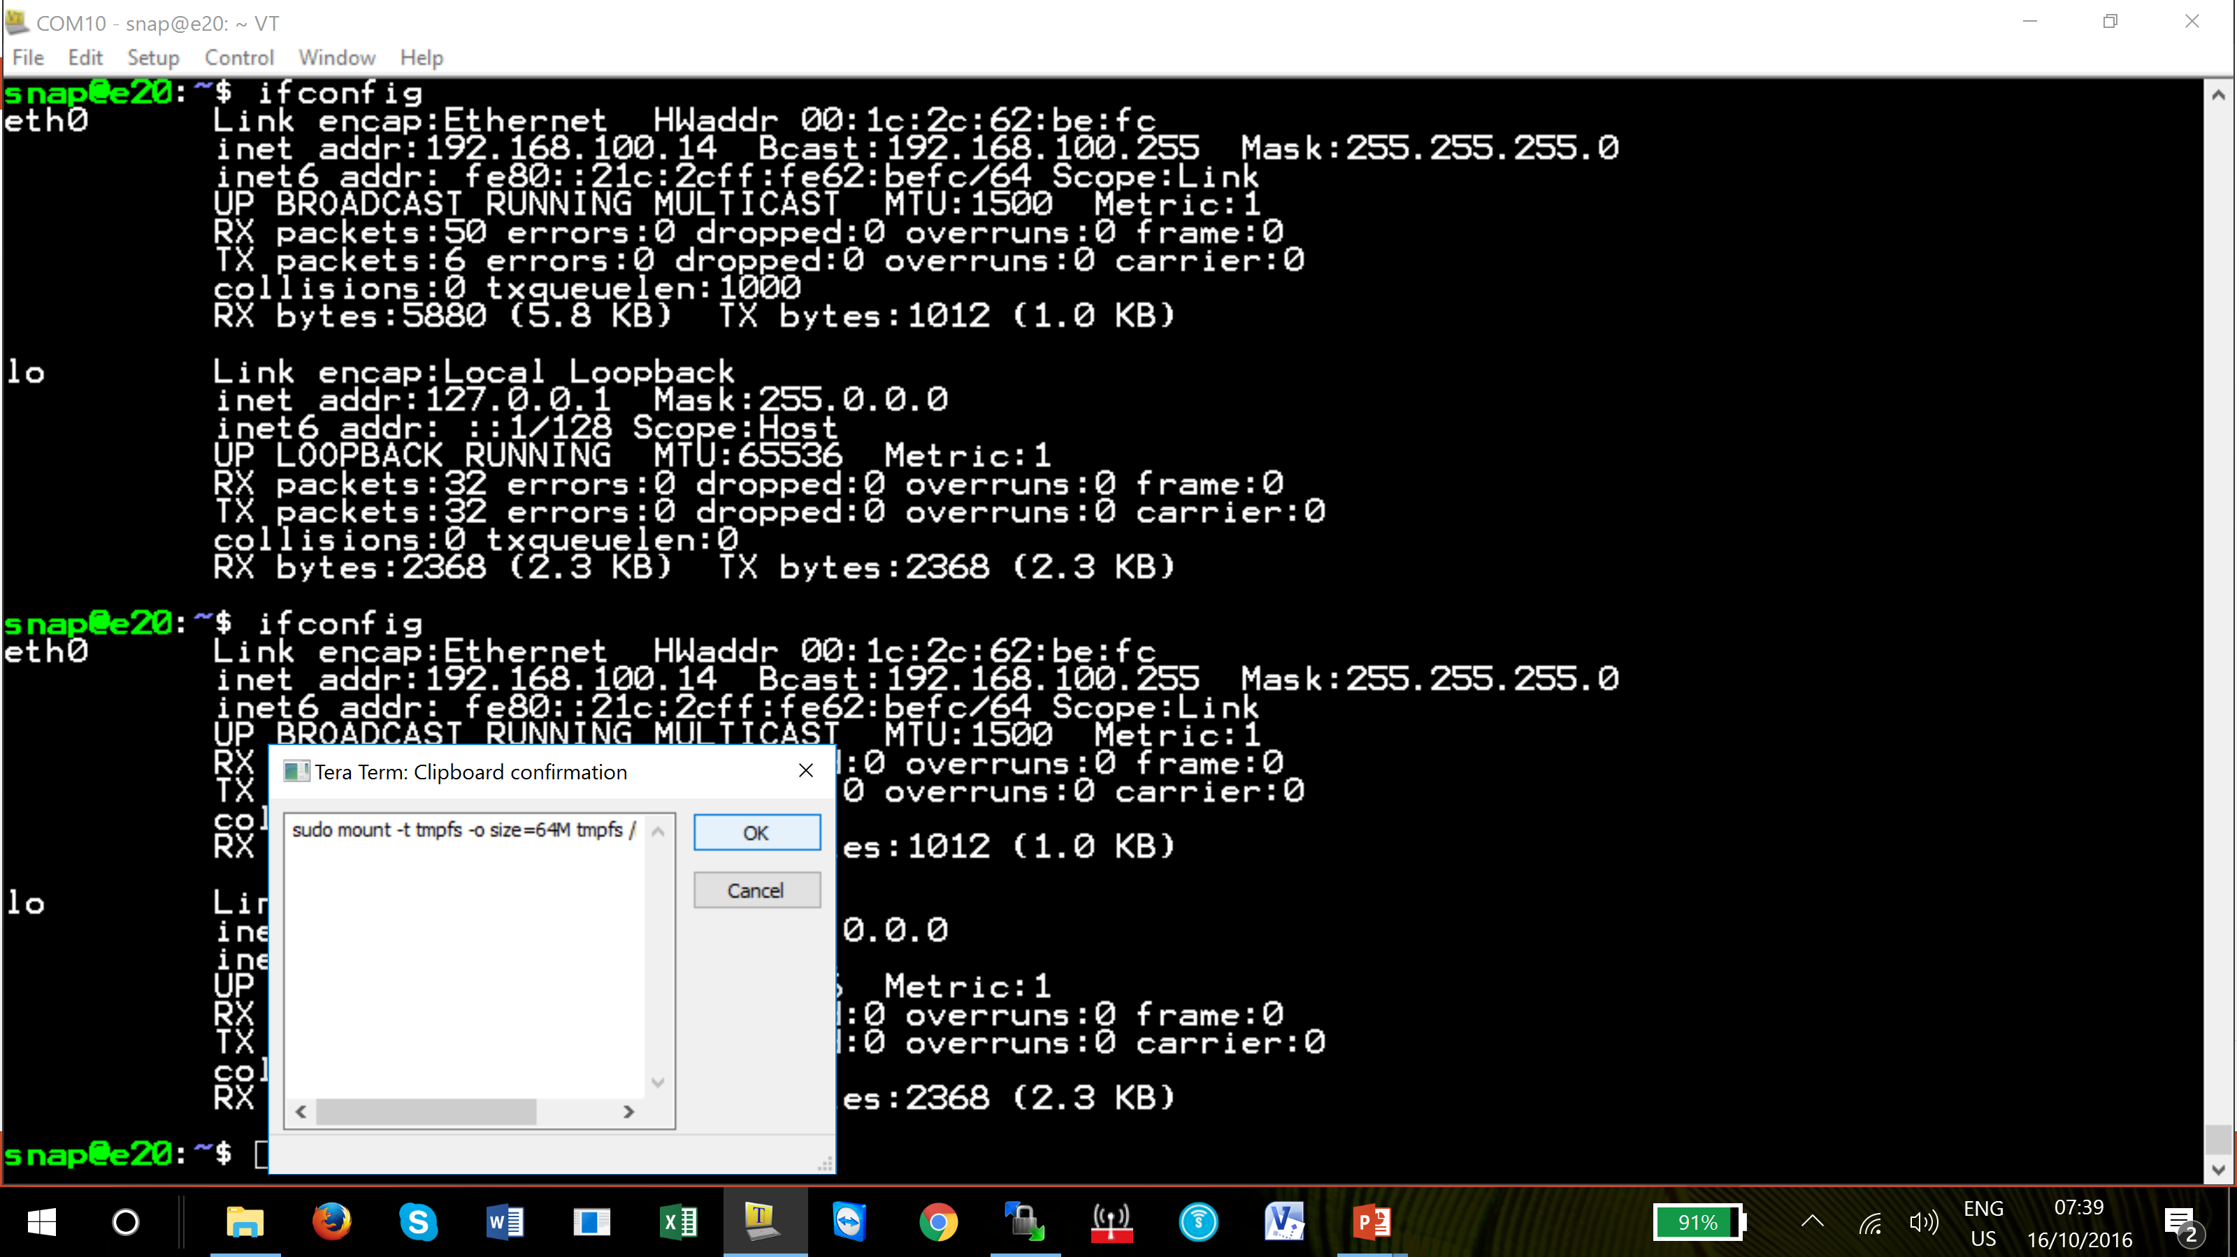
Site Controller
Paste each line using the Edit tab drop down menu as previously described.
Click OK in the pop up window to paste the copied line.
It will ask for the password. Check the ramdisk folder by using WinSCP

Slide 11
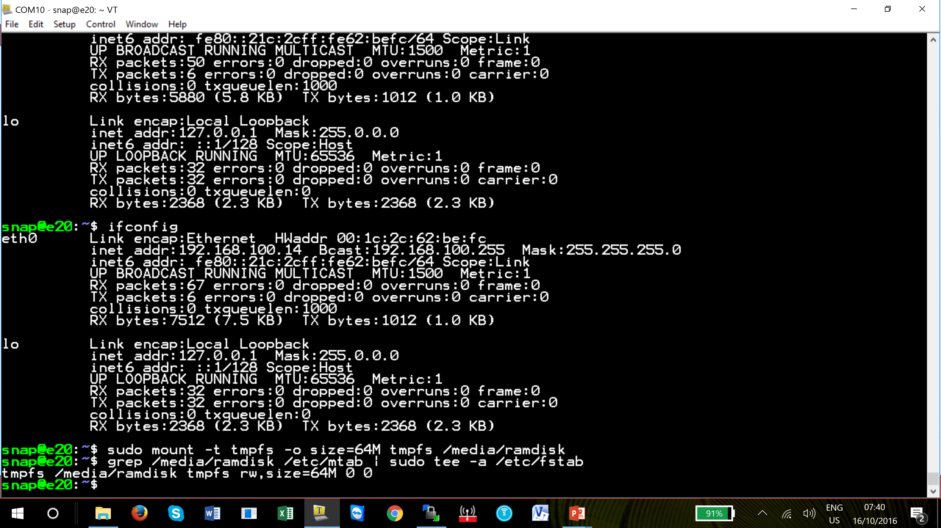
Site Controller
Paste each line using the Edit tab drop down menu as previously described.
Click OK in the pop up window to paste the copied line.
Here the ramdisk has replied with a response.

Slide 12
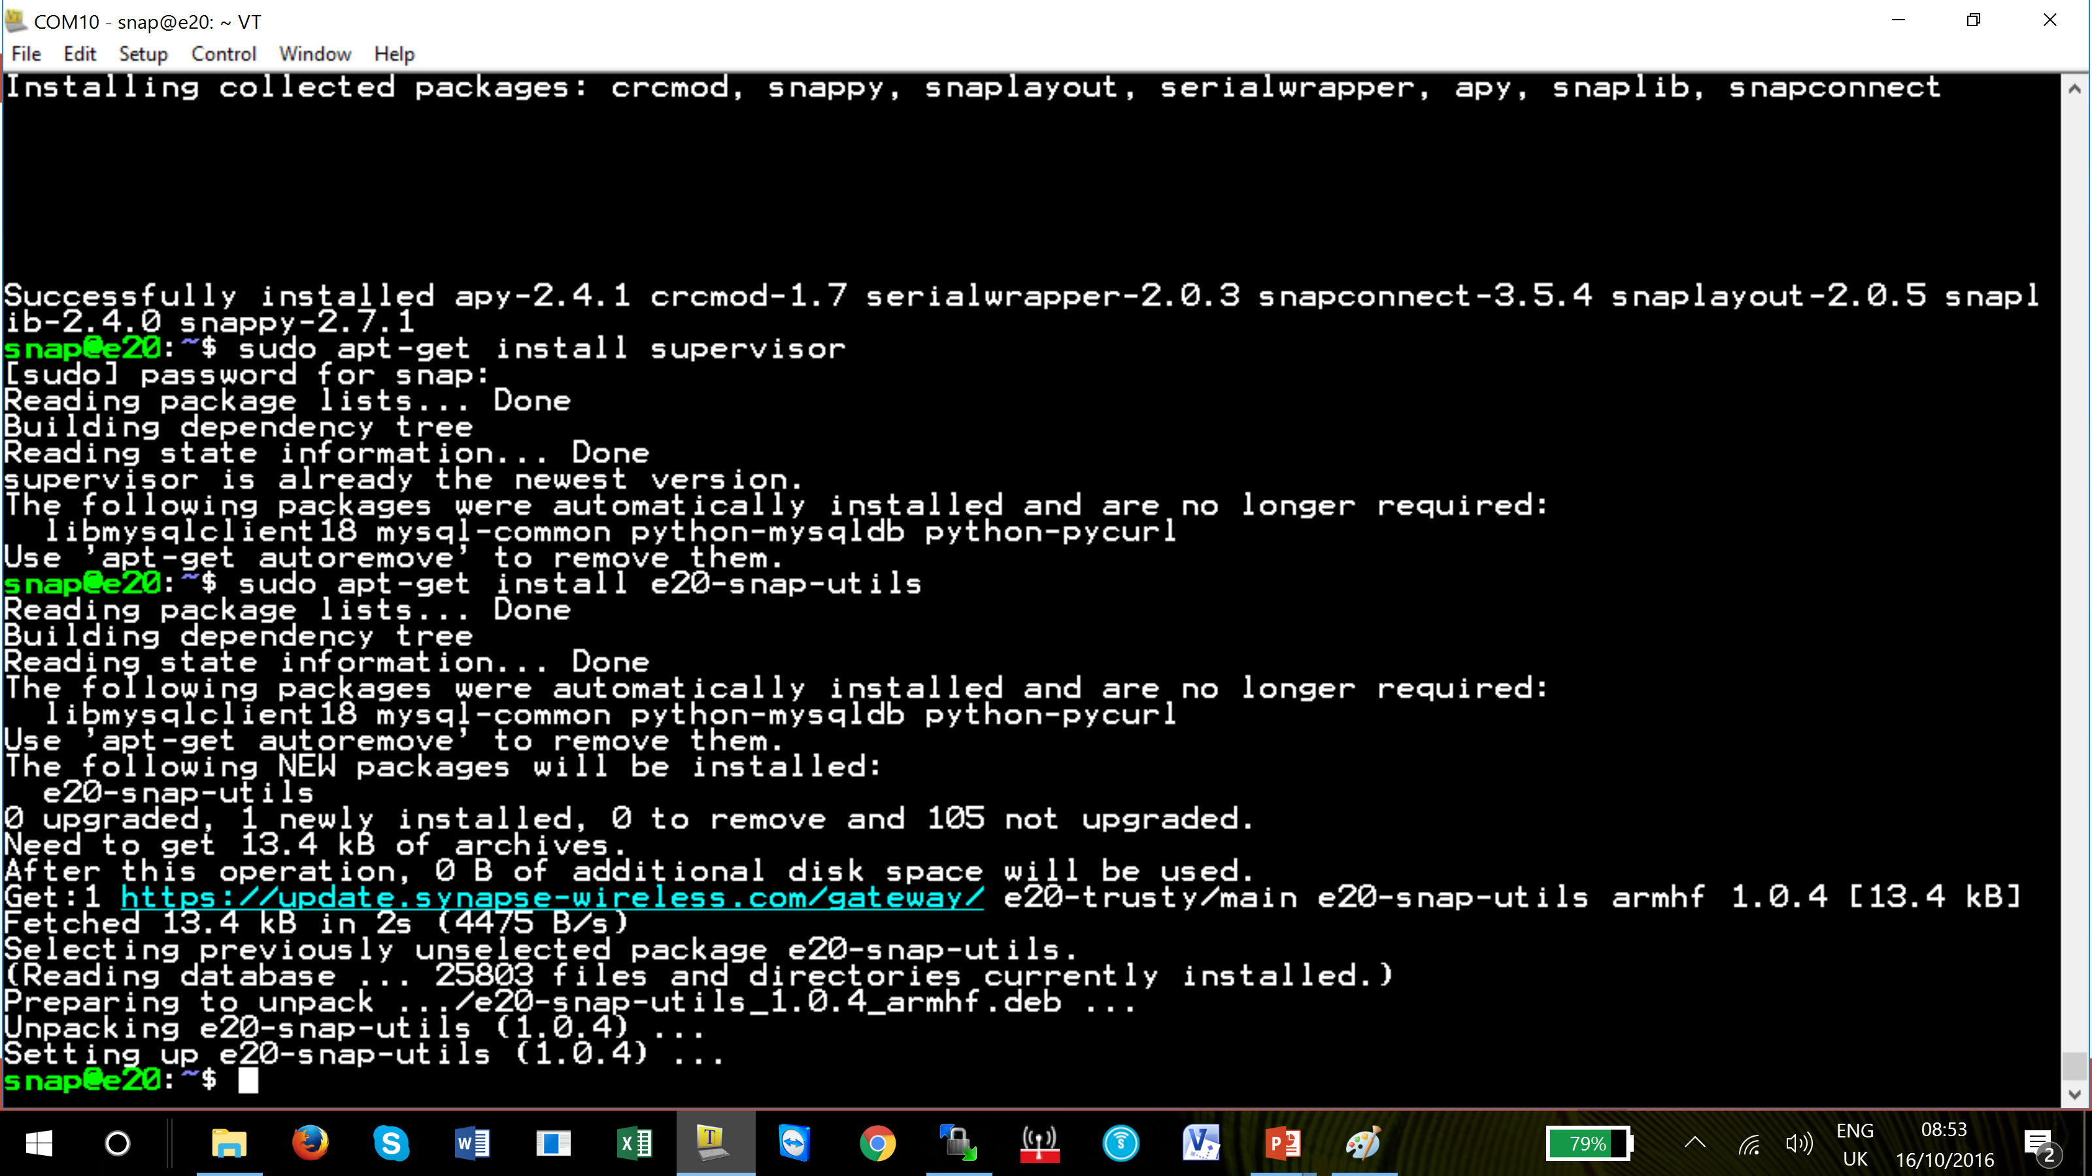
Site Controller
Paste each line using the Edit tab drop down menu as previously described.
Click OK in the pop up window to paste the copied line.
Here the supervisor programming is being loaded.

Slide 13
Site Controller
Paste each line using the Edit tab drop down menu as previously described.
Click OK in the pop up window to paste the copied line.
Here the utilities programming is being loaded.

Slide 14
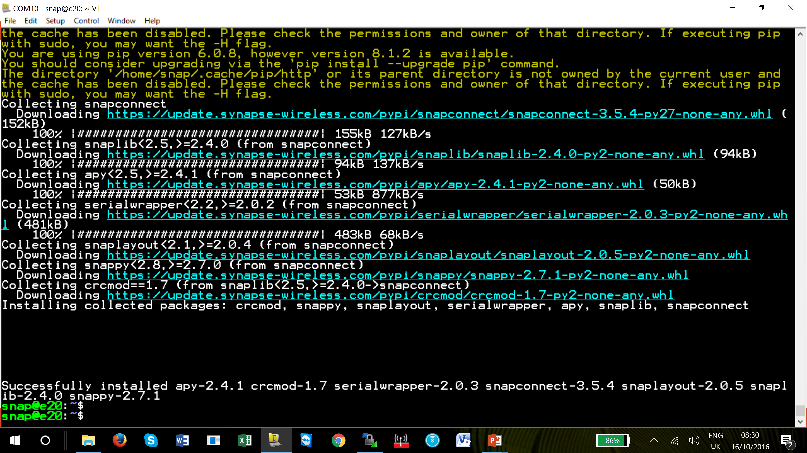
Site Controller
Paste each line using the Edit tab drop down menu as previously described.
Click OK in the pop up window to paste the copied line.
Here the software from Synapse has been loaded.

Slide 15
Site Controller
Once the embedded files have been activated the site controller is ready to be configured for the AMEREX Integrated programs

Slide 16
Questions?
Notes:
Note –

Slide 17
Return

