Slide 2
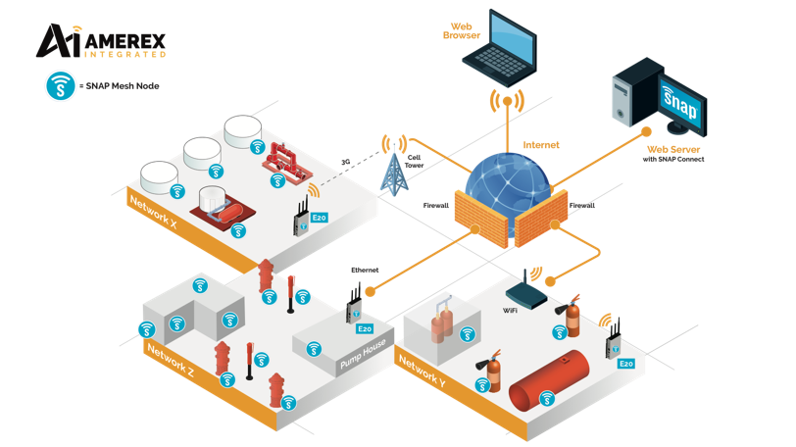
The SNAP network
Synapse's SNAP network operating system is an Internet-enabled, instant-on, multi-hop, mesh network designed to cost-effectively run efficiently over a wide range of popular microprocessors and microcontrollers.

Slide 3
SNAP network
Auto-forming
Instant-On
Peer-to-Peer
Over-the-air programming
Processor Independence
No central coordinator
No single point of failure
Self healing MESH

Slide 4
SNAP network
The ability to monitor any system on any site and populate a range of software using specific I/O modules connected to the SNAP network.

Slide 5
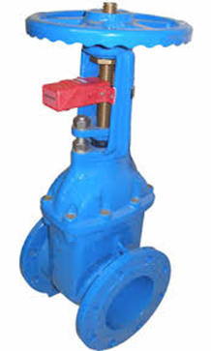
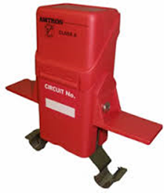
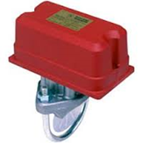
SNAP modules
Battery or 24 VDC powered module with three digital inputs and one local digital output. (relay or LED) for valve position monitoring, water flow etc.

Slide 6
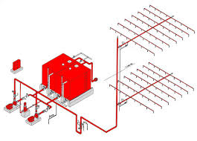
SNAP modules
24 VDC powered module with a 4-20 mA input and three digital inputs and one local digital output. Monitoring temperature, pressure, flow etc. from any 4-20 mA transducer.
Water header pressure
Motor temperature
Diesel tank level

Slide 7
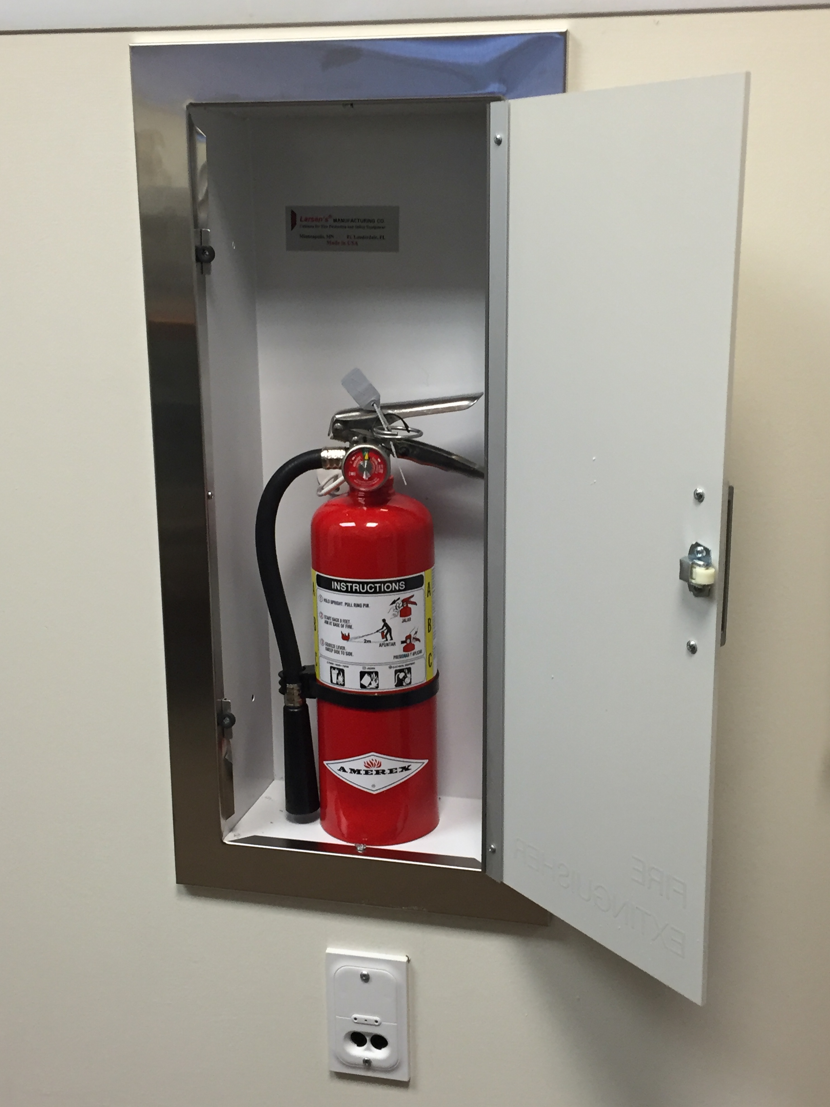
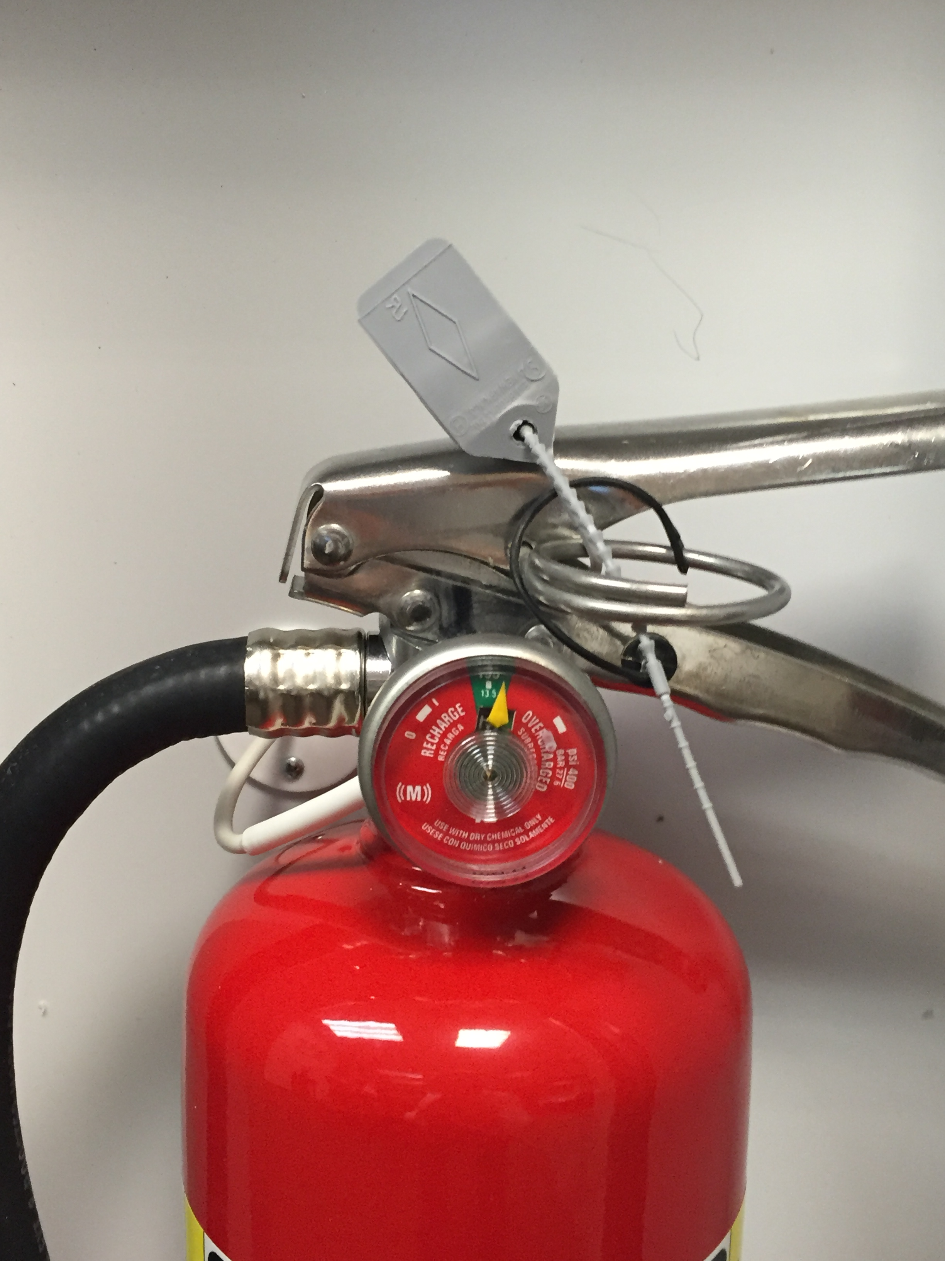
SNAP modules
An extinguisher monitoring unit fitted with a SNAP module
The ability to wirelessly automatically monitor pressure, removal or the obstruction of an extinguisher

Slide 8
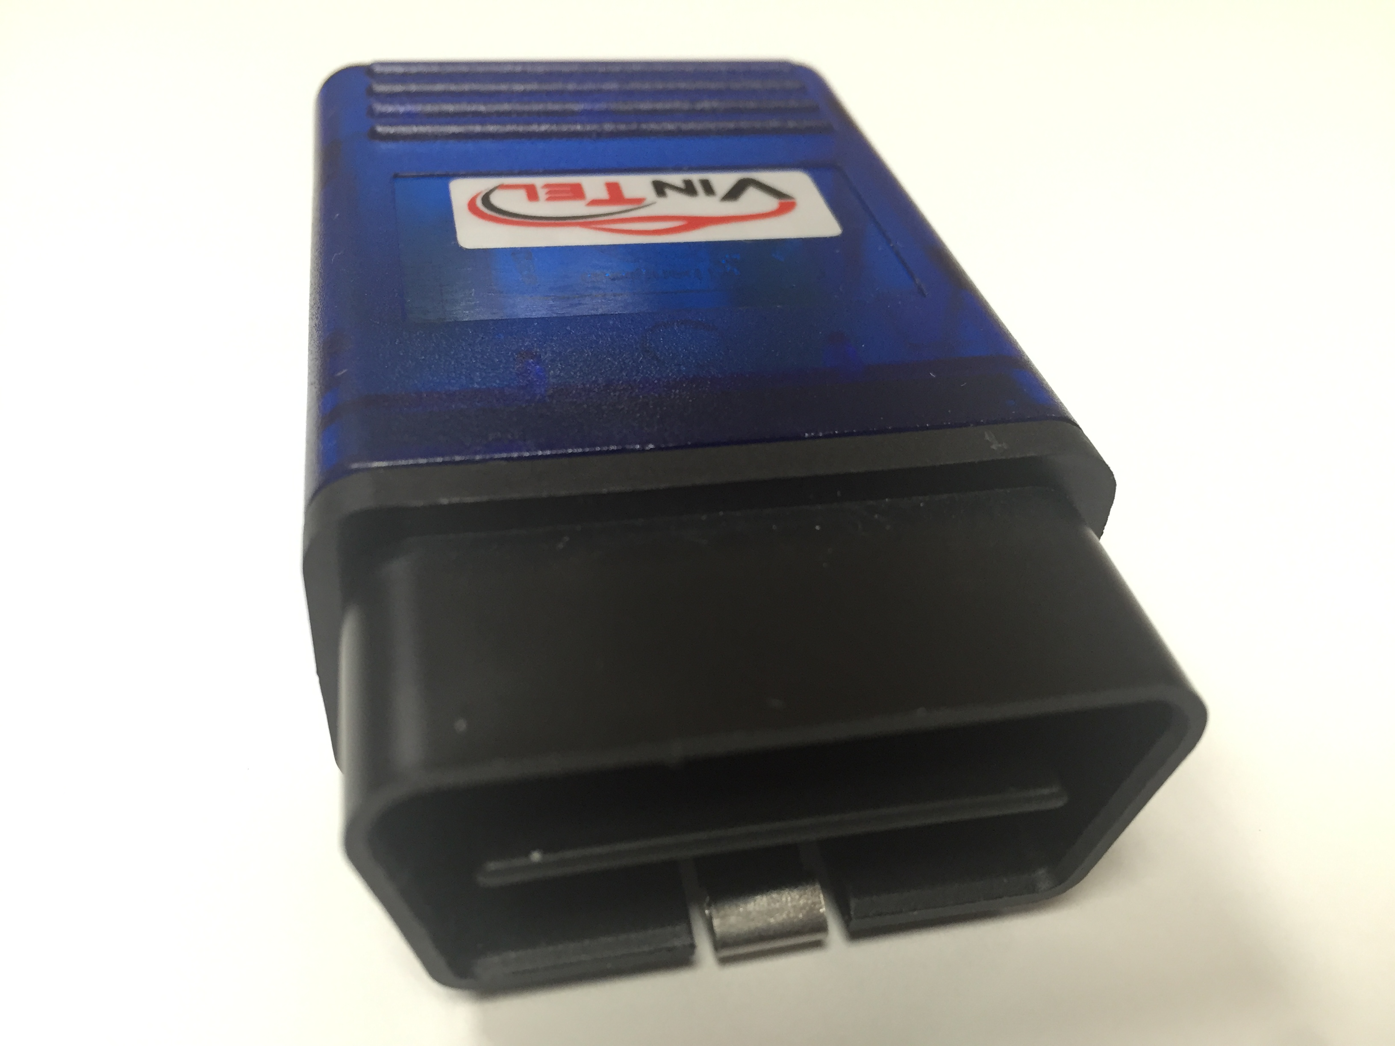
SNAP modules
A unit that plugs into the ODB port of any vehicle that is able to transmit all information from the vehicle CANBUS, including vehicle position engine status, etc.

Slide 9
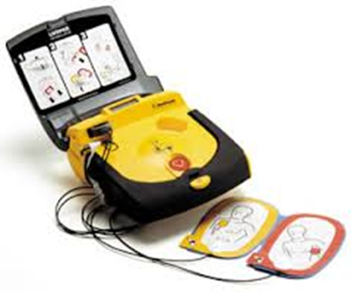
SNAP modules
A defibrillator monitoring unit fitted with a SNAP module
The ability to wirelessly automatically monitor removal or the obstruction of a defibrillator

Slide 10
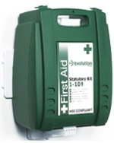
SNAP modules
An emergency medical kit monitoring unit fitted with a SNAP module
The ability to wirelessly automatically monitor removal or the obstruction of an emergency medical kit

Slide 11
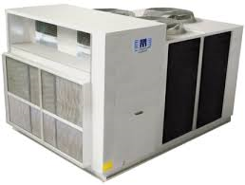
SNAP modules
A packaged HVAC system fitted with two dual 4-20 mA and 4 digital input module
The ability to wirelessly automatically monitor the efficiency of an HVAC or Chiller system using SNAP enabled sensors

Slide 12
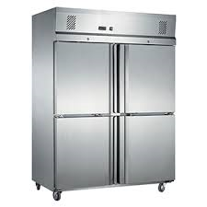
SNAP modules
A packaged HVAC system fitted with a single 4-20 mA and 3 digital input module
The ability to wirelessly automatically monitor the temperature of a freezer using SNAP enabled sensors

Slide 13
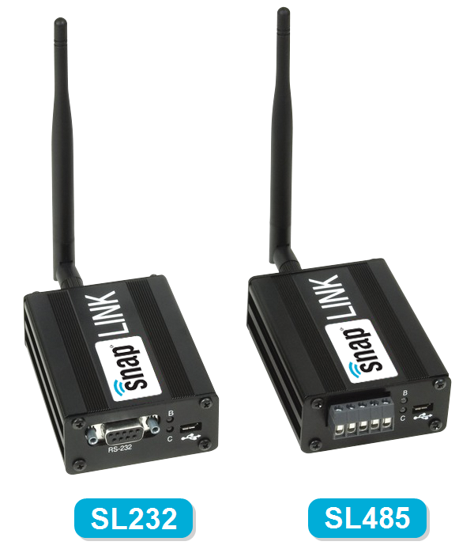
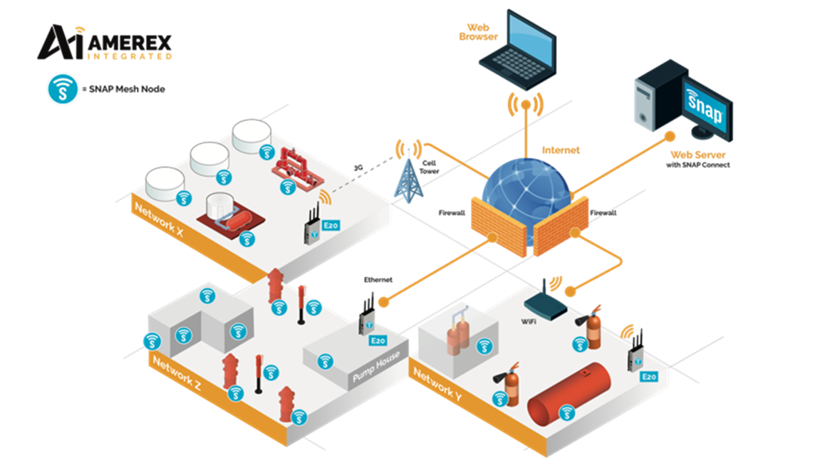
SNAP modules
A wireless method of connecting RS232 and RS485 across a site.

Slide 14
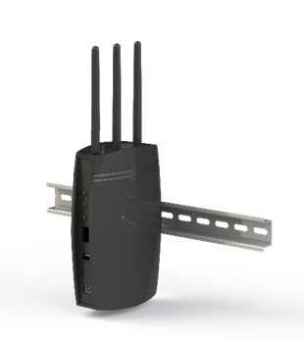
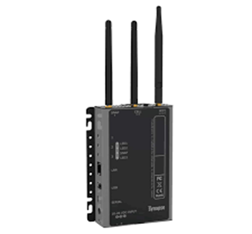
SNAP modules
The SNAP Wireless Site Controller is a rugged, powerful, embedded connectivity appliance built to interface directly with SNAP mesh networks. The Wireless Site Controller can collect data from SNAP devices for centralized storage, database processing or application monitoring. The Wireless Site Controller bridges SNAP networks across TCP/IP, without requiring firewall configuration or policy exceptions

Slide 15
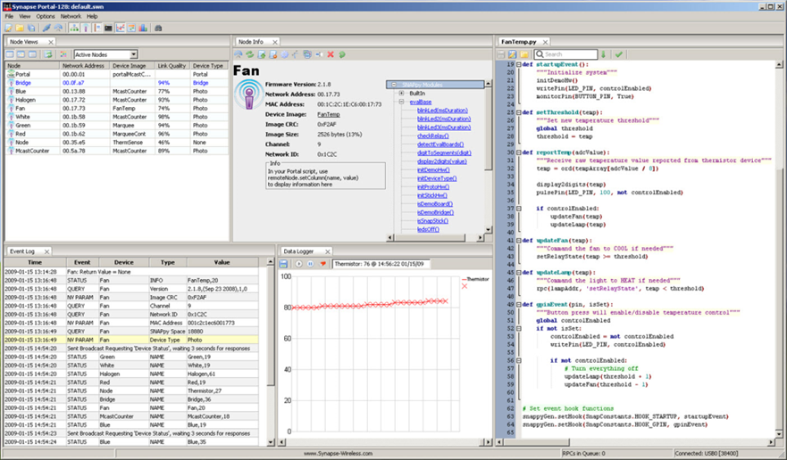
SNAP portal
Administration tool for SNAP® networks
Channel analyzer to find channel for network
Event Log with timestamps and filtering
Graphical Data Logger
Node configuration editor
Channel scanner to detect new nodes

Slide 16
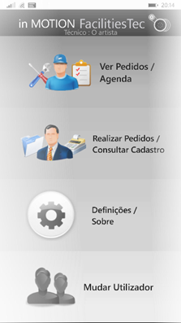
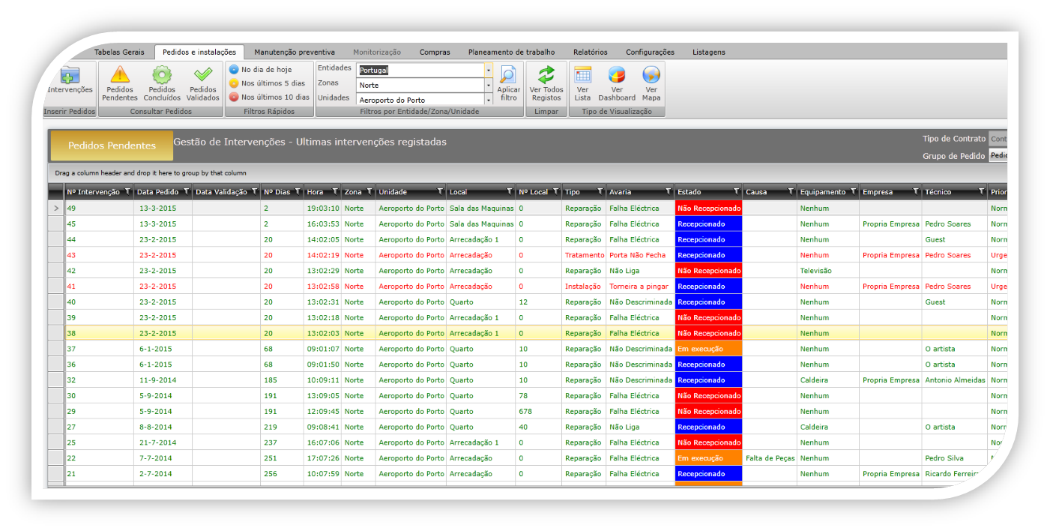
AMEREX In Motion
AMEREX In Motion links People, Processes and Things

Slide 17
AMEREX In Motion
AMEREX In Motion: Our Vision
Simplicity: User friendly platform
Adaptability: User defined
Functionality: Limitless applications
Connectivity: The Internet of Things
Mobility: Anyone-Anywhere
Efficiency: Time, Resources, Cost

Slide 18
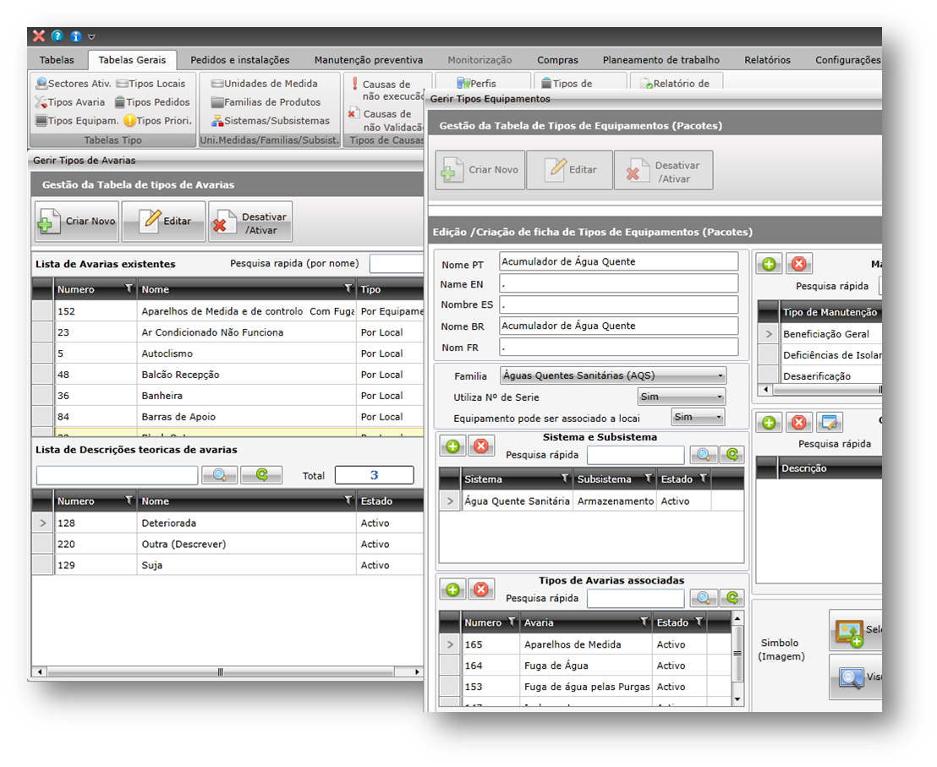
AMEREX In Motion
Easy Configuration and Setup
Configuration and date entry is easy, import information from existing data bases
Pre-set Configuration
Typical alarms and faults
Predefined tasks
Materials and spares

Slide 19
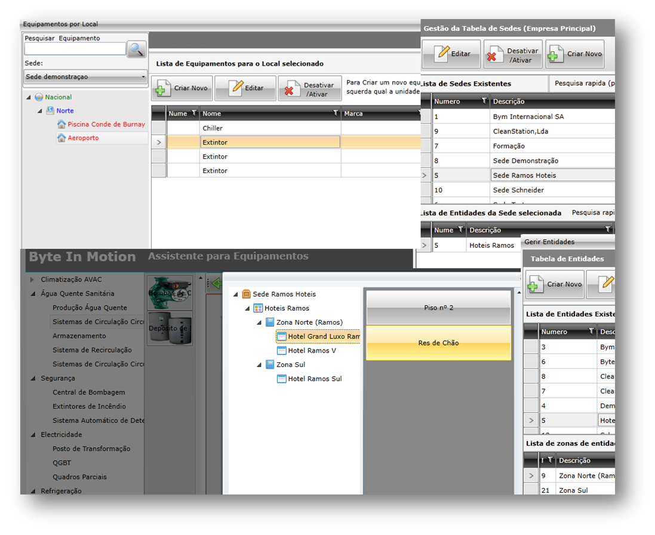
AMEREX In Motion
Organisation levels Organisation chart with processes and procedures.
Set up
Drag and drop elements, clone tool, import tools for data bases

Slide 20
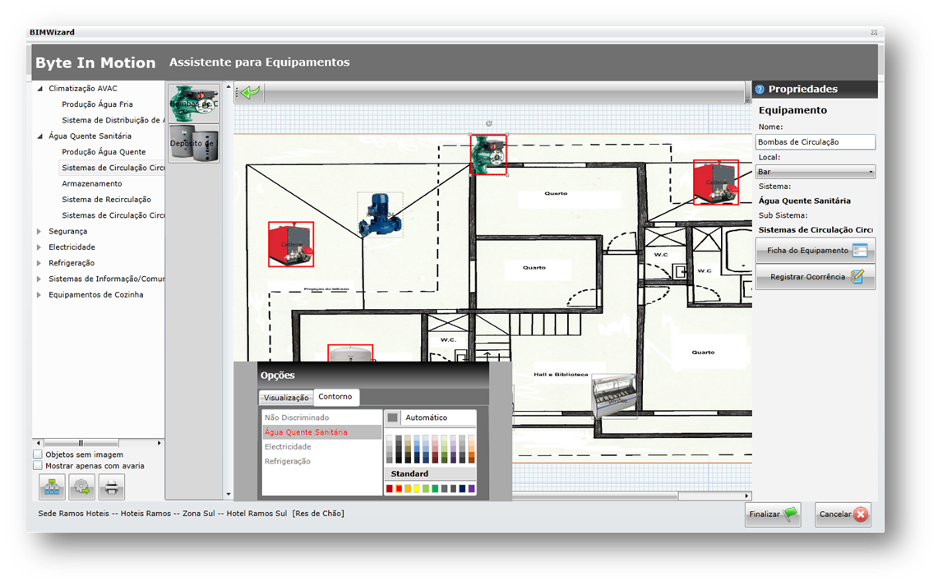
AMEREX In Motion
Equipment input
Asset type preset with main characteristics
Predictive and Preventive maintenance tasks preset
Technician profile matching with task and/or equipment
Frequent Alarms, Faults and Failures
Quality
Equipment pasted on drawing

Slide 21
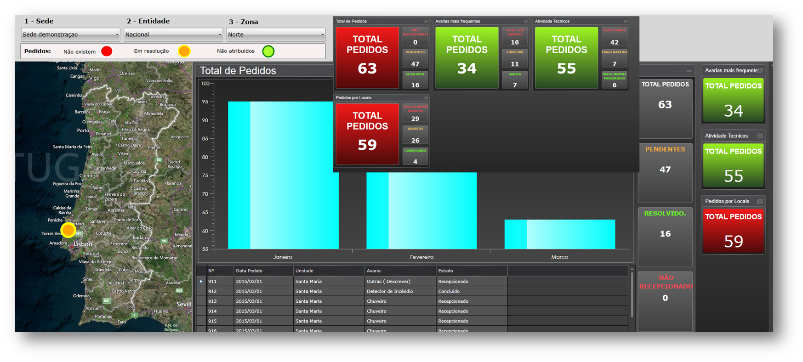
AMEREX In Motion
Equipment monitoring
Equipment Monitoring Module: acquiring data, recording, backlog
Integration with different data sources;
M2M and H2M (“Machine to Machine” and “Human to Machine”)
Configurable Alarms and Alerts
Email, GSM, Wi-Fi, PowerLine, 3G, 4G, etc communication.
Monitoring Dashboard

Slide 22
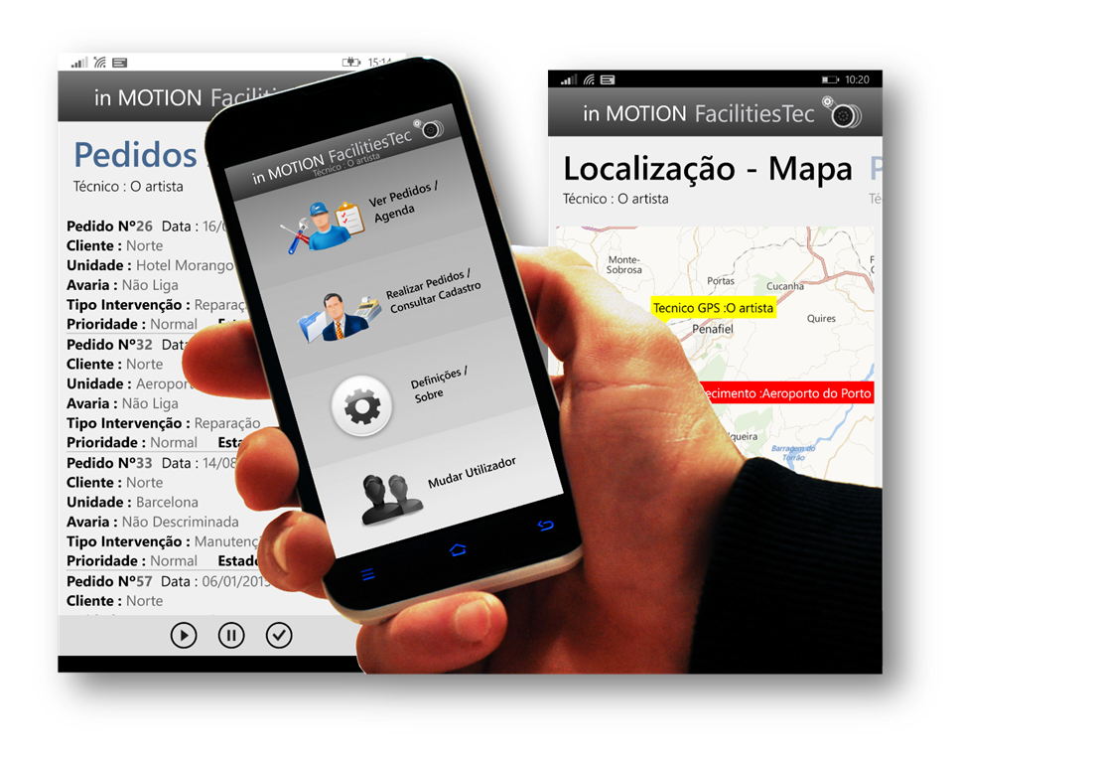
AMEREX In Motion
Higher Management made easy
Allows online, global vision of what is happening in each region, local, building, country
Teams, Systems, Equipment, Units online follow up
Quality x Costs x Results online follow up
Allows to assure fulfilment of legislation, norms, standards, procedures.
KPI’s and SLA’s follow up
Access to all information required from top to bottom in a selected format
On line Follow up from your Desktop, smartphone and/or tablet devices

Slide 23
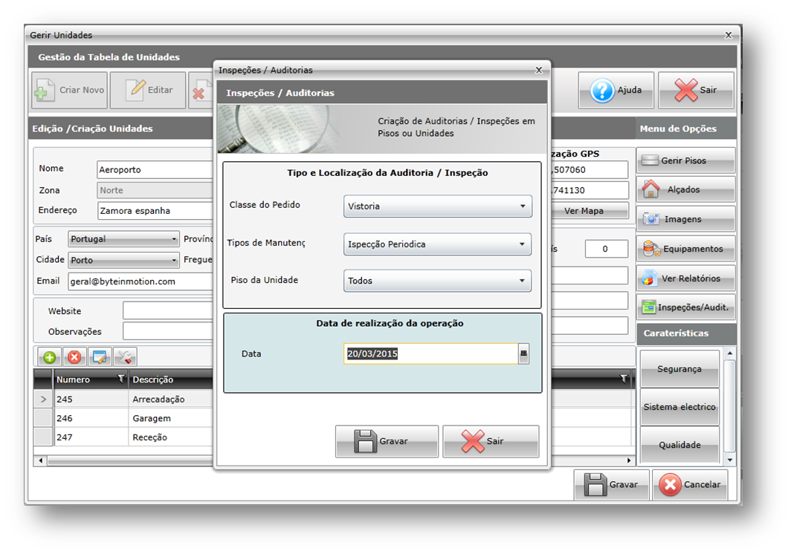
AMEREX In Motion
Middle management made easy
Check lists, Inspections and Audits setup and scheduling of units under management.
Follow up KPI’s and SLA’s performance
On line Follow up from your Desktop, smartphone and/or tablet devices
Real time follow of accountable plant, building, system

Slide 24
AMEREX In Motion
Team leading made easy
On line and real time information available on Smartphone or Tablet.
In-house Teams and Technicians and as well as Outsourced companies work scheduling and follow up
Frequent Faults and Alarm analysis and comparison
Budgeting Module with easy access to built a Specification Survey Book
Suppliers and Materials Data Base
Graphics and KPI’s for decision support.
Daily work activity follow up.
Drag and Drop preventative maintenance tasks.
Easy access to all data for each asset
View on line equipment data in real time

Slide 25
AMEREX In Motion
Stake holders information
All Process Stakeholders involved share the platform and selected information
Work Order Request created by all stakeholders
Access to Work Status and selected information directly from smartphone or tablet
Bidirectional communication channel
Automatic Information change
Easy and Friendly to Use

Slide 26
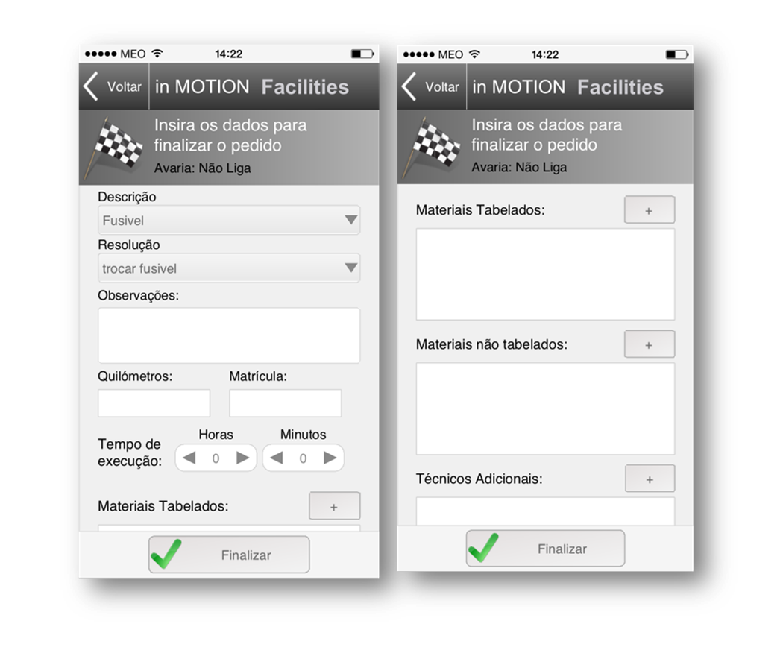
AMEREX In Motion
Technicians life made easy
Calendar with Scheduled Activities
Reach calendar via desktop, tablet or smartphone
Managing Tasks: Start, Pause, Running, Completed
Working Time record; Materials, Spares and Products used
Add other technicians to task
Add and Save distance, vehicle used, transportation costs

Slide 27
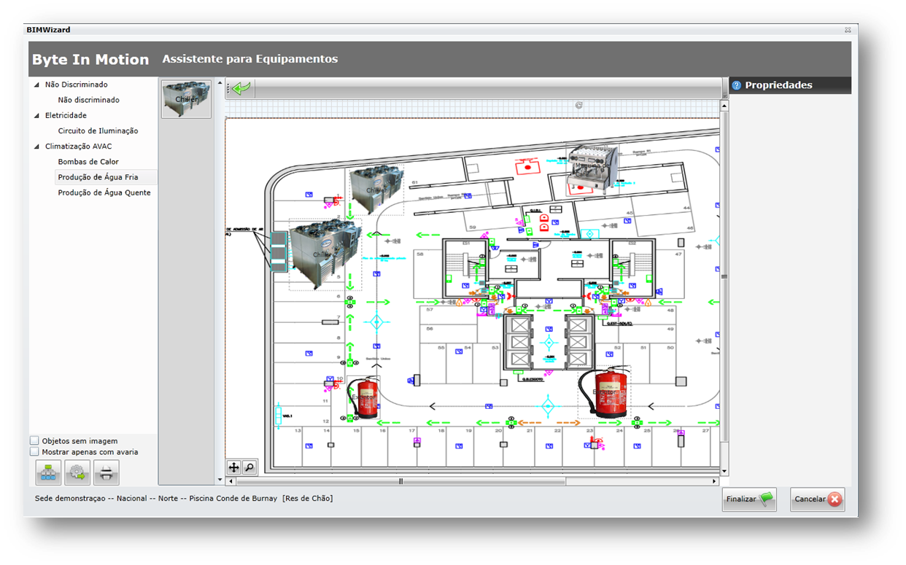
AMEREX In Motion
Main Characteristics
Work Order Management
Preventive Maintenance, with Visual Scheduler
Assets records
Warehouse management (Spares, Materials, etc.)
Suppliers and Outsourcing Management allowing them to be inside the management platform
Pre-set Tables

Slide 28
AMEREX In Motion
Main Characteristics (cont)
Equipment Management
Assets registration linked with Manuals, Catalogues, Pictures, Drawings, H&S rules, etc.
Email , SMS and Post Notifications to all stakeholders
Cloud computing
Logins configuration to different access level
Organisation Design

Slide 29
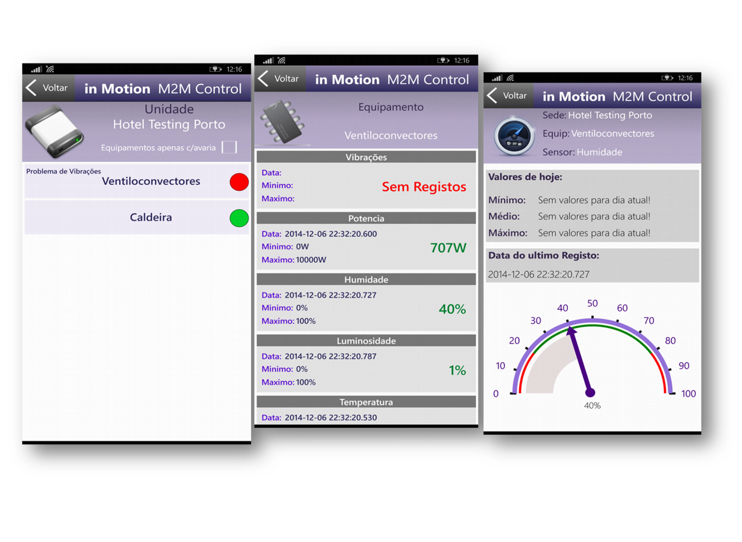
AMEREX In Motion
Mobile Apps
Manager and Technician Login
Login for Building users
Create and Manage Work Orders
GPS maps Service Orders location
NFC tags programming and reading
QR Code Reading
M2M Mobile (remote sensors readings and data registration)
Android, IOS and Windows Phone versions available

Slide 30
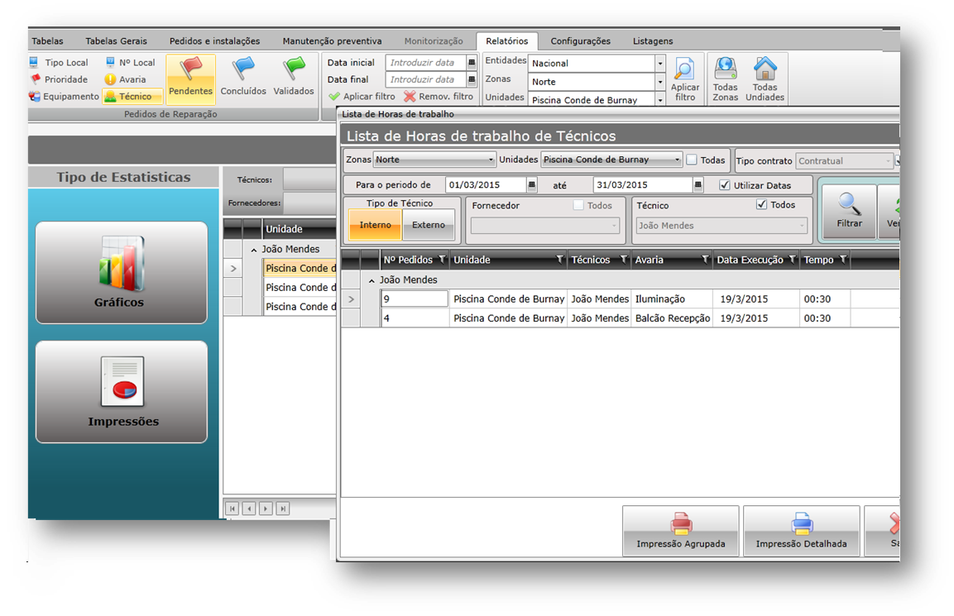
AMEREX In Motion
Safety and Training
Inspections Module
Audits Module
Training Scheduling Module
Reports and Analysis
Dashboard
Reports
“Tailor Made reports”
Graphical Analysis

Slide 31
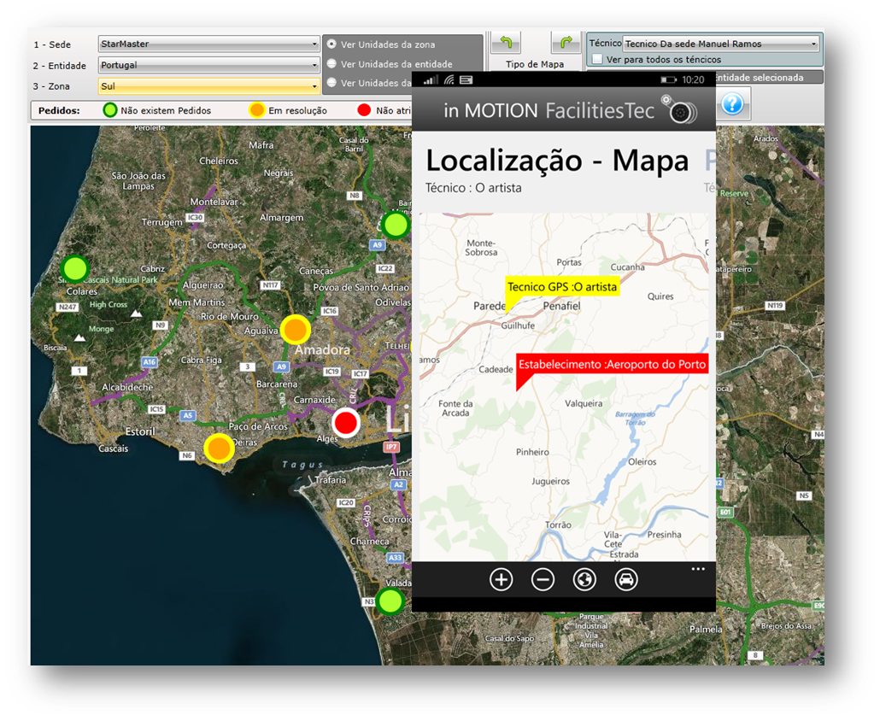
AMEREX In Motion
In Development
Visualising Work Orders with GPS coordinates, Bing, OpenStreet and Google maps
GPS Technicians location
Local Client server can be used (non cloud)
Api’s development for full Integration with ERPS
Integration with ERP’s and other software's and Data Base being used in different processes

Slide 32
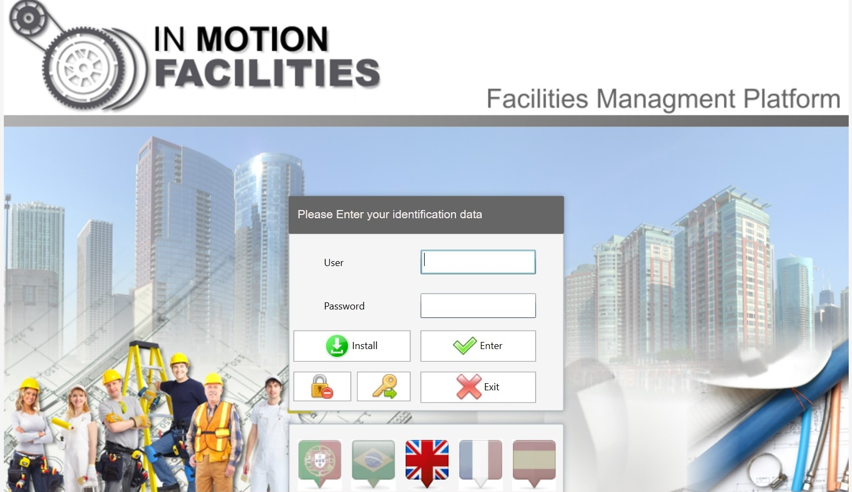
AMEREX In Motion

